Slide 1
The Opioid Epidemic

Slide 2
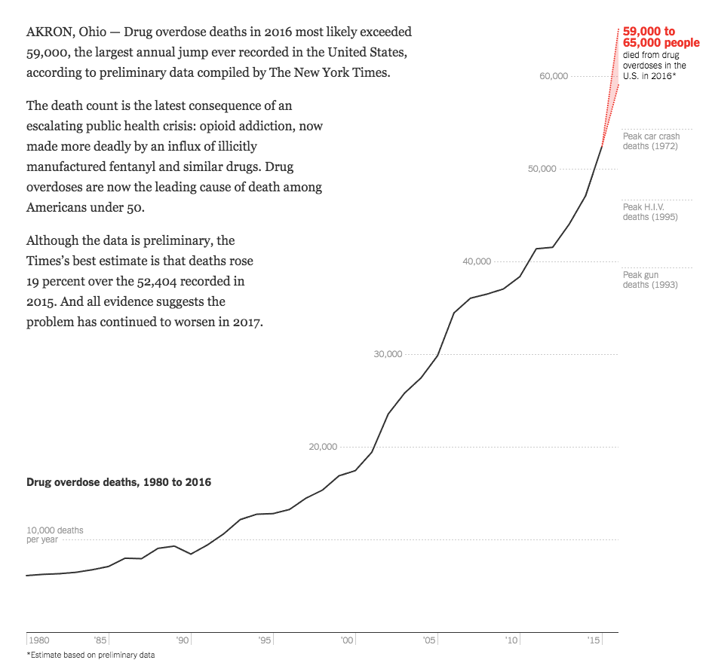
The Opioid Epidemic in America
Source: The New York Times

Slide 3
Additional Toll on System
Source: Colorado Consortium for Prescription Drug Abuse Prevention

Slide 4
The Disease of Addiction
ENDORPHINS
DYNORPHINS
DOPAMINE
REWARD SYSTEM MALFUNCTION
USE TO:
GET HIGH
FEEL NORMAL
BRAIN
FAILURE!
NOT FEEL SICK
A MEDICAL DISEASE
DRUG SEEKING IS COMPULSIVE. DIFFICULT TO CONTROL. ADDICTION > CONSEQUENCE. RELAPSING & REMITTING.

Slide 5
The Epidemic in Colorado
Colorado is #12 in the country for misuse and abuse of prescription opioids.
Four out of 10 of Coloradan adults admit to misuse of prescription medication, primarily pain killers.
Colorado death rate from opioid overdose tops the national average.
Roughly two-thirds of overdose deaths are from pharmaceuticals, and one-third are from heroin.
Notes:
http://www.cpr.org/news/story/colorado-drug-overdoses-almost-every-county-and-ahead-national-average
¼ of those do so for recreational purposes
No county that gets lighter
12 of the counties, including Denver have some of the highest rates of drug death in the country

Slide 6
A Call to Action
There is a solution.
In Colorado, there is a coordinated response.
There is something that you can do.
Together we can address the opioid epidemic through the ED!

Slide 7
The Colorado ALTO Project
Guidelines for Opioid Use in the ED

Slide 8
Partners

Slide 9
Background
Need:
CHA hospitals requested support for opioid work
Opportunity:
Pain is the #1 reason for ED visits
Solution:
Colorado ACEP 2017 Opioid Prescribing & Treatment Guidelines first in the nation to promote alternatives to opioids in multiple ED’s

Slide 10
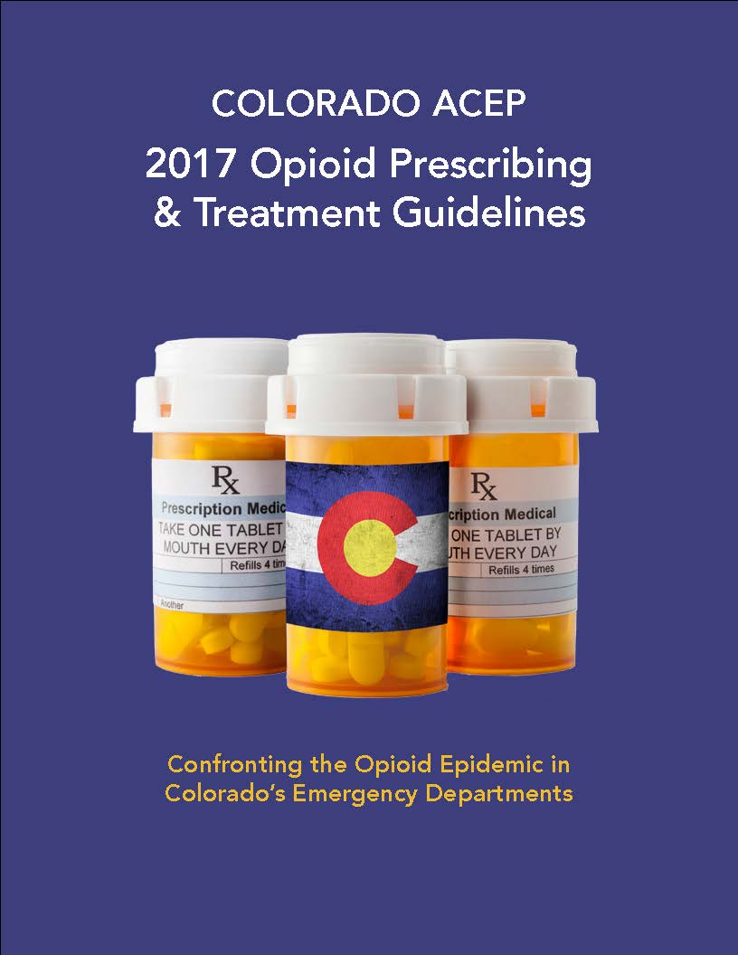
Colorado ACEP Guidelines
Colorado ACEP 2017 Opioid Prescribing & Treatment Guidelines
Guidelines for opioid use in the emergency department
Four Pillars
Limiting opioids from the ED
Alternatives to opioids for painful conditions (ALTOs)
Harm reduction
Treatment for addicted patients and referral

Slide 11
ALTOs – Colorado ACEP Guidance
Non-opioid medications first
Opioids as rescue therapy
Multimodal and holistic pain management
Pathways:
Kidney stones
Low back pain
Fractures
Headache
Chronic abdominal pain

Slide 12
Measures
Opioids Used
ALTOs Used
ED HCAHPS Responses
Total administration (in MEUs)/1,000 ED visits
Total administrations/ 1,000 ED visits
How well was your pain controlled?
Total number of treated pain visits/1,000 ED visits
Total number of treated pain visits/1,000 ED visits
Would you recommend this ED?

Slide 13
Participating ED Characteristics
Annual ED visit range: 4,164 – 59,753 (median = 26,297)
Licensed bed range: 0 – 408
(median = 169)

Slide 14
Overall Results
31%
in ALTO administration
35,000
fewer projected opioid administrations during the pilot than during the baseline period
36%
in opioid administration
Measured in MEUs/1,000 ED visits across all 10 EDs
2017 vs. 2016

Slide 15
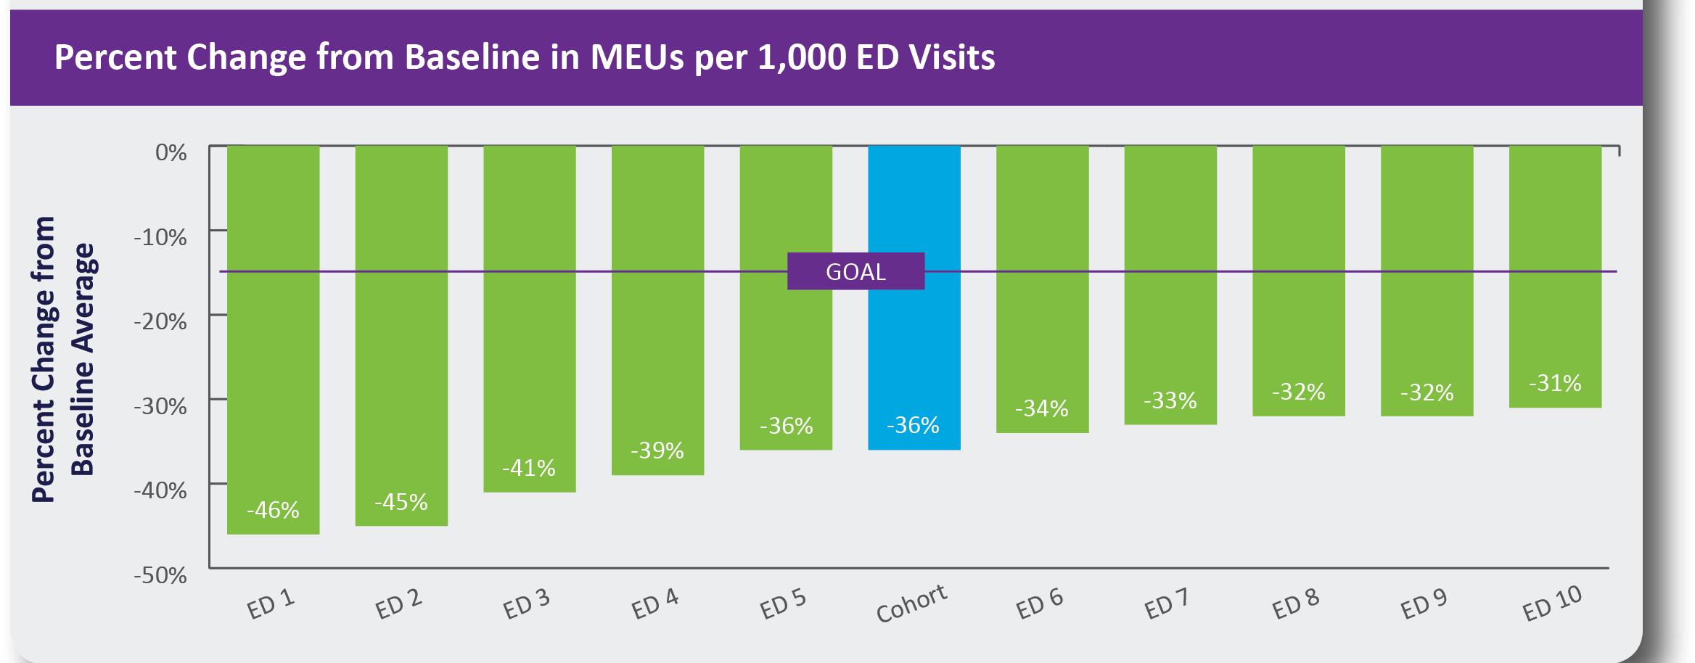
Overall Results – by Site

Slide 16
ALTO vs. Opioid Use Over Time

Slide 17
Change in Medical Administration

Slide 18
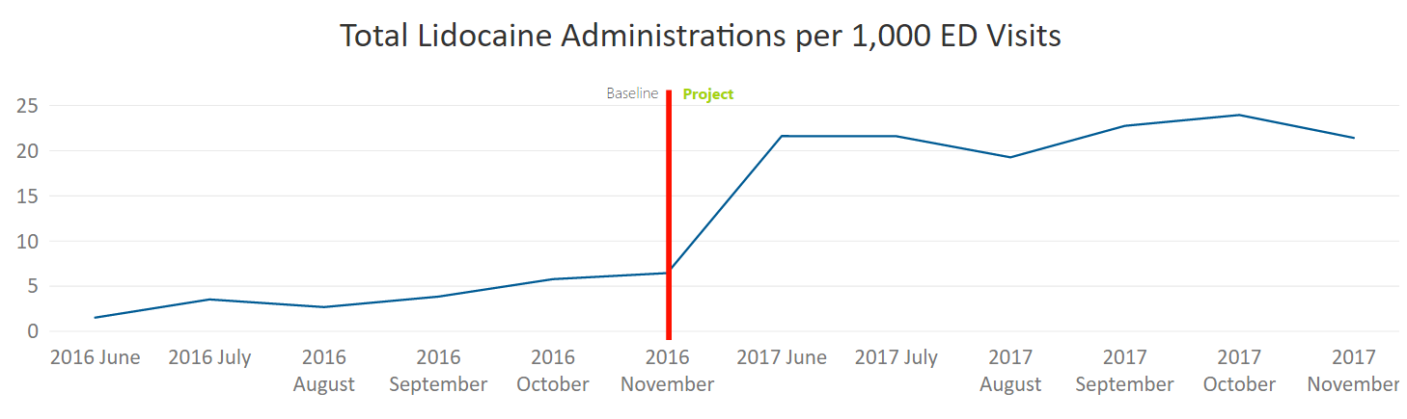
Lidocaine Use

Slide 19
Ketamine Use

Slide 20
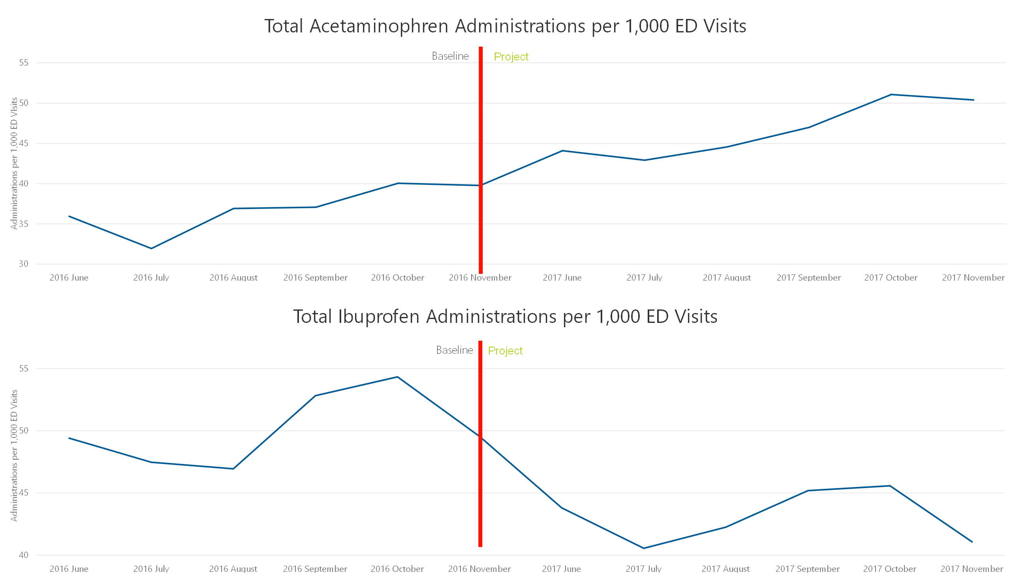
Acetaminophen and Ibuprofen Use

Slide 21
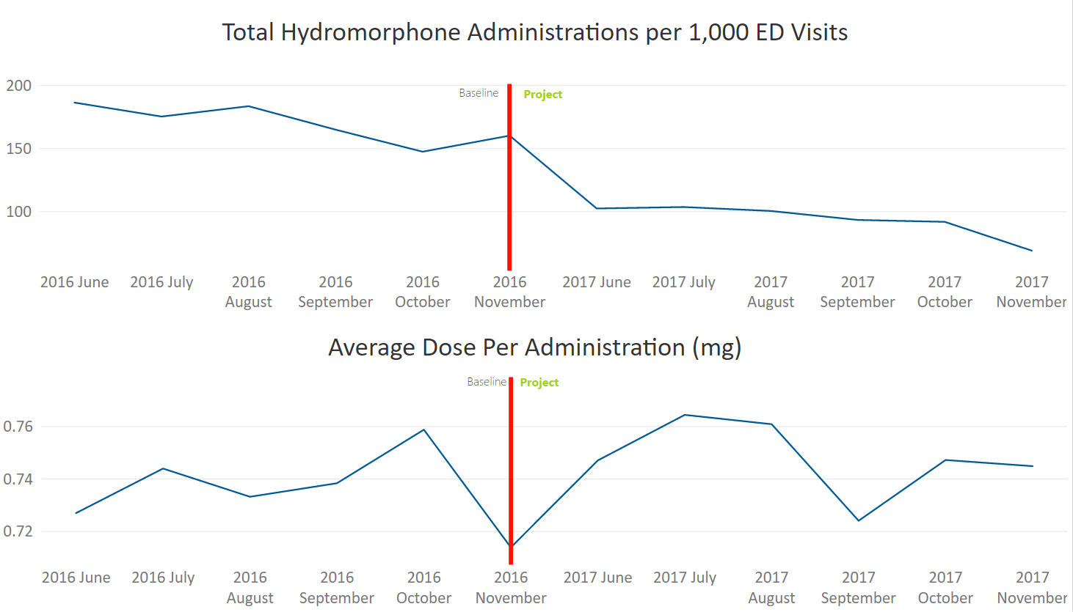
Hydromorphone Use

Slide 22
Total Unique Visits by Diagnosis
ALTO
Opioid

Slide 23
Patient Satisfaction
ED Specific HCAHPS Questions:
How well was your pain controlled?
How likely are you to recommend this ED?
There were no significant differences in HCAHPS scores between the baseline and project period.

Slide 24
Limitations
Small pilot with significant support
No control hospitals
Limited assessment of balancing measures:
ED length of stay
Adverse reactions or outcomes related to ALTO usage

Slide 25
Conclusions
Colorado ACEP 2017 Opioid Prescribing & Treatment Guidelines are effective in reducing opioid usage.
ALTOs for pain in the ED is a feasible and effective strategy.
Significant change to clinician culture regarding pain treatment.
The Colorado Opioid Safety Pilot ED ALTO approach should be disseminated statewide.

Slide 26
Colorado Opioid Safety Pilot Next Steps
Assist pilot hospitals with sustainability plans
Provide support from CHA and Colorado ACEP for Colorado EDs implementing the ALTO approach – goal is statewide adoption
Identify additional venues for implementation (e.g., promote out-of-state adoption)

Slide 27
Colorado ALTO Project
Need:
CHA hospitals requesting support for opioid ALTO work
Opportunity:
Leverage ED pilot ALTO success to hospitals across the state
Solution:
CHA and collaborating partners provide support for Colorado hospitals seeking to implement ALTO approach

Slide 28
Colorado ALTO Project
Step One – Pre-Launch Phase
Executive Team Readiness Checklist
Commitment and Attestation Form
Step Two – Training
Train the Trainer session
Staff training and preparation
Step Three – Project Launch
ALTO Launch in the ED
Data submission to CHA
Pre-Launch Checklist

Slide 29
Federal ALTO Work
Potential Funding:
Bi-partisan support for S. 2516/H. 5197 which would provide federal funding for hospitals to implement a ALTO project. Bill sponsors from Colorado, New Jersey and West Virginia following successful work on this important issue.

Slide 30
Resources
www.cha.com/ALTO

Slide 31
You save lives every day … Thank you.

