Slide 1
The Colorado ALTO Project
Guidelines for Opioid Use in the ED

Slide 2
Partners

Slide 3
Background
Need:
CHA hospitals requested support for opioid work
Opportunity:
Pain is the #1 reason for ED visits
Solution:
Colorado ACEP 2017 Opioid Prescribing & Treatment Guidelines first in the nation to promote alternatives to opioids in multiple ED’s

Slide 4
Colorado ACEP Guidelines
Colorado ACEP 2017 Opioid Prescribing & Treatment Guidelines
Guidelines for opioid use in the emergency department
Four Pillars
Limiting opioids from the ED
Alternatives to opioids for painful conditions (ALTOs)
Harm reduction
Treatment for addicted patients and referral

Slide 5
ALTOs – Colorado ACEP Guidance
Non-opioid medications first
Opioids as rescue therapy
Multimodal and holistic pain management
Pathways:
Kidney stones
Low back pain
Fractures
Headache
Chronic abdominal pain

Slide 6
Measures
Opioids Used
ALTOs Used
ED HCAHPS Responses
Total administration (in MEUs)/1,000 ED visits
Total administrations/ 1,000 ED visits
How well was your pain controlled?
Total number of treated pain visits/1,000 ED visits
Total number of treated pain visits/1,000 ED visits
Would you recommend this ED?

Slide 7
Participating ED Characteristics
Annual ED visit range: 4,164 – 59,753 (median = 26,297)
Licensed bed range: 0 – 408
(median = 169)

Slide 8
Overall Results
31%
in ALTO administration
35,000
fewer projected opioid administrations during the pilot than during the baseline period
36%
in opioid administration
Measured in MEUs/1,000 ED visits across all 10 EDs
2017 vs. 2016

Slide 9
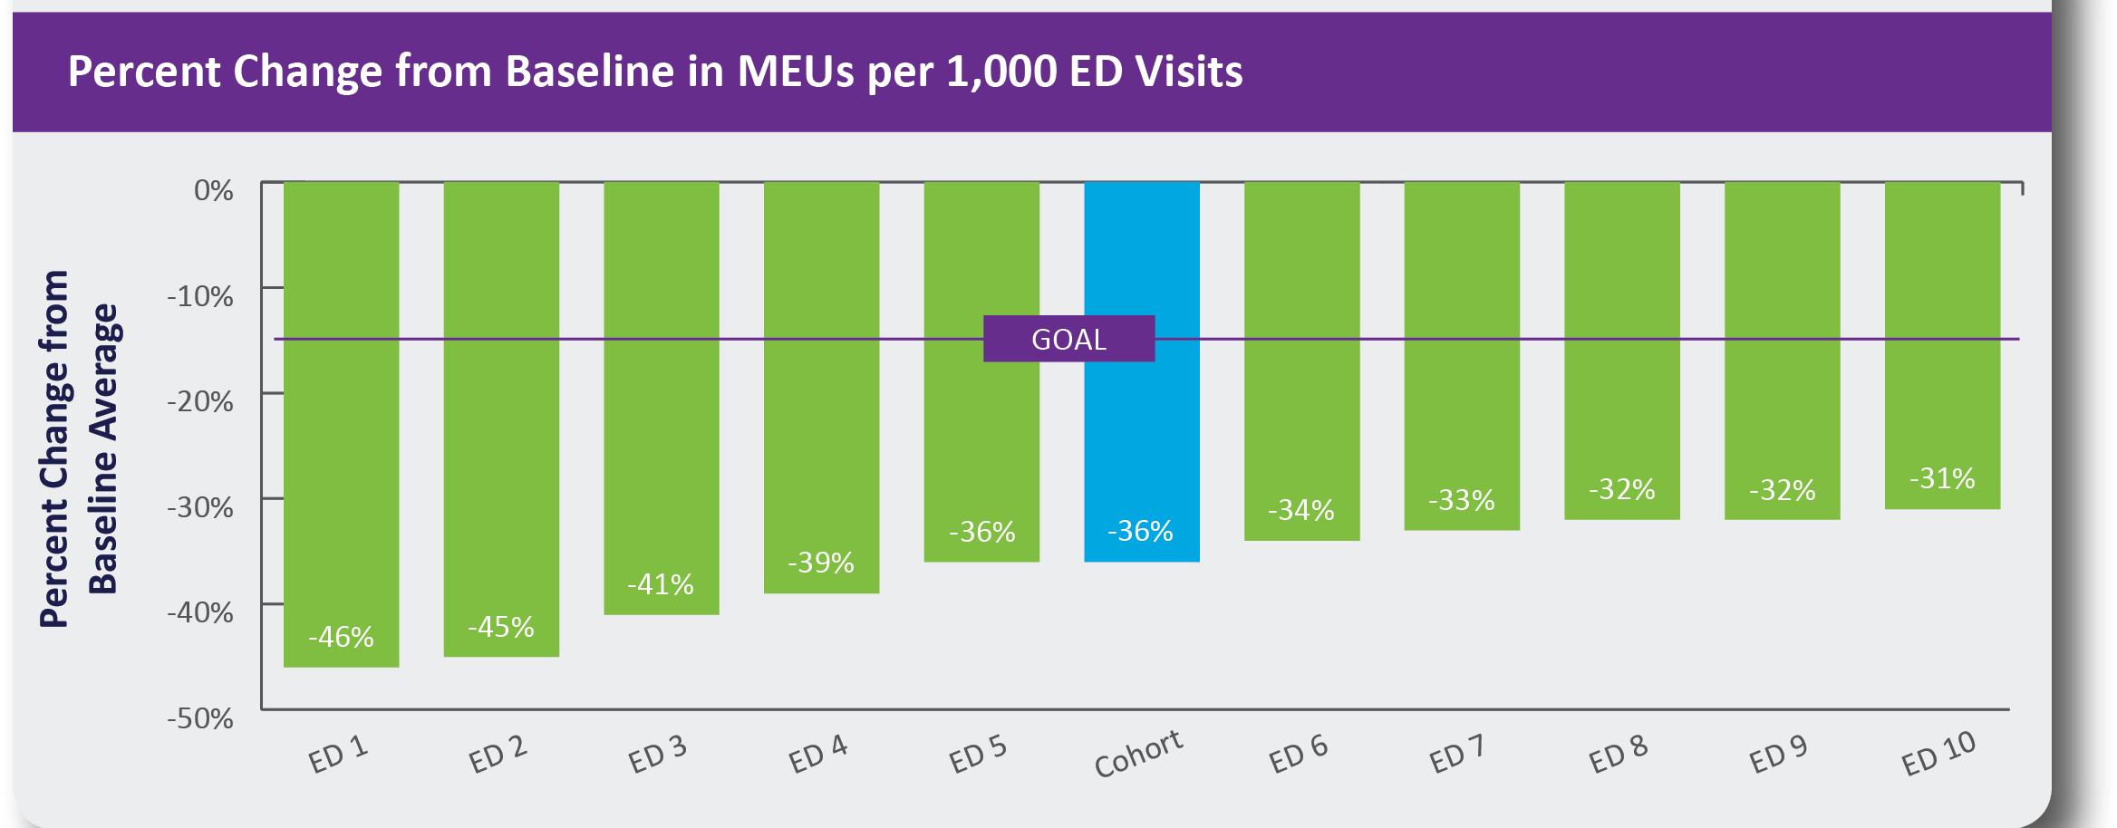
Overall Results – by Site

Slide 10
ALTO vs. Opioid Use Over Time

Slide 11
Patient Satisfaction
ED Specific HCAHPS Questions:
How well was your pain controlled?
How likely are you to recommend this ED?
There were no significant differences in HCAHPS scores between the baseline and project period.

Slide 12
Conclusions
Colorado ACEP 2017 Opioid Prescribing & Treatment Guidelines are effective in reducing opioid usage.
ALTOs for pain in the ED is a feasible and effective strategy.
Significant change to clinician culture regarding pain treatment.
The Colorado Opioid Safety Pilot ED ALTO approach should be disseminated statewide.

Slide 13
Colorado Opioid Safety Pilot Next Steps
Assist pilot hospitals with sustainability plans
Provide support from CHA and Colorado ACEP for Colorado EDs implementing the ALTO approach – goal is statewide adoption
Identify additional venues for implementation (e.g., promote out-of-state adoption)

Slide 14
Colorado ALTO Project
Need:
CHA hospitals requesting support for opioid ALTO work
Opportunity:
Leverage ED pilot ALTO success to hospitals across the state
Solution:
CHA and collaborating partners provide support for Colorado hospitals seeking to implement ALTO approach

Slide 15
Federal ALTO Work
Potential Funding:
Bipartisan support for S. 2516 and HR 5197, which would provide federal funding for hospitals to implement an ALTO project. Bill sponsors from Colorado and New Jersey, following successful work in both states on this important issue, brought the idea forward.

Slide 16
Resources
www.cha.com/ALTO

Slide 17
You save lives every day … Thank you.

