Slide 1
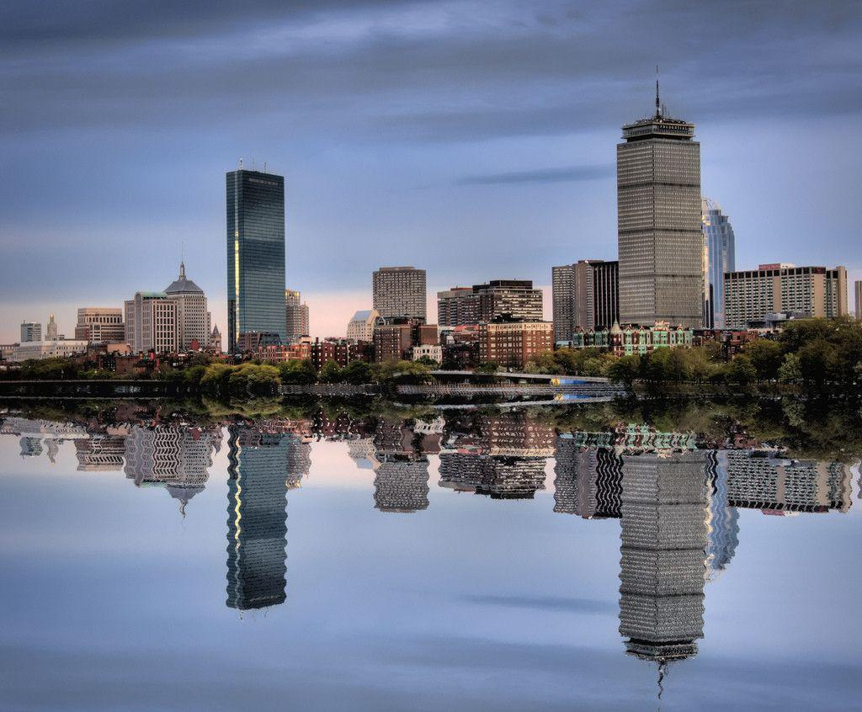
Save the Date
2019 A2Q Fall Meeting
October 27-29
Boston Loews Hotel
Boston, MA
www.loewshotels.com/boston-hotel
For questions, contact:
pnoga@mhalink.org
Registration details and agenda will be available soon.
Hosted by

