Slide 1
Welcome!
Allied Association Quality
Fall 2018 Meeting
Oct. 3-5
Denver, Colorado

Slide 2
Administration
Agenda
Round Robin Project Discussion
Break
Round Robin continued
6:30 p.m. Dinner
Invoices: Proportional base + evening events (if chosen)
History
Tonight's dinner Venice Ristorante
Tomorrow’s dinner & event: Oxford & Haunted/Historical Walk
John Savage Cell: 720.295.7187
Happy 127th Birthday
Notes:
Welcome to our Fall meeting.
Thank you for coming, I hope travels went well. I sincerely appreciate you being here and know that we have worked hard to support you.
We are here for you…Gold badges
For those coming from sea level, remember to hydrate…this is not an idol warning. You are at 5200 feet, the beginning of ‘high altitude’ . Hydrate, you are at 5000 feet. The symptoms of altitude sickness can feel like a hangover – dizziness, headache, muscle aches, nausea. So we recommend lots of water and alcohol only in moderation
Regarding the Dinners & Evening events: back of badge indicates what we are expecting. If you plan to join us for an evening event and it isn’t reflected on the back of your badge, please see Barb in the back of the room so we can assure you are accommodated.
Tonight we have a great dinner just across the street, some of you may remember it the Venice Ristorante. If you don’t have a check mark on the back for the dinner, please let us know as soon as you can so we can make sure the restaurant is ready for all of us.
That goes as well for tomorrow night. We have a dinner option here in the hotel, and then a walking haunted/historical tour of the area. You can do either or both…just let Barb know if what you want to do isn’t reflected on the back of your name badge. That tour will be fun, led by Dr. Goodstein….an eccentric PHD historian who literally wrote the book on Denver (or actually the books, over 30 of them). I was on a test walking tour with him and another walking tour came down the street…using one of his guidebooks.
Put my phone number down somewhere. If you have an issue, text me. If you need support to get to a pharmacy or hospital, we have world class options for you. Really if you need anything, let me know.
I’ve asked the hotel to come in and ensure you know what services they offer. Today is a special day, it’s their 127th birthday.

Slide 3
Round Robin Project Discussion
Patrice Mayo
Rosemary Blackman

Slide 4
Networking
And
Refreshment Break

Slide 5
Round Robin Project Discussion
Patrice Mayo
Rosemary Blackman

Slide 6
Administrative Wrap-Up
Dinner: 6:30 p.m., Venice Ristorante (across the street)
RSVP at registration not necessary
Check in with team
Tomorrow start:
Breakfast 7:30-8:00 a.m.
CHA President’s Welcome 8:00 a.m.

Slide 7
Welcome – Day 2
Topics:
AHA Regulatory Update
NQIIC
Lunch today in the Sage room
Hospital Violence
Social Determinants
HRO
Sepsis
Evening:
Dinner - Oxford Buffet 6:00 p.m.
Historical/Haunted Walk 7:00 p.m.
Guided by noted Denver eccentric, historian and author: Dr. Phil Goodstein

Slide 8
President’s Welcome

Slide 9
AHA Regulatory Update
Nancy Foster, American Hospital Association

Slide 10
Federal Regulatory Update
October 2018
Nancy Foster, Vice President, Quality Policy
Diane Jones, Director, Policy

Slide 11
Agenda
Washington Update
Burden Reduction rule
FY Final and CY Proposed Rule Recaps
Health IT
CAHPS
Accrediting Organizations
Behavioral Health
Opioids
Rural Hospitals
Looking Ahead

Slide 12
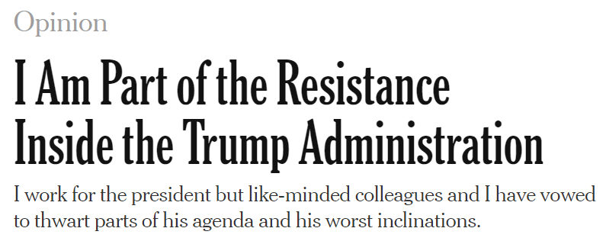
Welcome to the Nation’s Capital
Summer’s over, and things are back to bonkers. Here’s the view from Crazytown, D.C.
- September 5, 2018
Notes:
Just to give you an idea of what life is like back in DC…
Personally, I would have inserted a photo of Robert Mueller…directly above the Bob Woodward book cover

Slide 13
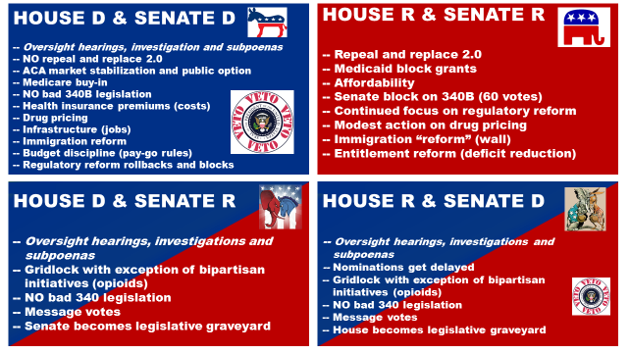
2018 Election: Predictions
Notes:
This slide outlines some possible policy scenarios, depending on which party controls the House and the Senate. The takeaway from this slide is that there is only one scenario in which a new effort to repeal and/or replace the ACA will be on the congressional agenda, and only one scenario where several health care topics will be on the agenda.
The Republican challenge of holding onto their tenuous House majority seems unrelenting; something could happen to alter the apparent trajectory of this election, but right now it seems headed for Democratic gains of between 20 and 40 seats, most likely more than the 23 necessary to tip control.
In the Senate, meanwhile, we don’t even know the direction of any shift that will take place. With about 14 seats in play, 10 held by Democrats, four by Republicans, the uncertainty could not be much greater.
In a president’s first term, the party in power typically loses seats, especially when a president’s approval rating is languishing. The president’s job-approval rating is into the low 40s. Will there be persuadable voters who backed Trump —as a balance to an expected Clinton victory, perhaps—who will cast their ballot for Democratic candidates simply as a check on Republican control of government. We shall see in on November 6.

Slide 14
2018 Election: Predictions
Forecast Calls for Legislative Paralysis in the Next Congress
- August 20, 2018
“Every midterm-election scenario suggests there will be a House-Senate split and/or narrow majorities in both chambers.”
“Governing costs money, and with soaring budget deficits and the federal debt looking increasingly ominous, spending money, whether in the form of appropriations or more tax cuts, will be very difficult, further dimming the chances for real legislative results.”
Notes:
Looking to local favorite Charlie Cook for some predictions, you can see that the major concern in the midterms is money. In years past that often meant tax reform or defense spending, but considering the historic proportion of spending that’s going toward health care, that means we’re not totally out of focus.
In order to increase their odds of success, the House is on recess until after the election. Senator McConnell is keeping the Senate in session in October.
The lame duck schedule could consist of a couple weeks in November and a couple in December. It will be necessary. Congress passed and the President signed on Sept 28 an appropriations bill that funds the Department of Health and Human Services, Education, Labor and Defense. However that bill includes a continuing resolution funding many departments and agencies until December 7. Departments impacted by a potential government shut down in December include Departments of Homeland Security, Justice, Agriculture, Commerce, Transportation, State .
Departments and agencies with full year budgets signed prior to Sept. 28 include Departments of Veterans Affairs, Energy and water projects (Army Corps of Engineers), as well as the Legislative Branch and military construction.

Slide 15
Individual Market Developments
Expanded access to association health plans
11 states and DC suing the Administration over this rule
Expanded availability of short-term, limited-duration health plans
Consumers will now be able to renew short-term coverage for up to three years
States retain authority to regulate (and even ban) these plans
Decreased funding for the navigator program for the second year
Texas lawsuit against the ACA continues
A coalition of state attorneys general are defending the law
Amicus brief filed by AHA and other national hospital associations
Notes:
The Administration expanded access to association health plans (group health plans that employer groups and associations can join together to offer; new rules allow members to join based on geography alone OR by business/professional interests)
11 states and DC are suing the Administration over this rule, as it allows flexibility in covering essential health benefits
Shared regulatory authority between states and federal government; exact state role under discussion with the Labor Department
Administration expanded availability of short-term, limited-duration health plans (extends maximum duration of short-term plans from 3 months to 12; plans to do not have to comply with ACA rules)
Consumers will now be able to renew short-term coverage for up to three years
States retain authority to regulate (and even ban) these plans
Administration decreased funding for the marketplace navigator program for the second year; the program was created by the ACA to provide outreach, education, and enrollment assistance for marketplace and Medicaid coverage
Justified reduction in funding because they say public awareness of health insurance options in marketplaces has grown
Will also require navigators to promote short-term plans during 2019 open enrollment
Texas lawsuit to end the ACA continues; state argues that ACA is no longer constitutional after Congress repealed the individual mandate.
A coalition of state attorneys general is defending the law, including the community rating and pre-existing condition protections; AHA and other national hospital associations filed an amicus brief in support of the ACA

Slide 16
Progress on Regulatory Relief
Reg Relief Ask | Status: Dec. 2016 | Status: Dec. 2017 | Status: Sept. 2018
Stark Exception for Value-Based Payment Arrangements
Readmission Adjustment for SES
Hospital-based Physician Reporting in MIPS
Employ Risk Adjustment Rigorously, including SES Adjustment in MIPs
Align Hospitals and Physician EHR Reporting Requirements for MIPS with Hospital Requirements for MU
Increase the Number of Alternative Payment Models that Qualify under MACRA
Use Only Measure that Truly Matter
Flexibility for Shared Treatment Space to Address Gaps in Patient Access to Care
Cancel Stage 3 of the "Meaningful Use" Program
Clarify Medicaid Payment Policies Regarding Justice-involved Individuals Receiving Inpatient Care
Delay Payment Impact and Reduce Burden of Appropriate Use Criteria (AUC)
Eliminate Regulatory Barriers for and Alternative Payment Models (APMs)
Eliminate Second Important Message from Medicare
Eliminate the Observation Hours Carve-out Policy
End Onerous Home Health Ageny Pre-claim Review Demonstration
Examine IRF '60% Rule'
Halt use of Encounter Data to Formulate MA Risk Scores
Improve Consistency and Accuracy of IRF 'Three-hour Rule' Enforement
Issue a Permanent Enforcement Mortorium on Direct Supervision Requirements
Issue a Permanent Enforcement Mortorium on the '96-hour' Rule
Make Future Bundled Payment Programs Voluntary
Modify CoPs to Allow Hospitals to Recommend Post-acute Care Providers
Permanently Eliminate Unfair Long-term Care Hospital (LTCH) Regulation
Postpone and Re-evaluate Post-acute Care Quality Measure Requirements
Preserve Medicaid Supplemental Payments in Managed Care
Promote Transparency/Timeliness for Development and Release of Interpretive Guidance
Reduce Burden Associated with Validation Surveys
Remove Faulty Hospital Quality Measures
Remove the Mandatory Free-text Field from the Medicare Outpatient Observation
Require Formal Reciprocity Arrangements for Medicaid Provider Enrollment and Screening
Rescind "JW Modifier" Requirement for Certain Drug Claims
Restore Compliant Codes for Inpatient Rehabilitation Facility (IRF) 60% Rule
Revise the RAC Contracts to Incorporate a Financial Penalty for Poor Performance
Stop Federal Agency Intrusion in Private-sector Acreditation Standards
Suspend Electronic Clinical Quality Meansures (eCQM) Reporting Requirements
Suspend Hospital Star Ratings
Undo Agency Over-reach on So-called "Information Blocking"
Withdraw Final rule on Medicaid DSH Third-Party Payments
Withdraw Proposed Mandatory Part B Drug Demonstration
Expand Medicare Coverage of Telehealth Services
2018 Movement on:
Stark exception for VBP arrangements
Elimination of 25% rule
Removing faulty hospital quality measures
Aligning physician and hospital EHR reporting requirements with greater flexibility
Allowing treating providers to access patients’ substance abuse disorder treatment records (Congressional)

Slide 17
Reducing Burden: Potential Progress
CMS RFI on Stark and HHS OIG RFI on Anti-Kickback Statute (AKS)
Stark RFI released June 25; comment period closed Aug. 24
AKS RFI released Aug. 24; comments due Oct. 26
CMS forthcoming guidance
Ligature risk
Co-location
EMTALA issues
Notes:
WE WILL DISCUSS CO-LOCATION AND EMTALA ISSUES IN A COUPLE OF SLIDES but they are referenced here
RFIs
Stark – physician self-referral law – AHA submitted comments
AKS – AHA will be submitting comments.
On September 17, 2018 CMS released a proposed rule intended to reform certain Medicare regulations that it identified as unnecessary, obsolete, or excessively burdensome on a subset of health care providers and suppliers. These are religious non-medical health care institutions, ambulatory surgical centers (ASCs), hospice, hospitals, transplant centers, home health agencies (HHAs), comprehensive outpatient rehabilitation facilities (CORFs), critical access hospitals (CAHs), community mental health centers, portable X-ray services, rural health clinics (RHCs) and federally qualified health centers (FQHCs). Also addressed are regulations involving emergency preparedness of providers and suppliers. The rule was published in the Federal Register on September 20th, and the deadline for public comment is November 19, 2018.

Slide 18
Calendar Year (CY) Proposed Rules
Burden Reduction
Outpatient/ASC
Home Health
Medicare Shared Savings Program
Fiscal Year (CY) Final Rules
Inpatient
Physician Fee Schedule (PFS)/MACRA Quality Payment Program
Inpatient Psychiatric Facility
Post-acute Care
Inpatient Psych
Long-term Care Hospitals
Skilled Nursing Facilities
Notes:
We’ll do a high-level overview of the issues in the calendar year proposed rules and fiscal year final rules, knowing that you’ve heard updates from us on these already. However, I want to start with the Burden Reduction rule.

Slide 19
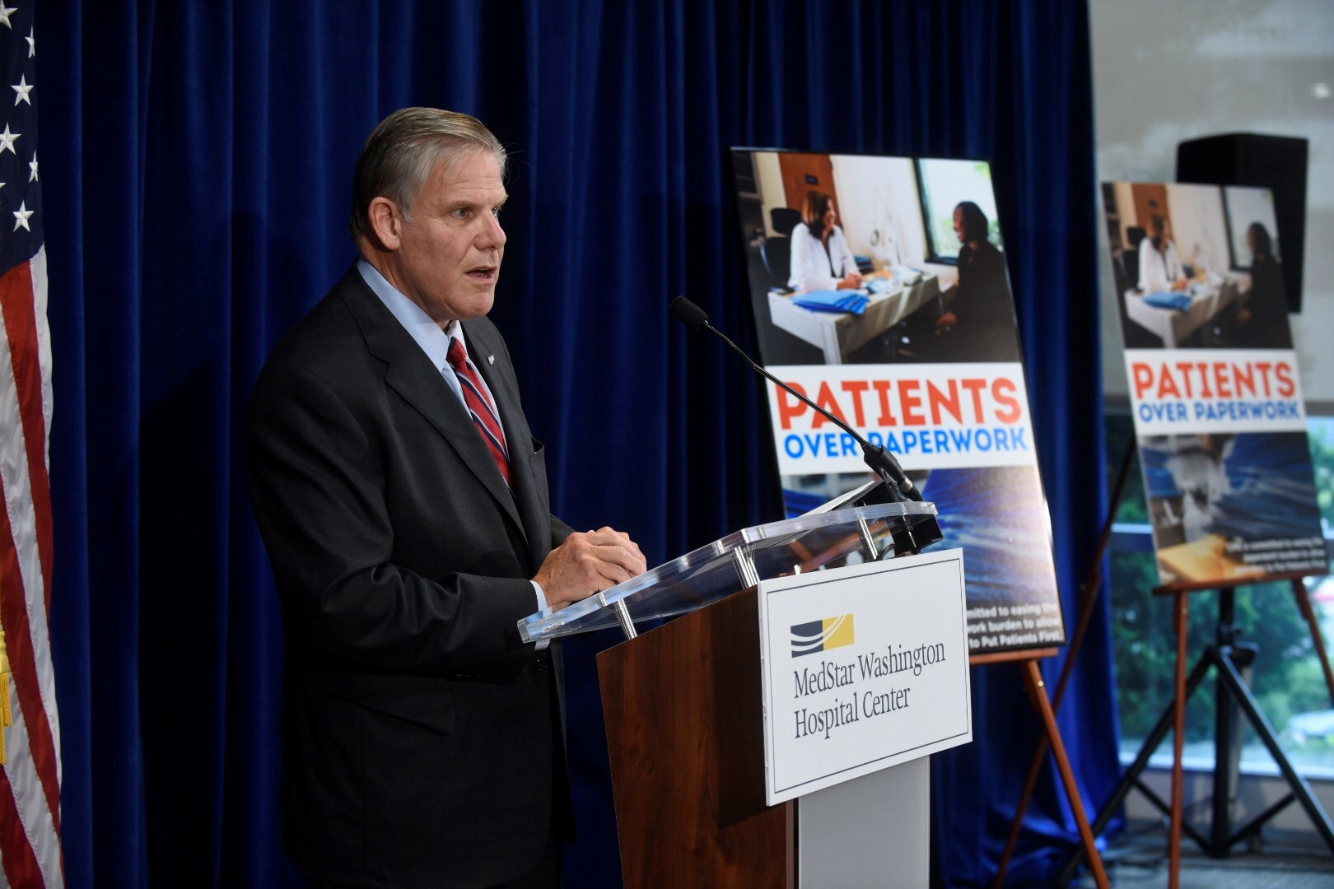
Reducing Burden: Proposals & Progress
Comments Due November 19
Omnibus CMS Proposed Rule Released September 17
Increase organs for transplantation
System approach to quality/ safety
Flexibility on emergency preparedness training & CAH review of policies
Greater flexibility on pre-op assessments
Eliminate ASC requirements to have agreements with hospitals in case something goes wrong
Notes:
TOSS TO NANCY FOR SLIDES 10-12, 13-18. DISCUSSION to occur on this slide (10)
On September 17, CMS released its Omnibus Burden Reduction Rule.
The proposed rule affects hospitals, critical access hospitals, psychiatric hospitals, ambulatory care clinics, ambulatory surgical centers, hospice providers and more.
CMS estimated the savings at $1/1 billion per year and asked AHA to join in a press event that both released the proposed rule and celebrated efforts to date to reduce burden. Rick Pollack joined CMS administrator, Seems Verma, for the event. (IN REGION 3, note that the event was at the Washington Hospital Center and the other person pictured is Dr. Greg Argyros (R-ger ROSS), President and CEO of WHC and formerly in charge of Walter Reed Medical Center.)
Key proposed provisions include:
Changing the way CMS uses metrics to assess transplant centers and determine if they will be re-certified to continue transplantation. (many had complained that the metrics of survival rates led the surgeons to not use some viable organs)
Allowing multihospital systems to take a unified approach to quality assessment and infection control
Providing greater flexibility in how hospitals conduct emergency preparedness training
Allowing CAHS to review their policies and procedures once every two years instead of annually
Allowing medical staffs to specify what types of pre-op/ pre-procedure assessments need to be done
Eliminating the requirement that ASCs have agreements with hospitals to treat patients when something goes wrong; no longer requiring ASC surgeons to maintain privileges at a hospital.
AHA is soliciting clinical and other input and will be submitting comments

Slide 20
CMS’s Meaningful Measures Initiative
Notes:
Moving on to the payment rules, much of the activity related to quality stemmed from CMS’s Meaningful Measures Initiative.

Slide 21
Progress on “Measures that Matter”
AHA influenced CMS’s “Meaningful Measures”
16 out of 19 CMS meaningful measure areas align with AHA measure priority list (other 3 reflect AHA cross-org priorities)
FY / CY 2019 CMS policies by the numbers:
29 percent reduction in inpatient hospital measures
28 percent reduction in inpatient psychiatric measures
55 percent reduction in outpatient hospital measures (proposed)
34 measures removed from MIPS (proposed)
10 measures removed from various post-acute care programs (final)
AHA-facilitated collaborative effort for public / private measure alignment underway
Notes:
We have made important progress on urging CMS to streamline and focus its quality measurement and value programs around “measures that matter.”
CMS calls its quality burden reduction framework “meaningful measures.” CMS’s measure priority topics align very closely with those the AHA developed with the input of councils and RPBs back in 2016. In fact, 16 out of 19 topics align with ours. And the remaining 3 (e.g., health equity, community engagement) reflect AHA cross-organizational priorities. CMS officials told us when Meaningful Measures launched that they made use of our analyses, and hoped we recognized our work in theirs.
Obviously, streamlining measures is a multi-year effort. But CMS has made some significant progress, as demonstrated by its most recent finalized and proposed policies [READ BULLETS ON SLIDE]
We also recognize that CMS programs are the biggest – but not only – driver of measurement burden. That is why we also have been working with the national hospital associations, AHIP and the Blues on a collaborative effort to align public and private measurement efforts. More to come on that in the coming months.

Slide 22
Updates to Measure Removal Factors
Factor 1: Measure performance among providers is so high and unvarying that meaningful distinctions in improvements in performance can no longer be made (measure is “topped out”).
Factor 2: Performance or improvement on a measure does not result in better patient outcomes.
Factor 3: The measure does not align with current clinical guidelines or practice.
Factor 4: A more broadly applicable measure (across settings, populations, or conditions) for the particular topic is available.
Factor 5: A measure that is more proximal in time to desired patient outcomes for the particular topic is available.
Factor 6: A measure that is more strongly associated with desired patient outcomes for the particular topic is available.
Factor 7: Collection or public reporting of a measure leads to negative unintended consequences other than patient harm.
NEW: Factor 8: the costs associated with a measure outweigh the benefit of its continued use in the program.
Notes:
Across the board, CMS proposed a unified set of measure removal factors that the agency uses to consider whether a measure, on a case by case basis, should be retained in a quality reporting program. Each of the QRPs– IP, OP, post-acute, etc.– had its own fairly similar list of removal factors. CMS proposed to use the first seven factors you see there in each of the programs, and to add a new 8th factor: the costs associated with a measure outweigh the benefit of its continued use in the program. When CMS says “Costs,” they mean both the costs to the provider associated with collecting and reporting the data as well as participating in various quality reporting and improvement activities and programs, but also the cost to the agency itself– costs to review and maintain measures and reporting interfaces.
One idea that occurred to use this year is that CMS might consider using a 9th factor when identifying measures that might be removed: loss or lack of NQF endorsement. As you know, NQF conducts regular measure reviews to ensure that specifications are up-to-date in terms of clinical guidelines, validity and reliability, so if NQF removes its endorsement then that’s an indication that the measure doesn’t work for its purpose any more. Of course, just as with any of these other factors, if a measure loses endorsement it wouldn’t automatically be removed from the program– for example, if the measure still addresses an important aspect of care that is otherwise not measured or if removing the measure would result in declines in quality of care.
CMS applies these measure removal factors to the various QRPs, and proposed the removal of several. Starting with the OQR:

Slide 23
OQR: Measures Proposed for Removal
Measure Number | Measure Title | Rationale for Removal
OP-27 | Influenza Vaccination Coverage among Healthcare Personnel | Costs to use NHSN outweigh benefits of measure
OP-5 | Median Time to ECG | Costs outweigh benefits; little variation; NQF endorsement removed
OP-9 | Mammography Follow-up Rates | Not in line with recently updated clinical practices
OP-11 | Thorax Computed Tomography (CT) Use of Contrast Material | Topped out
OP-12 | The Ability for Providers with HIT to Receive Laboratory Data Electronically Directly into Their Qualified/Certified EHR System as Discrete Searchable Data | Does not directly assess quality or patient outcomes; not NQF-endorsed
Notes:
NANCY WILL DO QUICK CLICKS THROUGH SLIDES 14-16
Won’t go into detail on all of these measures unless asked, but you can see that a common theme among these measures for removal is that several of them have lost or never received NQF endorsement. CMS acknowledges in their rationale that the measures are not endorsed, although they don’t directly state that they are removing the measure because of that reason.

Slide 24
Measures Proposed for Removal, cont.
Measure Number | Measure Title | Rationale for Removal
OP-14 | Simultaneous Use of Brain Computed Tomography (CT) and Sinus CT | Topped out
OP-17 | Tracking Clinical Results between Visits | Does not directly assess quality or patient outcomes; NQF endorsement removed
OP-29* | Endoscopy/Polyp Surveillance: Appropriate Follow-up Interval for Normal Colonoscopy in Average Risk Patients | Costs outweigh benefits; measure available in MIPS
OP-30* | Endoscopy/Polyp Surveillance: Colonoscopy Interval for Patients with a History of Adenomatous Polyps-Avoidance of Inappropriate Use | Costs outweigh benefits; measure available in MIPS
OP-31* | Cataracts: Improvement in Patient’s Visual Function within 90 Days Following Cataract Surgery | Costs outweigh benefits; low reporting rates
*Proposed for removal from ASCQR as well
Notes:
I’ll note that there are a few other OQR measures that do not have NQF endorsement but are not proposed for removal in this proposed rule. In our comments, we do suggest that CMS consider the removal of those measures as well.

Slide 25
ASCQR: Measures Proposed for Removal
Measure Number | Measure Title | Rationale for Removal
ASC-8 | Influenza Vaccination Coverage among Healthcare Personnel | Costs to use NHSN outweigh benefits of measure
ASC-1 | Patient Burn | Topped Out; NQF endorsement removed
ASC-2 | Patient Fall | Topped Out; NQF endorsement removed
ASC-3 | Wrong Site, Wrong Side, Wrong Patient, Wrong Procedure, Wrong Implant | Topped Out; NQF endorsement removed
ASC-4 | All-Cause Hospital Transfer/Admission | Topped Out; NQF endorsement removed
Notes:
Overall, CMS proposes to remove 10 measures from the OQR and 8 measures from the ASCQR. And like I said, there are several others that we think should be removed. However, if all of these measures were removed, both QRPs would have very few measures left. You’ll see here in the ASCQR that several safety-related measures are being removed. CMS does raise the question in their rules about future measure topics– if these measures aren’t the right ones, what measures are? One conversation this leads to is whether there are aspects of patient safety, perhaps even beyond HACs, that we should be considering.

Slide 26
HH Proposed Rule: Measures for Removal
Depression Assessment Conducted
Still required for risk adjustment
Diabetic Foot Care and Patient/Caregiver Education
Multifactor Fall Risk Assessment
Improvement of Surgical Wounds
Still required for risk adjustment
ED Use Without Readmission in First 30 Days
Rehospitalization in First 30 Days
Pneumococcal Polysaccharide Vaccine
Topped Out
More applicable measure available
Not in line with clinical guidelines
Notes:
CMS also proposed to remove 7 measures from the home health QRP. Happy to go into detail, but I think one of the takeaways here is from the removal of the ED Use and Rehospitalization measures– both are being removed because there are other measures in the HH QRP that capture the same data and more because they look at a longer time period (in first 60 days). We’re hoping CMS learns some lessons from this measure removal– maybe next time when they add a measure that will capture the same data as an existing measure, they’ll remove that from the outset.

Slide 27
HH VBP: New Composite Measures
Replace Improvement in Bathing, Bed Transferring, and Ambulation-Locomotion measures
Incorporates those OASIS items with 6 others to create two new measures:
Total Normalized Composite Change in Self-Care
Grooming, upper body/lower body dressing, bathing, toileting hygiene, eating
Total Normalized Composite Change in Mobility
Toilet transferring, bed transferring, ambulation/locomotion
Calculates absolute change for each OASIS item at episode level
Normalizes scores; sums normalized scores
Averages scores for all episodes
Risk-adjustment with national and HHA-specific predicted values
HHA Risk-Adjusted Score = HHA Observed + (National Predicted – HHA Predicted)
Notes:
Another interesting development from the HH space is in the VBP pilot. CMS is testing out measures in these limited-scope pilots so they can potentially implement them in larger scale programs later. For HHAs, this might mean measures that are more applicable to their patients. For example, a lot of outcomes measures evaluate how a patient is improving. However, many HH patients are chronically ill or otherwise not really expected to get better. Thus, if a HHA performs poorly on an outcome measure, it might not be due to a failure on the HHA’s part, but rather a reflection of patient characteristics.
Thus, CMS proposed to implement two new composite measures that evaluate stabilization, or lack of decline, rather than improvement. These measures combine several aspects of functional status– generally, self-care and mobility– and instead of measuring improvement over time, will compare absolute change over time. So if a patient starts out less functionally independent– that is, sicker– and doesn’t have high functional scores at the end of the episode, the HHA would not necessarily look like a poor performer.
Of course, these are new measures that haven’t been implemented yet– the rule isn’t final– so we’ll see how it pans out.

Slide 28
MSSP: ACOs – Pathways to Success Rule
Proposed redesign of Medicare Shared Savings Program
New tracks
Differentiated options by ACO characteristics
If finalized, would be harder for “high-revenue” ACOs to achieve savings
Other proposals include less time for upside-only risk, fewer shared savings, and refinements to benchmarking methodology
Notes:
DIANE PICKS UP WITH THIS SLIDE (slide 19) AND CONTINUE TO SLIDE 23 (HOSPITAL VBP)
In mid-August, CMS published a proposed rule to completely redesign the Medicare Shared Savings Programs (MSSP). Among the changes, CMS would discontinue the existing Tracks 1 and 2 and the CMMI Track 1+ model and instead offer a BASIC track and an ENHANCED track. The BASIC track would offer a glide path to risk consisting of 5 levels, two of which would be upside-only risk, but only certain ACOs would be permitted to enter the program at the start of the glide path. The ENHANCED track is designed to replace the existing Track 3.
CMS proposes to differentiate between ACOs based on several characteristics (e.g., previous experience in two-sided risk Medicare ACOs) and to restrict certain ACOs to certain participation options. We are most concerned about CMS’s proposal to differentiate between “high-” and “low-revenue” ACOs. To define low- and high-revenue ACOs, CMS proposes to assess the degree of control an ACO holds over the Medicare expenditures of its assigned beneficiaries. CMS proposes to gauge control by comparing the total Medicare Part A and Part B fee-for-services (FFS) revenue of an ACO’s participants with the total Medicare Part A and Part B FFS expenditures of its assigned beneficiaries. If an ACO’s Medicare Part A and B FFS revenue is 25 percent or more of the Medicare Part A and B FFS expenditures for its assigned beneficiaries, CMS would consider that ACO “high-revenue.” CMS expects that ACOs with hospital participation would fall into the “high-revenue” category. CMS’s proposed participation options for high revenue ACOs will require those ACOs to take on more risk at a faster pace, making it more difficult for them to achieve shared savings.
Other proposed changes include:
Reducing the amount of time ACOs can spend in upside-only risk from a maximum of 6 years to a maximum of 2
Greatly cutting the amount of shared savings that ACOs can achieve
Refining various aspects of the benchmarking methodology.
**Please inform members that we’d love to hear from them if they have thoughts on this rule as comments are not due until Oct. 16.

Slide 29
Where are we on MACRA Quality Payment Program?
2016
2017
2018
2019
1st round of rulemaking
1st Performance Period
2nd Performance Period
Payment Adjustment (based on 2017 data)
2nd round of rulemaking
Submit 2017 data (Mar 31)
Submit 2018 data + 2018 feedback reports
2017 feedback report
Additional rulemaking
Additional rulemaking

Slide 30
2019 QPP Proposals – Key Takeaways
Gradual implementation of MIPS continues
Low-volume threshold still excludes large number of clinicians (590,000)
MIPS opt-in available
Carry over of most 2018 quality reporting requirements
Expansion to new clinician types (PT, OT, social work, psychologists)
Impact of MIPS cost measurement grows
Increased category weight to 15 percent, and new episode-based measures
MIPS Advancing Care Information (ACI) category renamed and revamped
Now “Promoting Interoperability”, with greater alignment with hospital program
CMS staying the course on MIPS facility-based measurement
Available in 2019, with minor proposed expansions
Changes to advanced APM track are quite minor
Excluded clinicians have more time to prepare…but stakes are rising!
Notes:
CHECK THE NOTES CONTENT AS THEY REFERENCE CY2018 PERFORMANCE YEAR AND A “RELEASED RULE ON NOV 2”
On Nov. 2, CMS released the final rule for the CY 2018 performance year of the MACRA’s (so it will affect payment in 2020). We continue to work our way through the details of the 1,600+ page rule now, and released a Special Bulletin on Fri. 11/3. We also have a webinar and full Regulatory Advisory planned. But we do want to highlight a few things:
CMS is continuing a gradual, flexible implementation approach. This is especially evident in two policies:
The increase in the MIPS “low volume threshold”, the amount of Medicare charges and patients below which clinicians don’t have to participate in the QPP. CMS estimates that over 540,000 clinicians will not have to participate in 2018.
Relief from meaningful use. Clinicians would still have a 90-day reporting period in 2018 and 2019, and don’t have to upgrade to the 2015 edition of certified EHRs.
We got a welcome win with a new facility-based measurement option in the MIPS. This will allow for hospital-based clinicians to use their hospital’s VBP performance in the MIPS without having to report separate data. We’ve urged the agency to adopt something like this for a long time. CMS did delay implementation until 2019 to give itself more time to prepare, but still, glad to see it.
CMS’s final policies do give the field more time to prepare. But, the stakes of performance on the MIPS are continuing to rise. As you may recall, the potential upside and downside of the MIPS started at 4 percent in 2019, and rises to a maximum of 9 percent in 2022 and beyond. So by the time more clinicians are added into the program, the stakes will be significantly higher.
That’s why we continue to educate the field about MACRA. Back in September we released a MACRA Decision Guide, and will refresh it once we’ve had the chance to more fully digest the rule. And there’s plenty more on our website – www.aha.org/MACRA

Slide 31
IPPS: Impact of CMS Meaningful Measure Policies
 | IQR | VBP | HAC | HRRP
Number of measures in FY 2019 Program | 62 | 18 | 6 | 6
Number of Measures Removed, FY 2019 – FY 2023 | 39 | 4 | 0 | 0
Number of Measures in FY 2023 | 23 | 14 | 6 | 6
IQR:
18 measures removed from ALL CMS hospital quality reporting and value programs because they are topped out, don’t lead to better quality, or have costs outweighing their benefit
21 measures “de-duplicated” (that is, removed from IQR, but retained for only one CMS hospital program)
VBP
4 measures removed to “de-duplicate” with IQR
CMS did NOT finalize proposal to remove 6 safety measures from VBP
Notes:
THIS IS THE DETAIL FROM THE PRIOR REFERENCES TO MEANINGFUL MEASURES SLIDES 11-12

Slide 32
Hospital VBP
Funded by reducing base inpatient PPS operating payments by 2.0 percent to create incentive pool -- $1.9 billion for FY 2019
Budget neutral – all funds must go back to hospitals (not a lever for Medicare savings)
“De-Duplication” of four measures
Remove PC-01 (Early Elective Deliveries)
PC-01 retained in IQR
Remove 3 condition-specific payment measures from VBP (retained in IQR)
CMS retains safety measures (PSI and infection measures), and will not change domain weights
AHA remains concerned by use of these measures in both VBP and HAC Reduction programs (i.e., potential for double penalties and misaligned performance incentives)
Notes:
4 measures to be de-duplicated
VBP measure weights to be revised based on measure removals:
Safety domain removed
Clinical outcomes domain now 50%
Other domains unchanged

Slide 33
Hospital Readmissions Reduction Program
Hospital Readmissions Reduction Program
Program began in FY 2013 (Oct. 1, 2012)
Hospitals with “excess” readmissions have their base inpatient Medicare payments reduced by:
1 percent in FY 2013
2 percent in FY 2014
3 percent in FY 2015 and beyond
Uses 30-day readmissions measures for a total of six conditions:
FY 2013: AMI, HF, PN
FY 2015: Elective hip/knee, COPD
FY 2017: CABG
Notes:
NANCY COVERS READMISSIONS SLIDES 24-26

Slide 34
Hospital Readmissions Reduction Program
FY 2019 Performance Period
Jul. 1, 2014 – Jun. 30, 2017
Socioeconomic adjustment will start with FY 2019 penalties
Mandated by 21st Century Cures Act of 2016
Statutory Requirements:
“Transitional adjustment” (FYs 2019 and 2020) in which hospitals assessed relative to other hospitals with similar proportions of dual eligible patients
CMS may implement different approach in future
Budget neutral (that is, aggregate penalties must be same as non-SES adjusted approach)

Slide 35
Readmissions Socioeconomic Adjustment
Calculate measure performance (i.e., excess readmission ratios) for all hospitals
Place hospitals into five peer groups (quintiles) based on proportion of dual eligible patients
Includes dual-eligible Medicare FFS & Medicare Advantage
Calculate median excess readmission ratio for each measure in each quintile
Calculate each hospital’s performance versus the quintile median and apply budget neutrality modifier

Slide 36
HAC Reduction Program
Beginning in FY 2015, 1-percent reduction to total inpatient PPS payments for hospitals in worst-performing quartile of HAC rates
HAC Measures:
Patient Safety Indicator 90 (claims-based)
Healthcare-Associated Infections (HAIs)
CAUTI
CLABSI
Surgical Site Infection
MRSA
C Difficile
Notes:
BACK TO DIANE FOR HACs SLIDES 27-30
No proposed measure removals or additions
HAC scoring methodology changes:
Measure domains eliminated
Equal weighting to all six performance measures
Remainder unchanged

Slide 37
HACs: Current Scoring Approach
A hospital’s Total HAC Score determines its performance…
1. Score each individual HAC measure (Winsorized z-score)
2. Calculate domain scores (85% HAI measures, 15% PSI)
3. Calculate the Total HAC Score
…hospitals with Total HAC Scores in highest (i.e., worst performing) quartile receive penalty

Slide 38
HACs: New Scoring Approach (Starting FY 2020)
A hospital’s Total HAC Score determines its performance…
1. Score each individual HAC measure (Winsorized z-score)
2. Sum individual measure scores (all weighted equally) to create Total HAC Score
…hospitals with Total HAC Scores in highest (i.e., worst performing) quartile receive penalty
© American Hospital Association
38

Slide 39
Inpatient Psych Quality Reporting Program: FY2020
Removal Finalized
Not Removed
Influenza Vaccination Coverage Among Healthcare Personnel
Requires registration with NHSN, not used for any other purpose by IPFs
Alcohol Use Screening (SUB-1)
Routinely high performance; moving away from chart-abstracted measures
Tobacco Use Screening (TOB-1)
Topped out
Use of an Electronic Health Record
Structural measure; not tied to improved patient outcomes
Static performance over past 2 program years
Assessment of Patient Experience of Care
Structural measure; not tied to improved patient outcomes
Originally intended as information gathering tool for future measures
Tobacco Use Treatment Provided or Offered at Discharge/Tobacco Use Treatment at Discharge (TOB-3/3a)
Hours of Physical Restraint Use (HBIPS-2)
Hours of Seclusion Use (HBIPS-3)
Notes:
NANCY TO COVER SLIDES 30-31
Onto inpatient psych- CMS proposed to remove 8 measures from the quality reporting program, but citing overwhelming public concern declined to remove three of those 8. Those three were related to use of controversial and often unsafe patient interventions, restraint and seclusion, and tobacco use treatment.
The argument behind removing the restrain and seclusion measures was that CMS already monitors the use of these interventions through the survey process, and measure results are showing that rates are very low across the board. However, several stakeholders commented that they fear the use of these techniques increasing if they’re not measured– that seeing the data in CMS’s QRP is an incentive to monitor their use. Other stakeholders commented that the rates reported are aggregate and thus it’s impossible to see population-specific rates, like for adolescents or elderly or by diagnostic group, and internal data collection shows that rates of restraint and seclusion use are often higher than the median values reported (in other words, the measure isn’t as “topped out” as it seems).
As for tobacco use treatment provided, some inpatient psychiatric practitioners argue that their job is really short-term, acute care, and they literally do not have time in the day to offer counseling for ongoing, chronic issues like tobacco and substance use. Others argue that the purpose of psychiatric care is to attend to the whole person, including other health behaviors that are common in the psychiatric patient population (like smoking and substance use). So, again, citing overwhelming public response to keep this measure, CMS will.

Slide 40
IPFQR: Developing New Measures
Only 3 measures in program developed specifically for psych (HBIPS)
August meeting with SAMHSA, CMS, APA, NABH, NAMI on developing new measures for IPFQR
IPF Discharges by Diagnostic Group
Notes:
Removing the 5 measures from the program means that the IPFQR only has 13 measures left, and only 3 of those– the HBIPS measures (restraint, seclusion, and patients released on multiple antispychotics)– were specifically developed for the inpatient psychiatric setting. Thus, CMS invited AHA and a few other provider and patient groups to SAMHSA for a discussion on priorities for developing new measures for the program.
During the discussion (which Caitlin attended, fyi) CMS mentioned that it didn’t think condition-specific outcomes measures were appropriate because they have limited relevance to a wide swath of patients. However, they also shared the data you see here– where you can see that over half of IPF discharges are for patients with mood disorders (depression, anxiety, etc.), and nearly a quarter are for psychotic disorders. So if we have cardiac-specific measures in the inpatient space, even though not all patients are cardio, why is that inappropriate in the IPF setting? In fact, CMS also touts these measures as being key in helping patients and families make decisions as to where to receive care, so ostensibly it would make sense to have more specific measures for this very specific type of setting.
Other ideas for measure topics are welcomed.

Slide 41
IQR eCQM Reporting Changes for FY 2021
Report on at least 4 of the eCQMs available in the CY 2019 reporting year
Report one, self-selected quarter from 2019
Hospital required to use the 2015 edition of certified EHR technology
Changes aligned with eCQM policies in the “Promoting Interoperability” program (formerly known as the Medicare EHR Incentive Program)
Looking Ahead:
Seven eCQMs removed from IQR for CY 2020 reporting year
CMS received feedback on future development and use of eCQMs and hybrid measures
Notes:
DIANE TO COVER HEALTH IT SLIDES 32-33

Slide 42
Promoting Interoperability Programs (aka Meaningful Use)
Greater flexibility in requirements
Better alignment across hospitals and physicians
Emphasis on sharing health information with patients and other providers
2015 Edition Certified EHR
Enabling use of “apps”
RFI on Conditions of Participation
Forthcoming ONC actions on a Trusted Exchange Framework and from ONC and CMS on information exchange
Image
Notes:
BREAK AFTER THIS SLIDE FOR 15 MINUTES
Both the IPPS Rule and the PFS Rule included an update to the “meaningful use” requirements, under the new name of the Promoting Interoperability Programs. There was good news in these rules:
Much greater flexibility in requirements
90-day reporting period
Many items removed
Use a “scoring” approach that retains the “all-or-nothing” but provides opportunity for points for reporting - this is something we advocated for, so that providers who put in the effort but fell just short of the benchmark would still get credit for their work. A minimum score of 50 points means hospitals pass the scoring round of meaningful use
Better alignment of those requirements across hospitals and physicians.
The proposals in the PFS are close to what was finalized in IPPS. Variation with Medicaid continues
This administration has also made it clear that they are serious about interoperability and sharing of information with patients and other providers. Therefore, the rules:
Require use of 2015 Edition Certified EHR Technology
Require providers to enable an application programming interface (API) that will connect “the app of the patient’s choice”. We are concerned that this requirement will be challenging to meet. CMS acknowledged but did not address the security concerns raised by the AHA, stating that steps could be taken to vet apps and hospitals could block apps that pose a security risk. CMS states their expectation that EHs, CAHs and their technology vendors will take reasonable steps to protect the privacy and security of their patients’ information.
CMS inquired in the IPPS, PFS and OPPS proposed rules whether interoperability and information sharing should be a condition of participation in Medicare. We stated support for the creation of an efficient and effective infrastructure for health information exchange. This is central to the efforts of hospitals and health systems to provide high-quality coordinated care, support new models of care and engage patients in their health. We objected strongly to that CoP proposal.
CoPs are requirements to ensure safe health care delivery, and care can be delivered safely without the interoperability of electronic health records. EHRs have potential to enable such a complete set of information in a manner that can easily be searched by the recipient so that vital facts can quickly be identified and used. However, we still lack a fully implemented exchange framework, adoption of common standards, and incentives for EHR and other IT vendors to adhere to standards.
Modification of the CoPs/CfCs require clear and unambiguous evidence that compliance could be readily seen by a survey team charged with assessing the facility’s compliance. What would surveyors rate as full compliance with the requirement? If the hospital or other provider can transmit the information, but the intended recipient cannot receive it or use it, has interoperability been achieved?
the commitment of health care providers is not sufficient by itself to create interoperability. Our survey data indicates challenges persist:
• the information sent is not useful to recipients;
• the workflow required to enter and send information from their EHR is cumbersome;
• identifying the correct patient between systems is difficult because there is no single patient identifier; and
• exchanging information across different vendor platforms is difficult.
CMS has other mechanisms to promote interoperability – the current information exchange attestation:
• did not “knowingly and willfully take action to limit or restrict the compatibility or interoperability” of their certified EHR;
• have implemented the technology to support “secure and trusted bidirectional exchange” of health information; and
• have “responded in good faith and in a timely manner” to requests for exchange information from others.
Work is needed on the vendor side
The efficient exchange and all parties to exchange must be using compatible technology in consistent ways to allow the free flow of information to others who have a legitimate reason to have the information while protecting the information from hackers and others with nefarious intent.
Elsewhere in HHS, the Office of the National Coordinator for Health IT is moving forward with rules to create better infrastructure for information sharing, including common “rules of the road” to connect across networks.
The ONC proposed rulemaking to define what is not information blocking, to aid in enforcement of rules against information blocking was submitted to OMB on Sept 18.
On Sept 24, a proposed CMS rule on health IT interoperability was submitted for OMB review. CMS has prioritized greater patient access to data under the My Health eData initiative. It will be interesting to understand how the ONC and CMS proposals fit together regarding hospital requirements to increase the exchange of health information.

Slide 43
IQR HCAHPS Pain Questions
CMS previously replaced pain management questions in HCAHPS with “Communication about Pain” questions
Stakeholders continue to voice concerns regarding inadvertent pressure to prescribe opioids for pain
CMS proposes to remove questions beginning with Jan. 2022 discharges
Can’t do it earlier: agency needs time to make “necessary updates”
Still wants to collect data on impact of questions to inform future program changes
Notes:
NANCY TO COVER SLIDES 34 AND 35

Slide 44
CAHPS Survey Developments
CAHPS Survey Family
Used in CMS Programs
Hospital CAHPS
CG CAHPS
MIPS
ACOs
Home Health CAHPS
CAHPS for Health Plans
Medicare Advantage
Part D Drug Plans
Medicaid
ICH CAHPS (ESRD)
Outpatient and ASC CAHPS (indefinitely suspended)
Other CAHPS Surveys
Surgical CAHPS
Dental CAHPS
Nursing Home CAHPS
ED CAHPS (under development)
Wide range of surveys available, some used in CMS program
Limited survey administration modes permitted in CMS programs (mail, phone)
CAHPS Consortium exploring ways to enhance response rates and refine surveys
Web and app-based survey modes
Survey length

Slide 45
AOs: Proposed Requirements (HH P Rule)
Honoring term of accreditation
AOs would have to provide written agreement to sustain accreditation for facilities that voluntarily withdraw from program until original end of accreditation or date of facility’s choosing
Surveyor training requirements
Would require all surveyors to take CMS program-specific training
AOs would have to provide documentation that all surveyors completed training
Notes:
NANCY TO COVER Aos AND TJC STUDY ON PATIENT SUICIDE SLIDES 36-37

Slide 46
TJC Study on Patient Suicide
First data-driven estimate of number of suicides in US hospitals
Based on CDC National Violent Death Reporting System (NCDRS) and TJC Sentinel Event Database
Major Findings:
49-65 hospital inpatient suicides per year (less than often cited 1,500)
75-80% among psychiatric inpatients
3.2 per 100,000 psychiatric inpatient admissions (0.03 per 100,000 non-psychiatric inpatients)
Method, location, fixture use
70% by hanging
~50% in bathroom (~33% in bedroom)
54% used door, door handle, or door hinge
Notes:
NANCY TO COVER
Study in the Joint Commission Journal on Quality and Patient Safety published September 3

Slide 47
Mismatch of Prevalence and Access
Source: Substance Abuse and Mental Health Services Administration (SAMHSA). (2017).
Notes:
NANCY TO COVER BH SLIDES 38-44
Behavioral health disorders, including mental health disorders like depression and anxiety, schizophrenia, and bipolar as well as substance use disorders, affect nearly one in five Americans. However, fewer than half of the 44.7 million adults with any behavioral health disorder received treatment in 2016.
Source: Substance Abuse and Mental Health Services Administration (SAMHSA). (2017). Key substance use and mental health indicators in the United States: Results from the 2016 National Survey on Drug Use and Health (HHS Publication No. SMA 17-5044, NSDUH Series H-52).

Slide 48
Multiple Barriers to Access
Reasons for Not Receiving Mental Health Services, Among Adults Reporting Unmet Need
Notes:
According to the Kaiser Family Foundation, the main reason that adults have unmet needs is due to cost, including out of pocket expenditures and lack of sufficient insurance coverage. However, there are several other issues not related to payment that are precluding adults from getting help.
These issues stem from the inaccessibility of services to concerns about how the care is perceived. Obviously, these barriers to access are intertwined; ideally, we would be able to take a holistic approach to behavioral health care. However, due to the nature of politics and policy, it’s often easier to break “access” up into discrete policy issues.

Slide 49
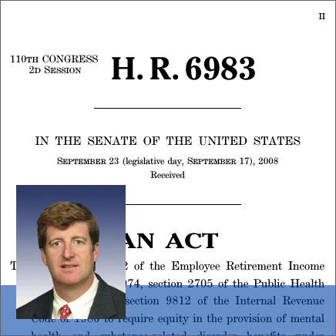
Reimbursement & Parity Enforcement
MHPAEA Enforcement
IMD Exclusion
190-day Lifetime Limit
Lack of bundled payment options
Non-compliant plans, benefit design restrictions
Short term/association plans
Narrow networks, high deductibles
“Medical necessity” reviews
Notes:
We understand that payment—both on the patient side regarding out of pocket expenditures and insurance coverage as well as on the provider side relating to reimbursement rates and funding streams– is a major issue for behavioral health. We have outlined what we believe are the major policy considerations; each council will be discussing payment and coverage for behavioral health services specifically at their respective meetings.

Slide 50
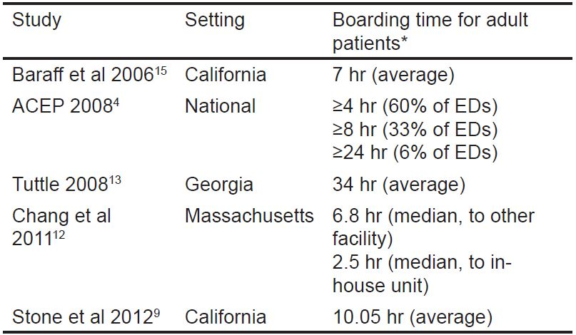
Resource Shortages
Decreasing number of state psychiatric beds
Workforce shortages
ED Boarding
Notes:
Another “category” of policy issues relevant to behavioral health is resource shortages. These include the decreasing number of state psychiatric beds, as well as the significant shortage of mental health professionals in the US. According to HRSA, the US is only fulfilling about 44 percent of the total need for mental healthcare professionals; these include psychiatrists, psychologists, family and marriage counselors, and social workers. The workforce is aging and tends to hold more specialization in education.
These shortages are a major facet of emergency department boarding, wherein a patient– not necessarily but more often than not a psychiatric patient– is held in the emergency department while awaiting a professional consultation or available bed for inpatient admission. Resource shortages are not the only cause of boarding– delays can be caused by pre-certification processes by insurance carriers, for example. However, the American College of Emergency Physicians survey found that only 16.9 percent of respondents reported having a psychiatrist to call to respond to psychiatric emergencies in the ED.

Slide 51
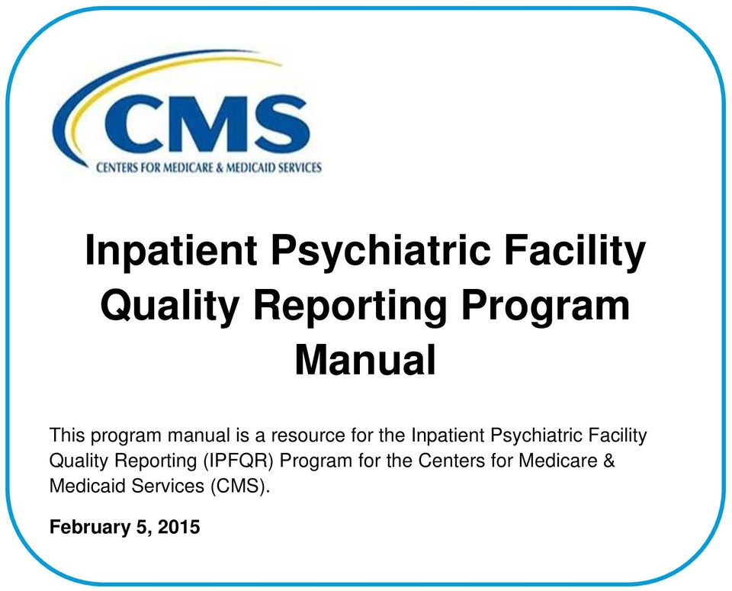
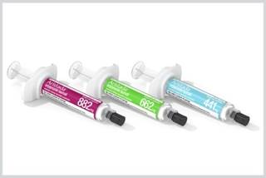
Treatment & Quality
Assisted Outpatient Treatment (AOT)
Long-acting Injectable (LAI) Antipsychotics
Restraint & Seclusion
Inpatient Psychiatric Facility Quality Reporting Program (IPFQR)
Ligature Risk
Notes:
Another area of policy that is sometimes overlooked is the actual regulations and requirements around treatment and quality of care. While this category covers many topics, there are a few that are generally top-of-mind. These include:
Assisted OP Treatment: court-ordered care for patients with SMI; 21st Century Cures Act allows states to implement AOT with flexibility and provides financial support and technical assistance. While this strategy has shown promising results in certain states, some patient advocates argue that it infringes upon autonomy and civil rights.
Similarly, Long-acting injectable antipsychotics have been used to improve adherence to medication, as they are not required to be taken with the same frequency as many oral medications. The FDA has approved six of these drugs for use in the US, a few very recently. Despite scientific evidence of effectiveness, LAIs are underused; some experts report that this is due to general discomfort with injectable medications, both on the part of patients and providers.
Restraint and Seclusion have been used for centuries, probably millennia, as interventions to respond to patients in crisis. Due to the negative consequences of their use– including trauma to both patients and providers– there have been international efforts to reduce or eliminate these interventions if possible. Still, SAMHSA reports that there are 50-150 deaths due to restraint and seclusion each year.
The IPFQR is a pay-for-reporting program, rather than pay for performance– this means that providers are evaluated on WHETHER they submit data, not how good their performance on the measures is. The program began with 6 measures originally developed and tested specifically for the psych setting by The Joint Commission; since then, measures addressing more generic aspects of care including transmission of information and flu vaccine. SAMHSA and CMS are currently working with external stakeholders including AHA to develop new measures for this setting.
(If asked): IPFQR Measures for FY2020 and beyond include:
Hours of physical restraint use (HBIPS-2)
Hours of seclusion use (HBIPS-3)
Patients Discharged on Multiple Antipsychotic Medications with Appropriate Justification (HBIPS-5)
Transition Record with Specified Elements Received by Discharged Patients
Timely Transmission of Transition Record
Screening for Metabolic Disorders
Alcohol Use Brief Intervention Provided or Offered and the subset, Alcohol Use Brief Intervention
Alcohol and Other Drug Use Disorder Treatment Provided or Offered at Discharge and the subset, Alcohol and Other Drug Use Disorder Treatment at Discharge
Tobacco Use Treatment Provided or Offered and the subset, Tobacco Use Treatment (during the hospital stay)
Tobacco Use Treatment Provided or Offered at Discharge and the subset, Tobacco Use Treatment at Discharge
Influenza Immunization
Follow-Up After Hospitalization for Mental Illness
30-Day All-Cause Unplanned Readmission Following Psychiatric Hospitalization in an Inpatient Psychiatric Facility (IPF)

Slide 52
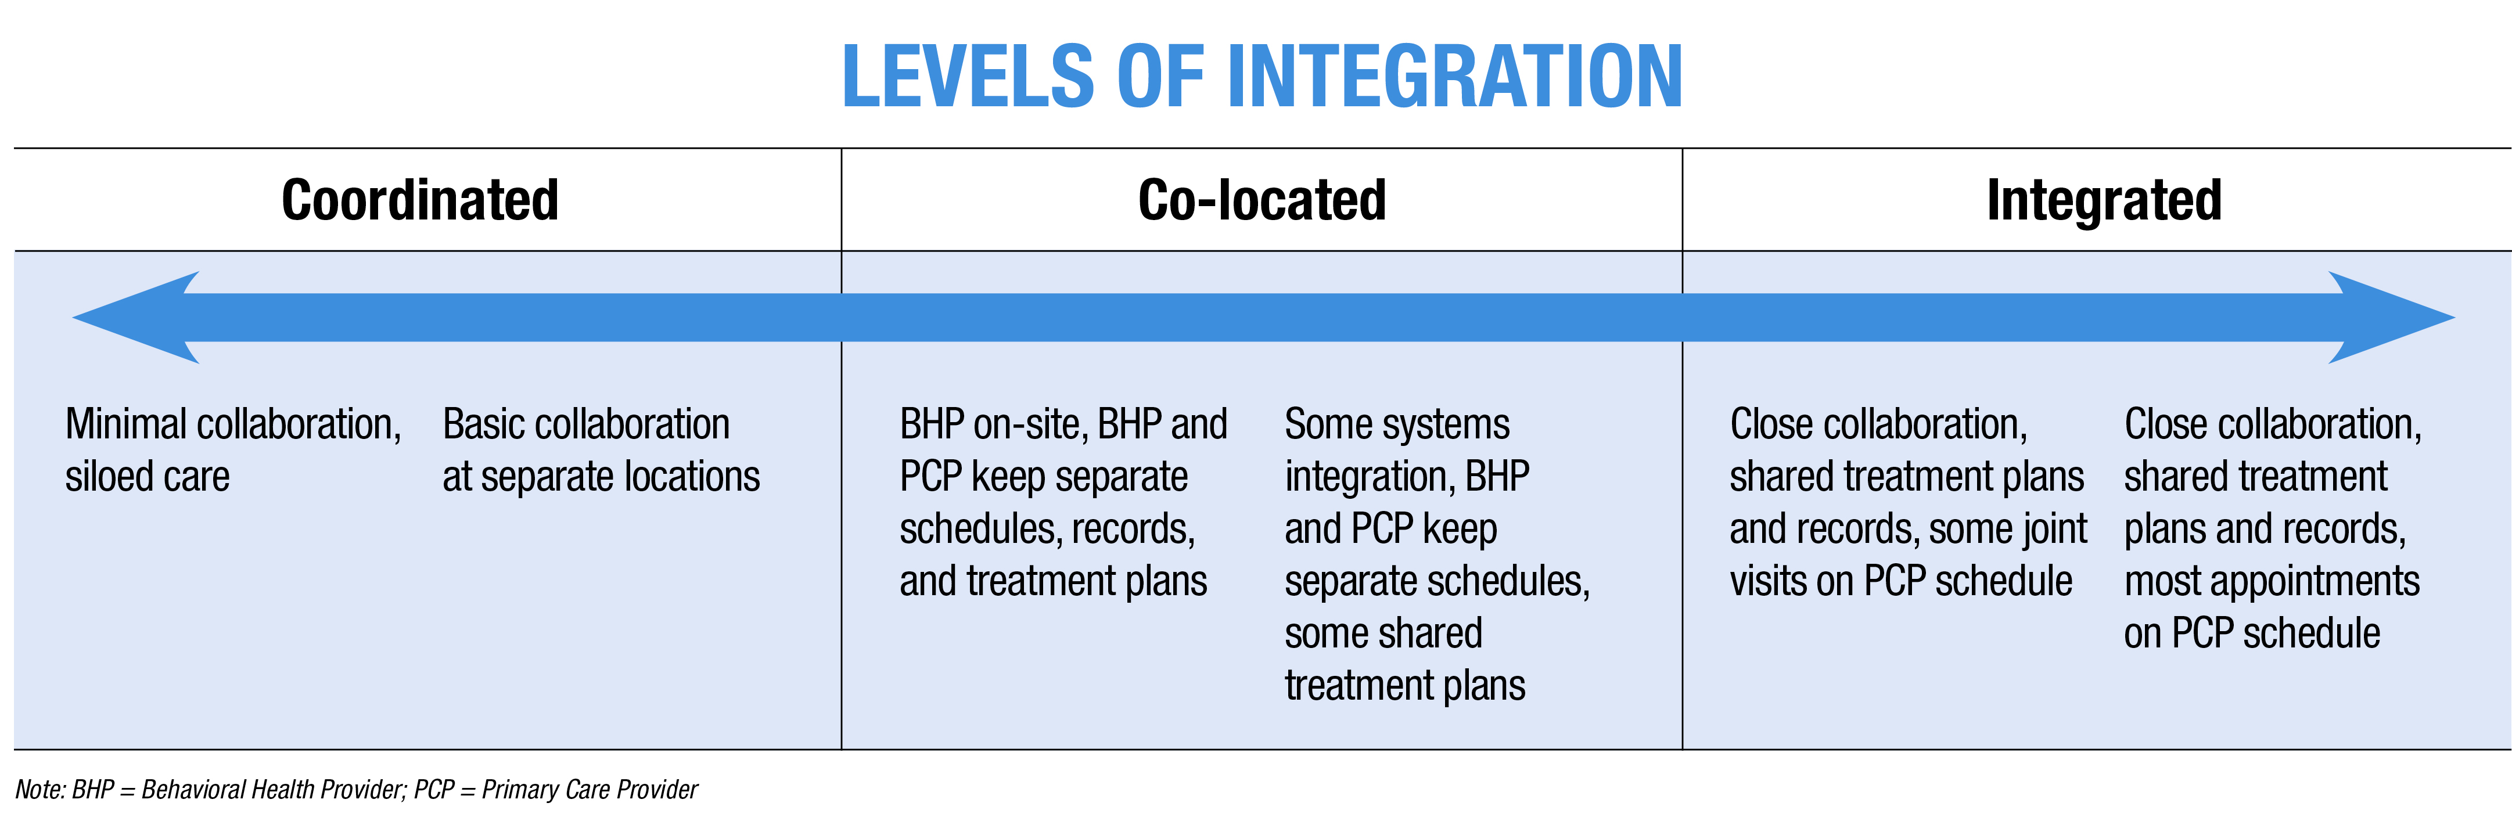
Overarching Issues
Stigma
Integration of Behavioral Health with Physical Health
Notes:
Finally, there are a few overarching issues that are key to addressing behavioral health, but have unclear ties to policy and regulation. We talk a lot about the stigma associated with mental illness that prevents patients from seeking help because they fear judgment by their peers, providers, or employers. In addition to the societal notions related to mental illness, there are other drivers that lead us to treat these patients differently than physical health patients. For example, behavioral health services are paid using a different system since traditional fee-for-service payments are based on finite episodes rather than the time-based nature of behavioral health services. Many policies, like the 190-day lifetime limit or medical necessity reviews, separately evaluate psychiatric needs.
Thus, treating mental health differently from physical health is both a cause and effect of stigma. We have scientific evidence that proves the interrelatedness of physical and mental health– improvements in one spur improvements in the other, and vice versa. However, integrating behavioral health with physical health faces logistical barriers, like physical space– where are you going to put a psychologist in your already crowded outpatient clinic?

Slide 53
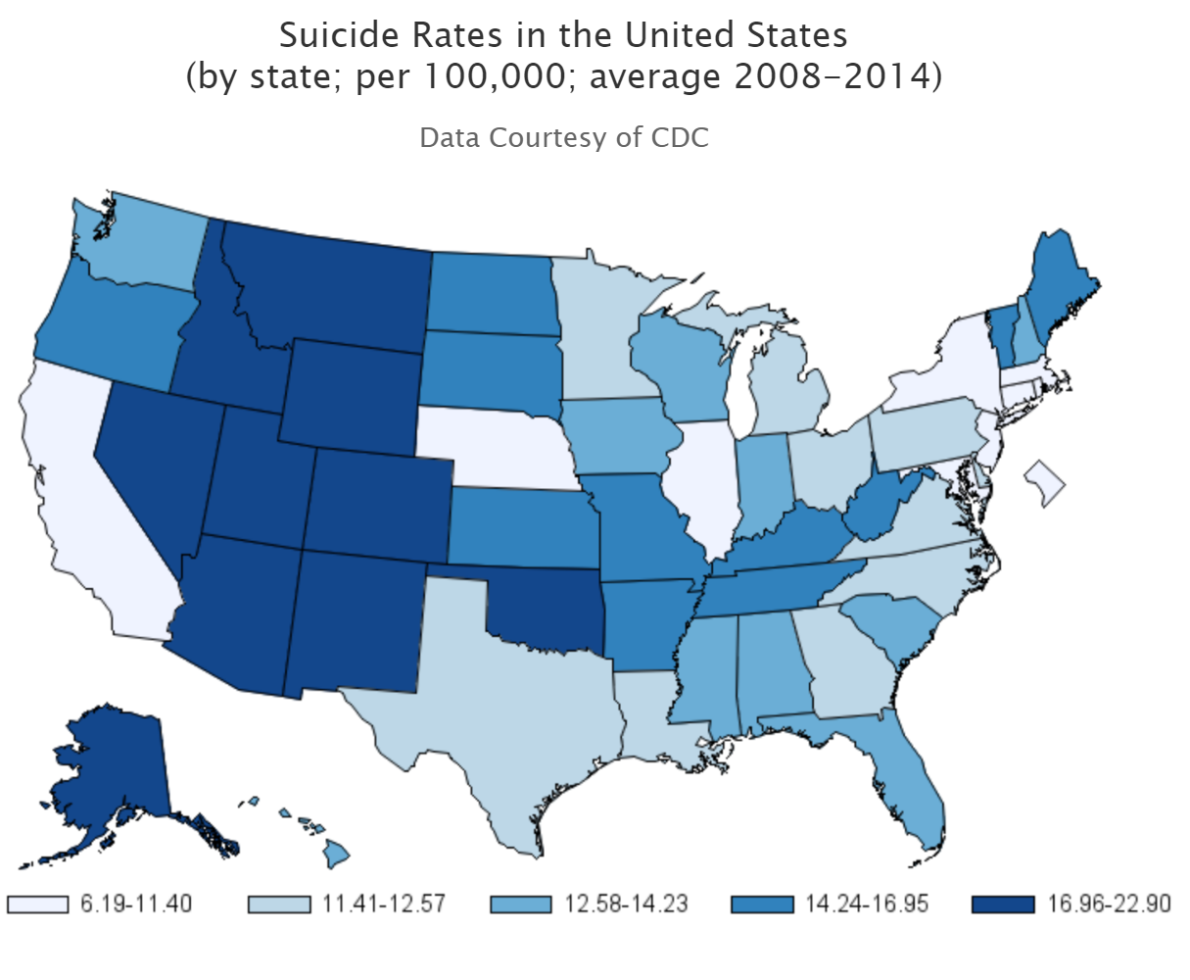
Extra-hospital Issues
Suicide Prevention
Community-based Services
Notes:
Similar to these overarching challenges are those that I’ll call “extra-hospital issues,” by which I mean those that are definitely related to facility-based care, but span beyond clinical walls. For example, the Zero Suicide campaign seeks to eliminate suicides within health care, but what about people with suicidal ideation who are no longer within our care or who were never patients? How far should the reach of hospitals and other providers extend before it becomes unsustainable or is perceived as infringing upon autonomy, as has been suggested for AOT?
Community-based services are key in maintaining long-term behavioral health, through non-clinical care models as well as other services that enable patients with mental illness to live day-to-day– like housing, transportation, and vocational training. In these policy boards, we have discussed the concept of the hospital being responsible for not only clinical care, but population health overall; are there policy levers we can pull to make this wide-ranging responsibility operationable?

Slide 54
Opioid Action in Congress
H.R. 6, the SUPPORT for Patients and Communities Act of 2018
Increases funding and flexibility for existing SAMHSA grants to states
Gives other federal agencies (CDC, FDA, NIH) more authority to address crisis
Demo to promote follow-up to ED care of overdose patients
Targets Medicare, Medicaid and CHIP programs’ ability to address crisis
The House and Senate passed the bill and it is going to the President for signature
AHA Priorities:
IMD included in Conference Package
Notes:
DIANE TO COVER OPIOIDS 45-48
House bill incorporates 50+ bills that went through four committees. The bill passed the House in June 261-155
The Senate passed opioid legislation on Sept 17 by a vote of 99-1.
Conference Agreement: Senate passage 98-1 (Sen. Mike Lee UT opposed)
The final language includes an AHA-supported provision that partially repeals the longstanding Institutions for Mental Diseases (IMD) exclusion by giving state Medicaid programs the option to cover up to 30 days per year of services for substance use disorder treatment in an IMD for patients 21-64 years old. The states will be allowed to receive federal Medicaid matching funds The bill also expands treatment coverage to individuals suffering from cocaine use disorder.
addresses health insurance for former foster youth;
maternal and infant health; includes new programs for family members of addiction victims and babies born with opioid dependence
medication-assisted treatment: expands access to medication-assisted treatment, known as the gold standard of addiction care, and will allow Medicare to reimburse for some of these services
access to telehealth: includes a pilot program to test incentives for adoption of EHR technology in behavioral health incentives through CMMI. The Behavioral Health IT Coalition believes such adoption will enable e-prescribing of medication-assisted treatment.
The law also strengthens prescription drug monitoring programs by enabling increased data-sharing among the programs and by encouraging mandates that prescribers check the databases.
parity in mental health and substance use disorder benefits;
alternatives to opioids and abuse deterrence and prevention;
patient experience survey questions relating to pain management;
care coordination for drug overdose patients; and the prescription drug monitoring program.
In the appropriations bill, Congress approved abouty $4 billion toward treatment programs as well as law enforcement. HR. 6 will direct where much of that money goes.
.
The requirements for electronic prescribing of controlled substances and the Promoting Interoperability Program requirements for PDMP query prior to prescribing controlled substances and query of an opioid treatment plan point to greater demand for EHR use and health information exchange.
IMD provision allows states to receive federal matching funds for up to 30 days per year for services provided to adult Medicaid beneficiaries with a substance use disorder in an Institution for Mental Disease – available FY 2019-2023
AHA statement upon Senate passage of conference report: We are deeply disappointed that the agreement excludes a critical provision passed overwhelmingly by the House to allow the responsible sharing of patients’ substance use disorder treatment information in accordance with Health Insurance Portability and Accountability Act regulations. Current law (42 CFR Part 2) undermines the ability of providers to effectively coordinate care for patients with SUDs. We remain committed to the passage of legislation that eliminates the statutory barriers to optimal care for our patients.
The House language would have aligned 42 CFR Part 2 regulations with the Health Insurance Portability and Accountability Act to allow health care providers to responsibly share substance use disorder treatment information.

Slide 55
42 CFR Part 2 Reform
H.R. 6082, the Overdose Prevention and Patient Safety Act
Delayed Action in Energy and Commerce
Passed House 357-57
S. 1850, the Protecting Jessica Grubb’s Legacy Act
Cosponsors: Manchin (WV), Capito (WV), Feinstein (CA), King (ME), Harris (CA), Klobuchar (MN), Rounds (SD), Tillis (NC), Donnelly (IN), Whitehouse (RI), Collins (ME)
Jessie’s Law (Manchin)
Notes:
Urged the Senate to vote separately on the Overdose Prevention and Patient Safety Act, H.R. 6082.

Slide 56
More Federal Efforts on Opioids
CMS Roadmap: Prevention, Treatment, Data
FDA MAT: approving generic versions, new dosages of Suboxone
DEA Production Quotas: FY19 quotas
National Academy of Medicine Action Collaborative
Notes:
CMS Roadmap: three pillars, have held various workgroups with stakeholders including AHA throughout summer with plan to inform future rulemaking
Prevention
Gathering best practices around prescribing by condition, working with specialty groups
Promoting non-opioid pain treatment; example, unpackaging non-opioid pain treatment (On-Q continuous infusion pump, ice machine, etc.) for surgical procedures to incentivize use
Treatment
Enhance access/coverage for opioid use disorder treatments
Data
Gathering prescriber, pharmacy data to track opioid use patterns across different populations
Promote data sharing across continuum of care
FDA approving new and adjusted options for MAT to increase use
DEA FY19 proposed aggregate production quotas for schedule I and II controlled substances: third straight year of reductions that affect both oral and injectable opioid medications; exacerbates shortages for IP drugs, which are less prone to diversion, lead to burdensome workarounds
NAM Action Collaborative: NAM-facilitated standing body that brings together stakeholders nationally to advance progress through collaboration, coordination, communication, and shared learning activities. Through various meetings, will develop tools and knowledge hub regarding education and training, prescribing guidelines and evidence standards, treatment and care models, communication, culture and stigma, engaging the private sector, and data.

Slide 57
Addiction Recovery Medical Home APM
Announced publicly Sept. 7
Five Elements to ARMH:
Payment in 3 phases: pre-recovery and stabilization (<30 days), recovery initiation and active treatment (0-12 months), and community-based recovery management (0-5 years)
Quality metrics developed by National Committee for Quality Assurance
Integrated treatment and recovery network
Care recovery team
Treatment and recovery plan
Looking for additional organizations to pilot model
Partners from Facing Addiction with National Council on Alcoholism and Drug Dependence have offered to provide live webinars with our members, interested providers
Notes:
As we mentioned in our section on challenges to behavioral health generally, there is a lack of alternative payment models that specifically address behavioral health issues. With that in mind, the AHA joined with several other organizations to develop an addiction recovery medical home model, which was publicly announced on September 7th after about a year of work. The model provides for bundled payments for three different phases of recovery: the immediate stabilization, shorter term recovery and treatment, and long-term community-based recovery management. This model is unique in that it recognizes that recovery takes longer than the oft-cited 28 days, and also requires the input of a team of clinical and non-clinical caregivers.
Our next steps are to pilot the model so we can gather some real data. We have a few organizations who have committed to piloting the model, including Anthem and Intermountain, but if you think there are organizations, especially systems, in your states who might have interest, let us know. More info, including a detailed paper on the various aspects of the model, is available at incentivizerecovery.org.
The next two hidden slides provide more info on the model if there is interest.

Slide 58
Notes:
Details if asked

Slide 60
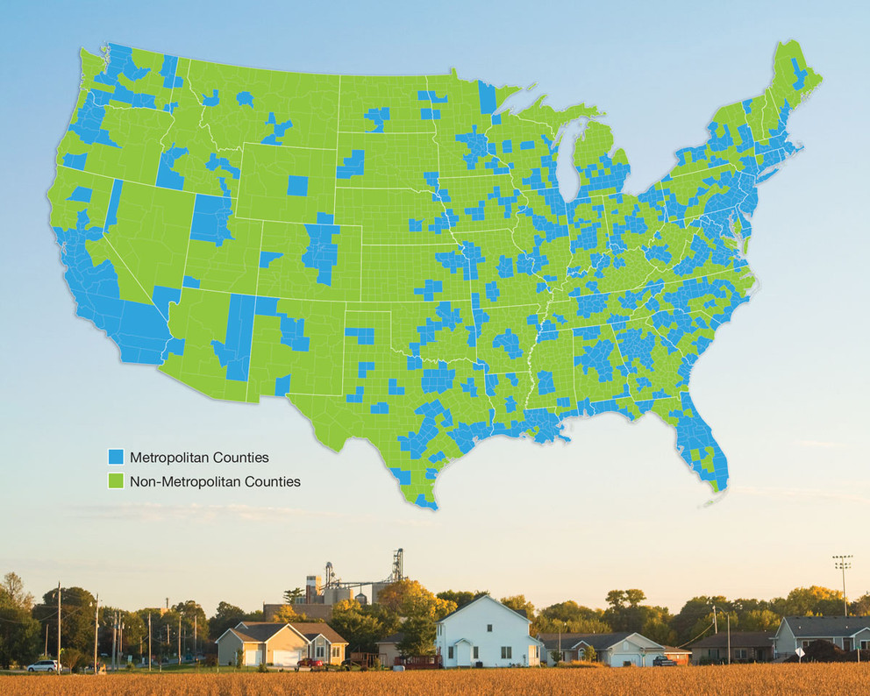
Cornerstones of Rural Communities
National reach:
20% of Americans live in rural areas
Key access points:
Local, timely access to health care
Economic anchors:
Employment opportunities
Transactions, attraction for business investment
Contributions local taxes, public services
Image
Notes:
NANCY TO COVER THE RURAL HEALTH SLIDES 51-56
Purpose of slide: why rural hospitals matter
To set the stage, almost 20% of Americans live in rural areas, dispersed throughout the country as you can see from the green areas on the map.
Rural communities rely on more than 1800 rural hospitals as key access points to health care, including emergency medical services
Having these hospitals in the community is crucial to prevent patients from having to travel long distances for care, or even forgoing care in some cases
In addition to their direct impact on health, rural hospitals are also economic anchors in their communities. They are often the largest employer in their area, and also have indirect impact on local economy through transactions with other businesses, attracting local business expansion or new business investments, in addition to contributing to a healthy tax base which helps to sustain public services like transportation, education, and public safety.
If asked, some additional factoids:
Nearly half of rural hospitals are part of larger health systems (2016 AHA hospital survey; includes CAHs)
1825 rural hospitals according to 2016 AHA survey (includes CAHs) – this is more than a third of US community hospitals
In one rural example, a community hospital in Virginia has led to 177 direct jobs and nearly 10. 5 million dollars in payroll within the community (in this case, the county)

Slide 61
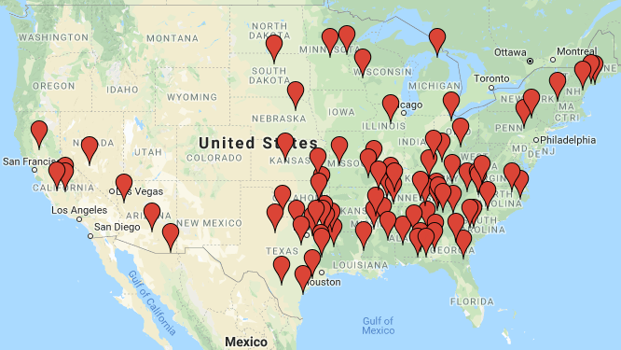
Facing Difficult Decisions
Closures since 2010
More than 40% of rural hospitals have negative operating margins
Hospital responses:
Conversion: service reduction
Merger: 380 between 2005 - 2016
Closure: 88 rural hospitals closed since 2010
Source: http://www.shepscenter.unc.edu
Service reductions + closures = access barriers
Notes:
Purpose of slide: rural hospitals are financially vulnerable, many face tough decisions/closure which have real ramifications for patients
In spite of their importance and community benefit, many rural hospitals are financially vulnerable – demonstrated by the more than 40% of rural hospitals (incl CAHs) that have negative operating margins
There are a few ways rural providers have been responding to their financial struggles
reduce the services they offer, or otherwise convert from a full service acute care hospital to a facility with more limited services
merge with another entity, typically a larger health system – and we are seeing this happen with some frequency. Roughly 380 rural hospitals mergers have occurred between 2005-2016 , according to UNC sheps center , with some rural facilities merging more than once
fully close its inpatient care and/or other services – since 2010, 88 rural hospitals have closed, and you can see from the map closures happen across the country, but have been mostly concentrated in the south east
While some responses to financial troubles can work to sustain access – e.g., preserving some outpatient care even if they eliminate inpatient, in general service reductions and closures lead to access barriers for rural patients who may have to travel long distances to receive care they had been accessing locally.
(If needed) According to recent research, a substantial portion of rural patients must travel over 25 miles to access care after their local provider closes – and for individuals who are older, have worse health, or lack transport, this is especially problematic
Factoids:
Two thirds of rural hospitals (incl CAHs) have negative margins for Medicare (same for Medicaid)
Hospital closures have been on the rise from 2010-2016, with a slide decrease last year but expected to continue
UNC defines closure (where the 88 number comes from) as eliminating inpatient services
Roughly 80% of rural hospital closures since 2014 have been in states that have not expanded Medicaid

Slide 62
What are the challenges?
Emergent
Opioid epidemic
Violence in communities
Medical surge capacity
Cyber threats
Care delivery shifts
Behavioral health
High cost of drugs
Regulatory burden
Recent
Economic & demographic shifts
Low patient volume
Payer mix
Patient mix
Geographic isolation
Workforce shortage
Aging infrastructure
Persistent
Notes:
Purpose of slide: Rural hospitals & communities always face unique circumstances and challenges - some have persisted for many years, while others are more recent. Issues of today may hinder rural providers’ preparedness for the challenges of tomorrow (tackling the bottom of the pyramid can strain rural hospitals; persistent and recent issues can make it impossible to address challenges that are higher up in the pyramid)
What factors underlie these financial pressures that rural hospitals are facing, leading to difficult decision? What are the unique challenges in providing rural health care?
This chart identifies several obstacles that rural providers face overall, although each hospital has its own mix of challenges to be addressed
Looking at the pyramid from bottom to top, we show numerous challenges that have persisted in rural areas for long periods, such as low patient volume and reliance on Medicare and Medicaid, with others that have developed more recently, like shifts from IP to OP care, and then several that emerge with little warning, but requiring shifts in attention and/or resources, such as the opioid crisis
[ if there is time and interest, presenter could pick out a few examples and describe – some stats are noted below if desired – more so in the rural report attachment].
These challenges compound each other, making it more and more difficult for providers to ensure access to care. Tackling persistent and recent issues can strain hospitals, and prevent them from having capacity to take on emergent challenges
Some Factoids
Payer mix:
46 percent of rural hospital revenue was from Medicare, and 17 percent was from Medicaid (AHA Annual Survey of Hospitals, 2016)
hospitals receive 87 cents for every dollar spent caring for Medicare patients, 88 cents for every dollar for Medicaid patients. (AHA survey 2016)
Medicare margin is -7.4%. (MedPAC March 2018)
Patient mix: rural areas are older, sicker, poorer than average
less than 14 percent of the nation’s population is over age 65, but 65+ make up 18 percent of residents in rural areas
Workforce
While almost 20 percent of the U.S. population live in rural areas, less than 10 percent of U.S. physicians practice in these communities
Changes in HC delivery
Since 2006, outpatient visits have risen 33 percent, while inpatient discharges have dropped 17 percent. (AHRQ data analysis, 2017)
In 2016, outpatient services represented nearly two-thirds of rural hospitals’ total gross revenue. ^{(AHA} survey)
Behavioral health
Suicide rates have long been higher in rural areas, but the gap between rural and other areas is widening since mid 2000s
more than 60% of mental health provider shortage areas are rural or partially rural
Economic, social, population shift
between 2010 and 2014, a majority of rural counties lost businesses across multiple industries, including farming, manufacturing, coal, timber, and fishing
from 2010-2016, the population in rural areas declined, due to the combination of migration (including younger workers seeking employment in urban areas) and natural changes (births minus deaths)
Reg burden
Hospitals , health systems, and PAC providers nationwide spend 39 billion per year on non clinical regulatory activities (2017 aha analysis)
While rural hospitals are subject to the same regulations as other hospitals, lower patient volumes mean that, on a per-discharge basis, their cost of compliance is often higher than for larger facilities
Opioid crisis
in 2017, the Centers for Disease Control announced that the rates of deaths from drug overdoses in rural areas were rising to surpass rates in urban areas

Slide 63
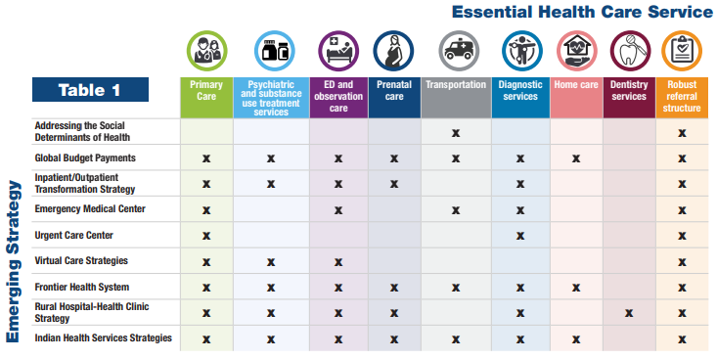
AHA Leadership and Member Engagement
Flexibility needed across rural areas
Task Force
Identified essential services that should be available in all communities
Outlined strategy options for rural communities to protect local access
Notes:
Purpose of slide: AHA has been working on access and rural issues for awhile; task force outlines options for providers since rural areas require flexibility; no one-size-fits-all
AHA has a recognized these challenges and has a long history of working on issues that affect access to care in rural communities
Because the mix of challenges varies from place to place, we know that flexibility is needed in order for rural areas to implement new strategies successfully
Taking that into account AHA put together a Task Force on ensuring access in vulnerable communities in 2015.
The Task Force identified a set of essential services that should be available in all communities [presenter note: they are listed below if you want to name them] and
Identified various strategy options that rural communities may explore in order to ensure local access to high quality, affordable care
Notably, these should be considered a menu to select from, rather than directives – the strategies are not mutually exclusive – some providers and decision makers may find that a combination of the strategies may ultimately provide the most benefit for their communities
there is no one-size-fits-all approach to ensuring access to care in rural areas
If needed:
Task force essential services
Primary care
Psych and substance use treatment
Emergency and observation services
Prenatal care
Transportation
Diagnostic services
Home care
Dentistry
Robust referral structure
Task force strategies
Addressing SDOH
Screening & information
Navigation
Alignment
Global budget payments
Inpatient/outpatient transformation strategy: Reduce IP; boost OP and primary care; continue providing ED services
Emergency Medical Center: Freestanding ED with transport; optional OP services; elimination of IP
Urgent care center
Facility to address Non life threatening conditions but needs to be addressed within 24 hours
Eliminate IP services; no appointments needed; evening and weekend hours; x ray services, some procedures available
Virtual care strategies
Frontier health system
Medical home for all pts in service area
Similar to ACOs with strong transportation component
local, integrated health care organizations for very small, isolated frontier communities
Rural hospital- health clinic strategy
Coordination with FQHC and other clinics
Contractual collaboration (referrals), corporate merger, agreements for data sharing
Indian health service strategies: Assessment of available services + collab/coordination to bridge gaps and connect to services

Slide 64
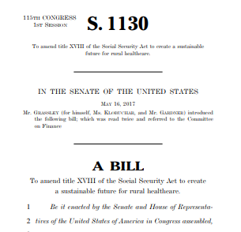
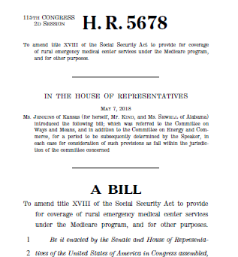
Increasing Visibility of Rural Issues
Rural Voters Played A Big Part In Helping Trump Defeat Clinton –NPR
Small hospital closures mean loss of access to care
Rural hospitals are in dire need of regulatory relief
Death by a Thousand Cuts: The Flickering Lights of the U.S. Rural Hospital
Rural hospitals need flexible policies to survive, report says
Rethinking Rural Health Solutions to Save Patients and Communities
Notes:
Purpose of slide: describe how there has been uptick in media attention on rural America, both the challenges they face and their political power; we are seeing an increased focus on rural issues from legislators and regulators
NPR https://www.npr.org/2016/11/14/501737150/rural-voters-played-a-big-part-in-helping-trump-defeat-Clinton
There has been increasing visibility of rural areas in the media, and more attention to these communities from legislators and regulators
These stakeholders are taking notice of not only rural challenges, but also the power and voice of these communities
On the legislative front, several bills have been introduced on both the senate and house sides that support the rural Emergency Medical Center model that was outlined by the AHA task force
[presenter note: you can remind them of the model; key points are that the model allows CAHs and some smaller rural hospitals to convert to a new Medicare EMC designation; inpatient care is eliminated; 24/7 ED with optional outpatient services depending on community need; SNF allowable although no swing beds; must have transport to full service hospital]
This model was also recommended recently by MedPAC in their June 2018 report to Congress
Also on the regulatory front, CMS recently released their Rural Health Strategy, which outlines a set of objectives to promote their work on rural health (included below if needed)
With this rise in visibility and attention to rural communities, the time is right for action that bolsters rural communities and ensures access to care
If needed, CMS rural health strategy objectives:
Apply rural lens to CMS programs and policies
Improve access to care through provider engagement
Advance telehealth and telemedicine
Empower patients in rural communities to make decisions about their health care
Leverage partnerships to achieve the goals of the Strategy

Slide 65
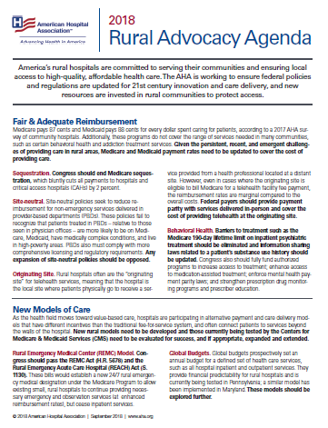
Federal Advocacy
Fair and adequate reimbursement
New models of care
Regulatory relief
Health information technology
Workforce
Prescription drug prices
Share the Hospital Story
This calamity did not arrive on us in 15 minutes,
we’re not going to solve it in 15 minutes.
Sen Ron Wyden (D-OR), Ranking Member, Senate Finance Committee
Notes:
Purpose of slide: Overview of key AHA advocacy areas and calls for action (legislative and regulatory); NEW investments and UPDATED policies are needed; acknowledgment that this is a marathon, not a sprint in light of the complex, multifaceted environment for rural health care; we are continuing to work to tell the rural hospital story and we ask members to do the same
The AHA is working to motivate federal action on rural health and communities across a number of focus areas
These include…
Fair and adequate reimbursement
New models of care
Regulatory relief
Health information technology
Workforce
Prescription drug prices
….which are described further in the advocacy agenda attachment
Overall, these areas requires NEW federal investments and UPDATED policies in order to support rural providers and the patients they serve
Because of the complex, multi-faceted environment for rural health care, policy activities – as well as our advocacy - will be a marathon and not sprint – as noted by Sen Wyden’s quote
Lastly, while we work to tell the rural hospital story, we ask our members to do so as well. This will help decision makers to have a real understanding of both the burdens and opportunities rural communities have, and to shape policies that are effective in protecting access to life saving health care in rural America

Slide 66
AHA’s Quality TrendWatch
Highlights progress in quality improvement
Explains various QI programs, infrastructure needed
Outlines quality and value-based purchasing programs
Details challenges to quality improvement:
Lack of meaningful measurement
Unintended consequences of measurement programs
Lack of useful, accurate comparisons
Challenges with eCQMs
Outdated, unclear CoPs, standards
Recommendations
Notes:
NANCY TO COVER QUALITY TRENDWATCH AND LOOKING AHEAD

Slide 67
LOOKING AHEAD
Measures that Matter
Hospital Pay-for-Performance programs
MedPAC’s HVIP
Including rural hospitals in quality reporting programs
More work on CoPs; right-sizing regulation
20th Anniversary of To Err is Human: Telling the story of quality improvement
Innovative care/payment models
Advanced Payment Model for Advanced Illness Management
Progress (or not?) on the opioid epidemic
How will efforts affect patients with other disorders?
Interoperability
Progress on eCQM?
Notes:
NOW THAT YOU HAVE HEARD OUR FEDERAL UPDATE, AS YOU THINK ABOUT THESE TOPICS AND THE TOPICS YOU DISCUSS WITH YOUR COLLEAGES BACK HOME AND THE ISSUES RAISED BY MEMBER HOSPITALS,, WHAT ARE THE FIVE BIG TOPICS THAT WE SHOULD THINK ABOUT FOR 2019.
JUST AS A RECAP, OUR FEDERAL UPDATE COVERED:
Burden Reduction
Fiscal Year final and Calendar Year proposed rules
Health IT
CAHPS
Accrediting Organizations
Behavioral Health
Opioid Legislation
Rural Hospital Issues / Concerns

Slide 68
Networking
and
Refreshment Break

Slide 69
AHA Regulatory Update
Nancy Foster, American Hospital Association

Slide 70
NQIIC Primer
Marie Cleary-Fishman, American Hospital Association

Slide 72
Notes:
It’s no secret that the world of health care is changing dramatically. And that hospitals and health systems continue to redefine the “H” both inside and outside the four walls of the hospital and within the communities we serve.
In response, the American Hospital Association is building an agenda around innovation and transformation that will involve the entire association. In addition to long-range policy planning and enhanced field engagement, this initiative includes the creation of the AHA Center for Health Innovation.

Slide 73
Notes:
The AHA Center for Health Innovation is uniquely designed to help our members drive high-impact innovation and transformation by providing forward-looking market insights, unique leadership development opportunities, actionable data, novel partnerships, and best-in-class resources that spread leading practices at-scale.
We plan to leverage our national scale and to further deepen our personal relationships with our members to be an even better partner in helping organizations and their leaders make progress on their innovation and improvement journey.
At the same time, the AHA is applying innovative thinking to our practices across the organization. We are expanding our public policy agenda to develop fresh policy ideas that better support the new direction the field is heading toward for long-term growth and success.
And, we are strengthening our field engagement efforts to more deeply involve our members in the day-to-day life of our association and the value it brings.

Slide 74
Notes:
So let’s break down some of the Center’s exciting, new offerings:
Market Scan: Regular news and insights into the forces shaping health care and how they will impact hospitals and health systems. In the future, other offerings also will include in-depth and unique analyses geared towards emerging issues and trends.
More critical learning opportunities: Building off of the success of programs like adaptive leadership or our Innovation 90 Boot Camps- a unique, 90-day coaching program that helps health care leaders utilize the latest innovation frameworks being used in industries from technology to manufacturing and validate innovative ideas using techniques including design thinking, agile development, iterative prototyping, and application.
Must-have services, such as Cyber Security: Access to unique, expert resources to protect vital information by assessing risk, investigating vulnerabilities, engineering an IT security environment, and staying on top of the latest cyber threat updates.
Game-changing partnerships at scale, such as AHA’s collaboration with a new not-for-profit generic drug company, called Civica Rx, to help patients by addressing shortages and high prices of lifesaving medications.
Advanced case studies about leading health care organizations making a difference in the field with hard-hitting data analytics and then new, more interactives forums and platforms to help connect leaders with each other to share leading practices in operationalization, sustainability, and scale.
And more applied research that adapts evidence and data for your specific organizational context and the place you are on your own journey to transform.

Slide 75
Notes:
We know the challenges we as a field face are vast. And we know we can’t tackle it all at once.
To do the most good, we must focus sharply on the areas that will have the greatest impact on our members and their patients.
Affordability and Value
Performance Improvement
Population Health
New Payment and Delivery Models
Emerging Issues and Market Intelligence
Innovation Capacity

Slide 76
Notes:
This is the portion of our presentation when we know you might be asking yourself…What makes this center for health innovation uniquely better?
Well, several things:
For more than a century, AHA has provided our members with expert counsel on a wide range of issues and opportunities …from supporting the development of Medicare and Medicaid …to expanding leadership opportunities for diverse individuals… to taking action on the social determinants of health. We are a proven partner.
We understand the complexity and specific context of our nearly 5,000 member hospitals and health systems and the unique communities they serve better than anyone else.
We offer a network that spans far and wide to enable health care leaders, entrepreneurs, government agencies, community health leaders, academics and other change agents to connect and transform by working together.
We recognize that we must go beyond incremental innovation and quick fixes by creating a strategic roadmap and sustainable culture of innovation across every clinical and business function throughout the system.

Slide 77
Notes:
How will be know we are getting it right?
We have created a comprehensive measurement program that tracks, monitors and analyzes our work through engagement, qualitative research, efficiency measures and a positive bottom-line.
Only through measurements like these can we continue to challenge, learn and improve ourselves and the field.

Slide 78
What has already happened?
Hired top level staff
Redesigned process for support with group learning and individual touch.
Structured input from the field.
Enhancing data services.
Linkages to the best.

Slide 79
Notes:
Staying connected with you is very important to us. And we want to make it easy for you to follow our progress, engage us in a conversation, and participate in our work.
We want to be where you are 24/7. Check out our web site at aha.org/center and follow us across these social media channels.

Slide 80
NQIIC Primer
Marie Cleary-Fishman
Vice President, Clinical Quality
October 3-5, 2018
A2Q

Slide 81
NQIIC
Network of Quality Improvement & Innovation Contractors (NQIIC)
New Indefinite Delivery Indefinite Quantity (IDIQ) contract from CMS
Base period: 5 years
Option period: Additional 5 years
Amount: Up to $25B in contracts, subject to available funds
Anticipated award: December 2018

Slide 82
NQIIC
Consolidates QIN/QIO, ESRD, Clinician-focused, and HIIN contracts
Broad scope of task orders will be available for NQIIC awardees to bid on

Slide 83
Focus of new task orders
Outcomes
Return on investment
Accountability
Real-time data access for faster feedback

Slide 84
Priorities
Workforce burden reduction
Behavioral health (including opioid abuse)
Chronic disease management
Patient safety
Care transitions
Long-term care

Slide 85
Cross-cutting aims
Rural health
Vulnerable populations
Patient and family engagement

Slide 86
Awardees
Demonstrated large-scale QI expertise
Will provide direct technical assistance
Will support providers in use of health information technology and interoperability
Will form community coalitions and Learning and Action Networks

Slide 87
New awards
Anticipated QIN/QIO task order, to be released Dec 2018 and awarded July 2019
Anticipated clinician-focused task order, to be released Jan 2019 and awarded Sept 2019
NQIIC primes can bid on task orders
NQIIC primes can also be subcontractors for other NQIIC primes that are bidding

Slide 88
Existing contracts
HIIN extended to March 2019 and may be extended to March 2020
QIN/QIO ends July 2019
TCPI ends Sept 2019

Slide 89
Lunch in the Sage Room
Sponsored by Collective Medical

Slide 90
Hospital Violence Sex Trafficking, Workforce Quality & Safety for Nurses
Pat Noga, Massachusetts Health and Hospital Association
Tania Daniels, Minnesota Hospital Association

Slide 91
Workplace Violence - Sex Trafficking, Workforce Quality & Safety for Nurses

Slide 92
Workplace Violence
Tania Daniels, PT, MBA VP, Quality & Patient Safety
tdaniels@mnhospitals.org
Pat Noga, PhD, RN, MBA, NEA-BC, FAAN
VP, Clinical Affairs
pnoga@mhalink.org

Slide 93
Minnesota Hospital Association: Workplace Violence Prevention

Slide 94
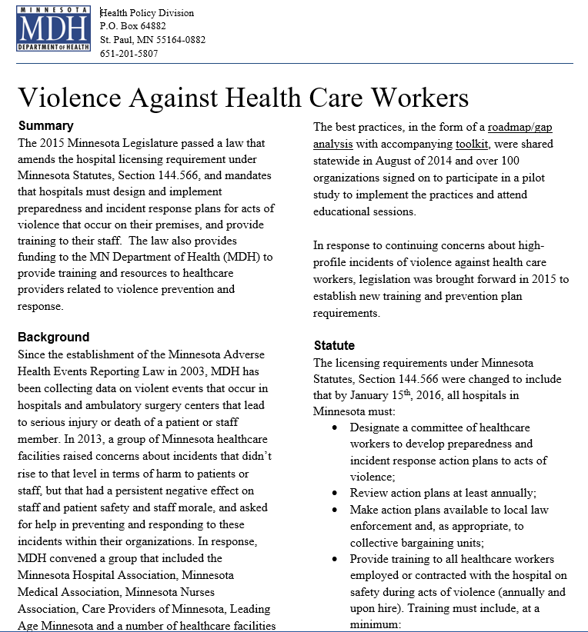
Violence Against Health Care Workers
In 2015, the Minnesota Legislature passed a law that hospitals must design and implement preparedness and incident response plans for action of violence that occur on their premises, and provide training for employees.
Hospitals must have preparedness and incident response plans in place as of Jan. 15, 2016.

Slide 95
Workplace Violence Coalition
MHA and MDH led a public-private coalition of health care stakeholders to help identify risks for violence and develop strategies to prevent workplace violence toward staff in health care settings
Coalition developed road map/gap analysis with resources for hospitals, long-term care facilities, clinics and other facilities

Slide 96
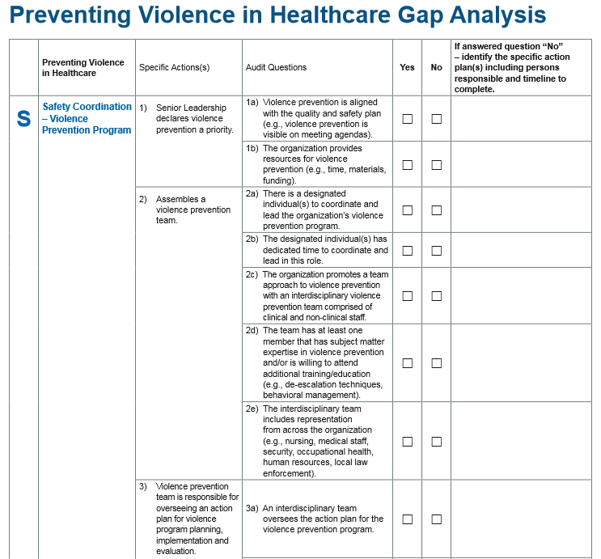
Workplace Violence Gap Analysis
The gap analysis to prevent violence in healthcare helps health care facilities meet the new mandate.

Slide 97
Question to consider
Patient abandonment in active shooter situation
“Healthcare professionals have a duty to care for the patients for which they are responsible. Since incidents such as an active shooter scenario are highly dynamic, some ethical decisions may need to be made to ensure the least loss of life possible. Every reasonable attempt to continue caring for patients must be made, but in the event this becomes impossible without putting others at risk for loss of life, certain decisions must be made.” (Active Shooter Planning and Response, 2017 developed by the Healthcare and Public Health Sector Coordinating Council)
The MN Board of Nursing has not taken a specific position regarding abandonment, particularly in the event of an active shooter. The Board takes into consideration all of the circumstances surrounding a reported incident. The Board would consider standards of practice and codes of ethics in evaluating a report of abandonment.
Notes:
The Board has not taken a specific position regarding abandonment, particularly in the event of an active shooter. This is not addressed in the MN Nurse Practice Act and the Board has not had experience with this occurring. The Board takes into consideration all of the circumstances surrounding a reported incident. The Board would consider standards of practice and codes of ethics in evaluating a report of abandonment. Each incident would be reviewed individually, taking into consideration all the circumstances present at the time. Clearly, an instance of an active shooter is an extremely atypical situation.
One document that addresses some of these considerations is “Active Shooter Planning and Response” developed by the Healthcare and Public Health Sector Coordinating Council. This document was updated in 2017. It says, in part,
“ Healthcare professionals have a duty to care for the patients for which they are responsible. Since incidents such as an active shooter scenario are highly dynamic, some ethical decisions may need to be made to ensure the least loss of life possible. Every reasonable attempt to continue caring for patients must be made, but in the event this becomes impossible without putting others at risk for loss of life, certain decisions must be made. The following guidelines are meant to provide issues to consider when making difficult decisions, prompt meaningful discussions, and prepare those who might be involved in such an incident before it ever happens.
Allocate resources fairly with special consideration given to those most vulnerable
Limit harm to the extent possible. With limited resources, healthcare professionals may not be able to meet the needs of all involved
Treat all patients with respect and dignity, regardless of the level of care that can continue to have provided them
Prepare to decide to discontinue care to those who may not be able to be brought to safety in consideration of those who can
Realize some individuals who are able to avoid the incident will choose to remain in dangerous areas. Consider how to react to those situations
To the extent possible, think about the needs of others as well as yourself. Consider the greater good as well as your own interests
During an active shooter situation, the natural human reaction is to be startled, feel fear and anxiety, and even experience initial disbelief. You can expect to hear noise from alarms, gunfire and explosions, and people shouting and screaming. Training provides the means to regain your composure, recall at least some of what you have learned, and commit to action. We know a trained individual will more likely respond according to the training received and will not descend into denial, while the untrained will more likely not respond appropriately, descend into denial and helplessness, and will usually become part of the problem. There are several sets of planning guidance that have been developed for active shooter incidents for organizations such as schools, government, and business office settings. The key message of this document is that hospitals, academic health centers, and other healthcare settings represent a unique set of challenges for active shooter planning. The uniqueness of healthcare facilities and the limitations as a result of size, location, critical care versus acute care, rural versus urban versus suburban, the presence of students, whether you have security, law enforcement availability and response times are just a few of the many challenges when developing a response to an active shooter. For this reason, we recommend that as you develop your plan, you consider the planning guidance listed below and determine what works best in your particular circumstances. You will notice however that all of the guidance below shares a common set of principles. The first of these principles is that your plan should seek to maximize the protection of life. If possible, evacuation from the incident will reduce the number of people in harm’s way, and facilitate the law enforcement response. Another principle is that in the end, individuals will have to make decisions based on their assessment of the situation in how best to maximize the protection of life and what tactics to employ. When all other options have been exhausted, an individual decision to engage or fight the shooter may be the only tactic available. Another important principle for healthcare is that individuals may have a duty of care for patients – in your planning, you should determine any specific requirements that your organization may have and include this in staff training so that they may include this aspect in determining the best course of action to take in maximizing the protection of life.”
I am not mentioning this resource as a binding authority just one statement of principles to consider. I am also aware there is research and writing on the ethical issues of patient care versus abandonment in the context of natural disasters, such as Hurricane Katrina. You may find some of that writing helpful to you in identifying the ethical issues in an incident with an active shooter.
While there is not a black and white answer, I hope this is helpful.
Tania

Slide 98
Intersection between Health Care and Law Enforcement (HCLE)
Gil Acevedo, Assistant Commissioner of Health Systems
William Hutton, Executive Director
Dr. Rahul Koranne, Chief Medical Officer
HCLE Coalition Conveners

Slide 99
Why?
Patient is arrested, incarcerated or involved in law enforcement and needs healthcare services
Minor is at a healthcare facility and there is suspicion of maltreatment
Law enforcement encounters someone in a mental health or chemical dependency crisis
Collection of evidence requiring medical intervention
Transfer of information from ambulance services to law enforcement
Crime committed by patient in healthcare facility
Notes:
Increase in violent situations in communities across MN including several high profile cases in a hospital setting
Various situations where law enforcement and health care cross paths and opportunities to improve collaboration:
Clarity on releasing information
Mental/behavioral health and chemical dependency crisis situations including peace/health officer authority and emergency admissions
Barriers in the MN Health Records Act
More clarity on court orders and blood draws
More clarity on how minors can be treated with law enforcement
Extension of workplace violence resources

Slide 100
HCLE Coalition Charge
Improve Collaboration
Prevent and React to Violent Situations
Develop Standardized Tools
Provide Methods to Build Relationships

Slide 101
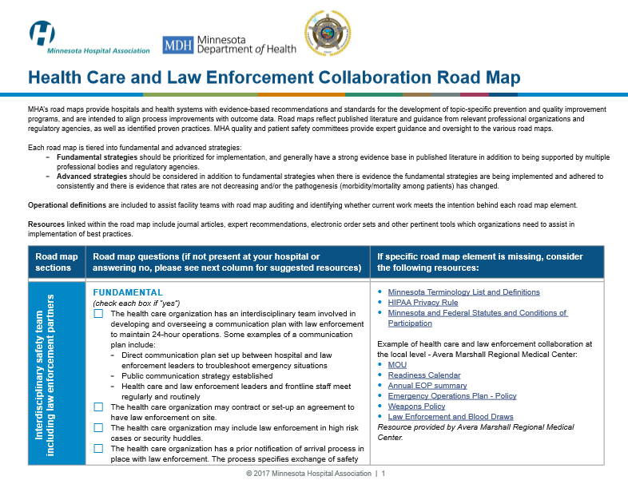
New HCLE Road Map

Slide 102
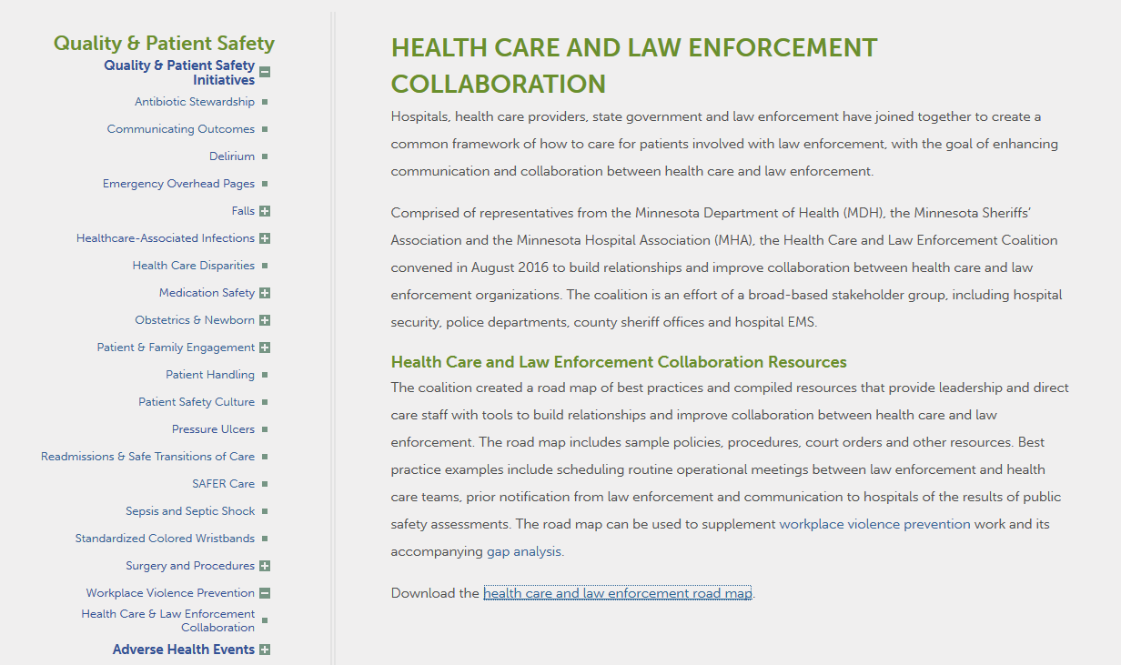
Road maps available on the MHA website!
http://www.mnhospitals.org/quality-patient-safety

Slide 103
Dissemination Progress

Slide 104
Key take-aways
Communication is key!
LE conducts Public Safety Risk Assessment- communicate to provider
Prior notification before bringing patient to health care facility to determine best method
Each community needs to develop local plan based on resources

Slide 105
MHA Workplace Safety & Violence Prevention Efforts
Patricia M. Noga, PhD, MBA, RN,
NEA-BC, FAAN

Slide 106
MA Workplace Violence Legislation
Chapter 151 of the Acts of 2010
Put in place enhanced penalties for assault and battery on healthcare providers, including nurses and doctors.
Chapter 3 of the Acts of 2013
Includes a section directing the Executive Office of Health and Human Services (EOHHS) to put forth regulations to ensure that programs licensed by a department of the division of EOHHS – which includes hospitals – have a workplace violence prevention and crisis response plan in place, updated at least annually.
Regulations 101 CMR 19.00 were promulgated by EOHHS under the 2013 law.
In 2018: Proposed HB4418 – An Act requiring employers to develop and implement programs to workplace violence prevention
MHA supported the healthcare workforce safety bill (HB4418) that came out of the state legislature’s Labor & Workforce Development Committee during this legislative session. Unfortunately, the bill did not advance.
This bill supported new statutory directives that provide the best possible protection for workers, appropriately respect patient and employee privacy concerns, and avoid direct conflict with existing requirements.

Slide 107
MHA Workplace Safety & Violence Prevention Efforts
Workplace Safety & Violence Prevention Workgroup
Promoting Employee Well-being Committee
Statewide Quality Forum & Steering Committee

Slide 108
MHA Workgroups
Statewide Quality Forum & Steering Committee
Identify opportunities to create alignment among quality and safety efforts in the state.
Quality Forum attendees have chosen workplace safety and violence as the topic on which to focus
Workplace Safety & Violence Prevention Workgroup
The purpose of developing this group is to help our members address the increasing trend in workplace violence and develop internal policies and best practices to protect our staff and patients.
Promoting Employee Well-being Committee
Caring for the Caregiver Initiative
The goal is to develop an initiative that will promote how hospitals are working with frontline clinical staff to improve and enhance their current work environment and their wellbeing.
MMS-MHA Joint Task Force on Physician Burnout

Slide 109
Workplace Safety & Violence Prevention Workgroup
Pat Noga, PhD, RN, MBA, NEA-BC, FAAN

Slide 110
WSVP Workgroup: Areas of Focus
Best Practice on Hospital Prevention Program
Formation of Promoting Employee Well-being Initiative
Data Reporting
MHA new list serve for workgroup/all hospitals
Statewide Incident Based Coding system
Standards for access by essential personnel/vendors to healthcare site during disaster/weather

Slide 111
MHA Survey of Workforce Safety and Violence Prevention Policies
34 question comprehensive survey fielded in
May – July 2018
Sent to Security Professionals, Facility Directors, Compliance, General Counsel, Risk Management, Government Relations contacts
46 Responses (64 acute care hospitals in MA)

Slide 112
MHA Survey of Workforce Safety and Violence Prevention Policies
Topic Areas
Detailed Worksite Analysis
Internal Multi-Disciplinary Workplace Violence Prevention Committee
Staff Training
Policies and Procedures
Record Keeping and Evaluation
Physical and Facility Security Efforts

Slide 113
Outline for Statewide Recommendations from Workgroup’s July 2018 Member Survey
Prevention
Internal workplace violence prevention committee
Annual worksite threat analysis
Comprehensive training program for staff
Patient/Visitor code of conduct and P&P for screenings and/or searches (Person & Room)
Facility & security preparedness
Program evaluation
Incident Management (In the Moment)
Response team
Response plan and procedures for managing persons committing acts of violence
Post Incident
Incident Record Keeping, Documentation & Reporting
Employee support and resources
Incident evaluations
Notes:
N = 46 responses
34 Question Survey
Sent to all Security Professionals, Facility Directors, Compliance, General Counsel, Risk Management, Government Relations contacts)

Slide 114
Promoting Employee Wellbeing Committee
Pat Noga, PhD, RN, MBA, NEA-BC, FAAN

Slide 115
Promoting Employee Wellbeing Committee
Three areas of focus
Gratitude
Safety
Well-being
Three ways to make an impact
Surveying
Messaging
Creating a Resource Portal
Notes:
Recognition/Gratitude – Thank You, We appreciate you, We care about you, We care about everyone, we’re making a commitment to you, convey a message of caring
Violence Prevention –
Wellbeing – healthy balance, nutrition, mindfulness, taking breaks, good breakrooms, exemplar, reach out to front line managers
Survey, messaging, portal with resources

Slide 116
Employee Wellbeing Committee Survey
15 question survey fielded in April 2018
Sent to VPs, Human Resources & Directors, Employee Health
29 Responses
20 hospital responses
9 hospital system responses
70% of respondents expressed interest in assisting MHA to convene future frontline employee focus group(s)

Slide 117
Employee Wellbeing Committee Survey Results
How do you define employee wellness or well-being at your organization?
“…to assist employees & their spouses in achieving optimum health and to improve the health and well-being of the community at large.”
“…enhance employee wellness ….by fostering and supporting the many dimensions of wellness; these being physical, emotional, spiritual, social, financial, occupational, environmental and intellectual well-being.”
“ to enhance organizational health by fostering an interest in well-being and encouraging wellness. It is not limited to employees but rather, hopes to positively influence the health behaviors of patients and their families as they experience care through this facility.”

Slide 118
Employee Wellbeing Committee Survey Results
Topics
Workforce Wellness
Policies
Programs
Staff Appreciation or Reward & Recognition
Policies
Programs
Top Areas of Concern for Your Employees
What have you implemented to address these?
Use of Metrics to Measure Impact of Policies & Programs
Notes:
Workforce Wellness
Policies – “putting our patients first” by: flu vaccination, smoke free, motor vehicle safety, violence in the workplace, EAP, drug/alcohol free, adoption assistance,
Programs (Hospital & Systemwide) – fitness challenge, Compassionate Connections – being aware of your well-being, reduced insurance premiums for those participating in wellness programming, Disease Management Program, program with 3 pillars: Movement with a Mission, Mental Well-Being and Nutritional Wellness, on site yoga & chair massage, pilot of urgent medical care for employees, Mothers’ Corner, Walking Maps, ergonomics website, smoking cessation program, BeFit fitness & nutrition program, Program focused on Human Caring Theory (space for staff for reflexology, meditation, relaxation, reiki, massages); professional peer support programs.
Staff Appreciation OR Reward & Recognition
Policies – annual staff recognition events, employee service awards, employee/MVP of the month, Clinical Award, Customer Service Award
Programs (Hospital & Systemwide) – Ace of Hearts, Way to Go Cards, Daisy Awards, Angel Wings, Great Catch, Employee Pillar Awards, Resident Wellness Committee, Visions of Excellence Award, Team Member of the Month, honoring “days” or “weeks of various hospital employees, “Everyone, Everyday” Caregiver, Employee Community Engagement
Other policies/programs that you believe your employees would benefit from and of which we should be aware?
Policies to address the environment (building in stretches/breaks, food selections to increase stamina, physical work environment for improved physical & emotional health such as standing or treadmill desks, onsite fitness & wellness centers, quiet spaces; peer-to-peer recognition program, mindfulness initiatives, “Healthy Meeting” – not just healthy food, but staying on task and ending on time.
Use of Metrics to Measure Impact of Policies & Programs – (next slide too)
Employee engagement surveys, data on burnout, workplace outcome metrics (EAP), colleague harm dashboard (workplace violence), measure health statistics of employees,

Slide 119
Employee Wellbeing Committee Survey Results
What specific programs or operational changes have been implemented to address these?
Notes:
Specific programs or operational changes that have been implemented:
Workplace Violence Committee
Behavioral Health Summit
Stress reduction sessions
Biometrics Screening Day
Provider Burnout Committee
Just Culture model
meQuilibrium Resiliency Program
Stress Management and Resiliency Training (SMART) program
Expanded safe patient handling program
Use of Metrics to Measure Impact of Policies & Programs
Employee engagement surveys, data on burnout, workplace outcome metrics (EAP), colleague harm dashboard (workplace violence), measure health statistics of employees,

Slide 120
Promoting Employee Wellbeing Committee
Mission Statement
Acknowledge the valued contributions of hospital staff and support them with resources to enhance the safety of their work environment and well-being.
Program Name
Caring for the Caregiver

Slide 121
Caring for the Caregiver – Next Steps
Announced program and implementation plan
Education of members ongoing
Building a resource portal
Resources
Best practices
Information sharing from member survey
Success stories and exemplars
Developing a toolkit
Planning future frontline employee focus group(s)

Slide 122
MMS MHA Task Force on Physician Burnout

Slide 123
9 Organizational Strategies to Promote Engagement and Reduce Burnout
Source: Shanafelt, Tait D. et al. Executive Leadership and Physician Well-being: Nine Organizational Strategies to Promote Engagement and Reduce Burnout. 2016 Mayo Clinic.

Slide 124
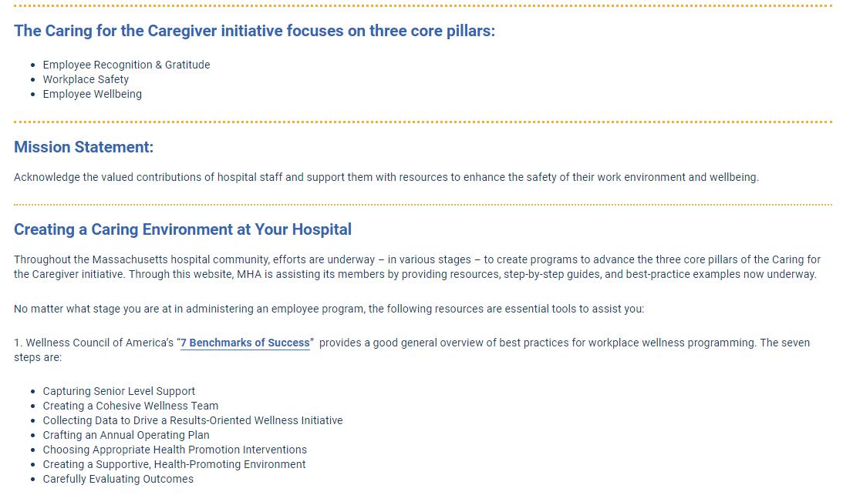

Slide 126
MHA’s Healthcare Safety Summit - December 4, 2018
Summit Topics
Overview of Current Trends & Types of Healthcare Violence and Conflict
Preventive Methodologies for Mitigating & Reducing Healthcare Violence and Conflict
Employee Engagement
Employee Recognition, Wellness & Resilience - Caring for the Caregiver Initiative

Slide 127
MHA Councils
Physician Hospital Integration Collaborative/Physician Leadership Council Quarterly Meetings
Focus on goal to combat physician burnout and provide task force updates.
Clinical Issues Advisory Council Quarterly Meetings
Focus on goal regarding workplace and worker safety and violence prevention education and strategies.

Slide 128
Resources
“Many elements of the work environment identified as important to nurses, including effective leadership, support for autonomous practice, good communication and strong interdisciplinary relationships, are central to the shared lived experience of other clinicians and health care workers throughout the health system.” ¹
Magnet Recognition Program (1990)
Eight Massachusetts hospitals are recognized as Magnet hospitals, with several more on the journey toward Magnet accreditation.
Healthy Nurse Healthy Nation, ANA (2017)
Joy and Meaning in Work and Building a Culture of Health, ONL (2017)
IHI Framework for Improving Joy in Work (2017)
Action Collaborative on Clinician Well-Being and Resilience, NAM (2016)
Standards for Establishing and Maintaining Healthy Work Environments, AACN (2016)
From Triple to Quadruple Aim: Care of the Patient Requires Care of the Provider, (2014)
Through the Eyes of the Workforce, NPSF, (2013)
Principles & Elements of a Healthful Practice/Work Environment, Nursing Organizations Alliance (2004)
¹Adams, JM, Zimmermann, D, Cipriano, PF et al. Improving the work life of health care workers: building on nursing’s experience. Medical Care. 2018: 56; 1-3.

Slide 129
Human Trafficking
Pat Noga, PhD, MBA, RN, NEA-BC, FAAN

Slide 131
What is Human Trafficking?
“..the recruitment, transportation, transfer, harboring or receipt of persons, by means of the threat or use of force or other forms of coercion, of abduction, of fraud, of deception of the abuse of power or of a position of vulnerability or of the giving or receiving of payments or benefits to achieve the consent of a person having control over another person, for the purpose of exploitation.
Exploitation shall include, at a minimum, the exploitation of the prostitution of others or other forms of sexual exploitation, forced labour or services, slavery or practices similar to slavery, servitude or the removal of organs…” (United Nations, 2000) (Article 3)
(https://www.unodc.org/unodc/en/human-trafficking/what-is-human-trafficking.html)

Slide 132
ICD-10-CM Codes for Human Trafficking Abuse
ICD-10-CM codes approved and released in June 2018; going live October 1
Required Action for
Coding professionals
Education on behalf of hospitals/health systems
Data collection and tracking to improve health

Slide 133
Human Trafficking
Joint Commission highlights “Identifying Human Trafficking Victims” in June 2018 newsletter
13% increase in the number of trafficking cases identified by Polaris Project in 2017
Up to 88% of self-identified sex trafficking survivors seen by health care provider while being exploited (Annals of Health Law study, 2014)
Proposed national legislation for HHS to create program to train providers to recognize human trafficking victims and refer to services

Slide 134
Human Trafficking
Missouri – passed law requiring the creation of posters providing information on national human trafficking resource center hotline.
New York – passed law requiring general hospitals and diagnostic treatment centers to establish and implement policies and procedures pertaining to the identification, assessment, and referral of victims of human trafficking.
Ohio – Attorney General requested hospitals to develop protocols to help staff identify human trafficking victims.
West Virginia – U.S. attorneys developed state Human Trafficking Task Force

Slide 135
24/7 National Human Trafficking Hotline and BeFree Textline (www.PolarisProject.org)
Notes:
Polaris Model
Serving victims and survivors through the 24/7 National Human Trafficking Hotline, coordinating with referral partners nationwide as a national access point for trauma-informed support.
Building one of the largest public data sets on human trafficking in the United States, digging deeper to learn how the
business of human trafficking really works, in real time.
Turning knowledge into action, designing targeted strategies that change entire systems tailored to specific sub-types
of trafficking and specific industries.
Enlisting law enforcement and other public and private-sector partners, moving those strategies into the real world to
support survivors, prevent and disrupt human trafficking

Slide 136
HEAL Trafficking (healtrafficking.org)
“We are a united group of multidisciplinary professionals dedicated to ending #humantrafficking and supporting its survivors, from a public health perspective.”
Evidence based protocols from across the country
Education and training
Resources
Listserv
Committees
Direct Services
Advocacy
Research
Notes:
Health, Education, Advocacy, Linkage
HEAL Trafficking. We are a united group of multidisciplinary professionals dedicated to ending human trafficking and supporting its survivors, from a public health perspective. Please join our network and commit to healing human trafficking!

Slide 137
HEAL Trafficking (healtrafficking.org)
Notes:
Health, Education, Advocacy, Linkage

Slide 138
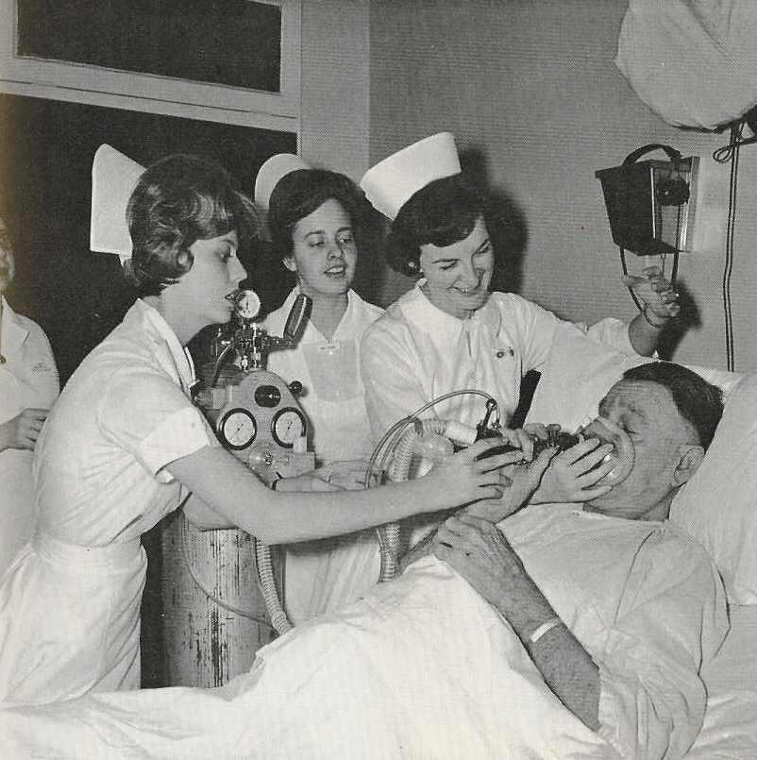
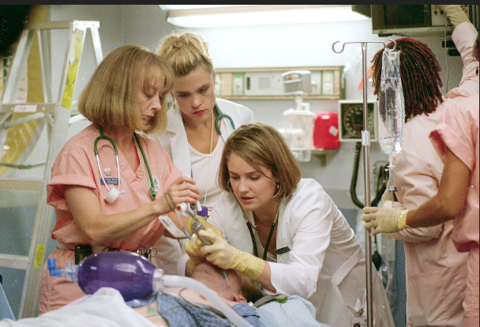
Workforce Quality & Safety for Nurses - Discussion
Pat Noga, PhD, MBA, RN, NEA-BC, FAAN

Slide 139
Thank you!

Slide 140
Social Determinants & Z Codes
Rob Shipp, The Hospital & Healthsystem Association of Pennsylvania

Slide 141
Disparities and Z-Code Analysis
Robert Shipp, III, MSHSA, RN, NEA-BC
VP, Population Health Strategies
October 12, 2018

Slide 142
Overview
Timeline
2015Q4-2017Q4
Quarterly Inpatient Claims
Patients
77,213 Z-Codes identified
57,561 Unique Patients
Codes
Inpatient Claim records
82 out of 87 identified Z-codes
Source: Pennsylvania Health Care Cost Containment Council, Inpatient claims

Slide 143
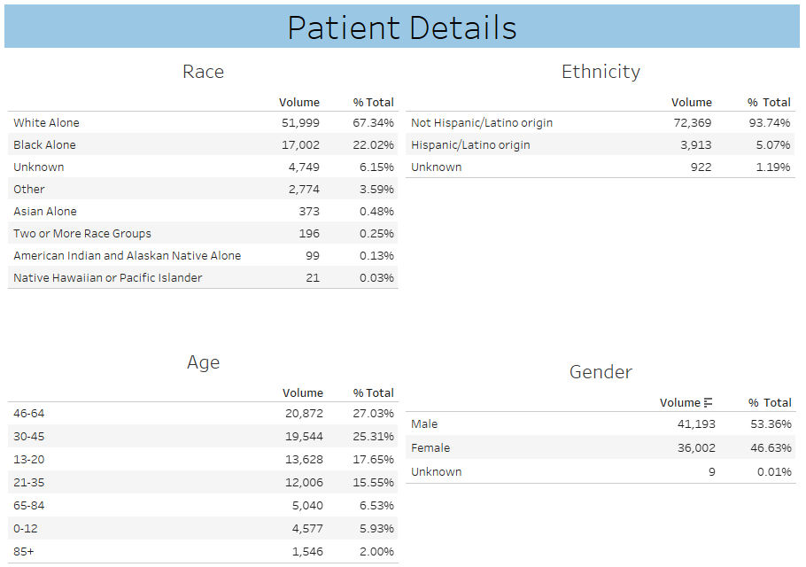

Slide 144
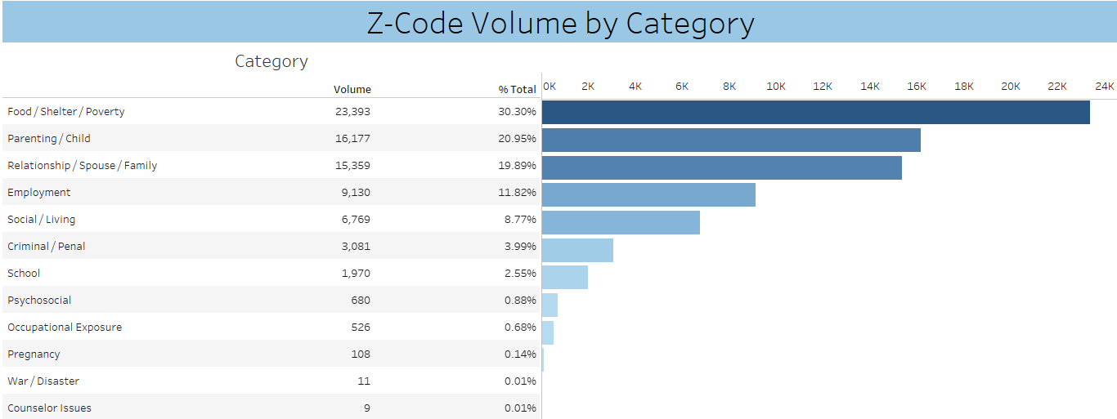

Slide 145
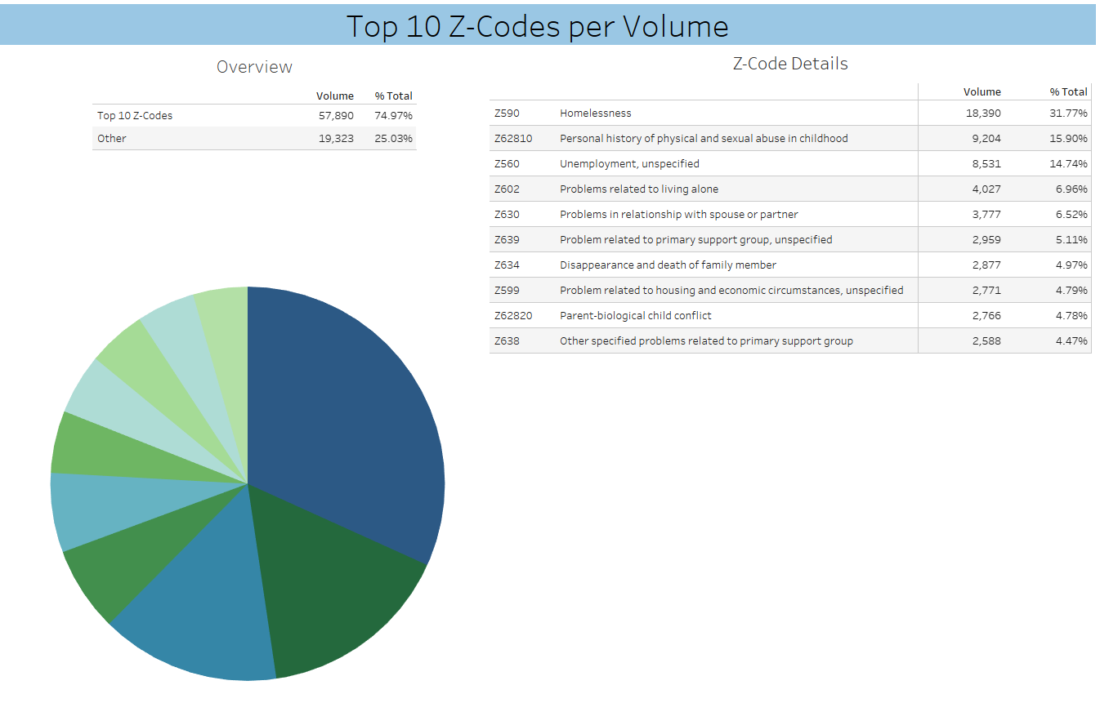

Slide 146
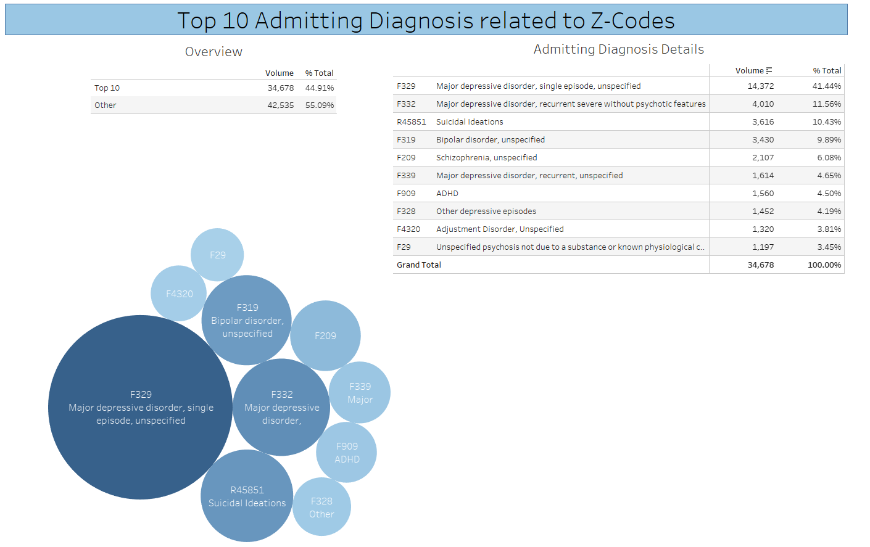
Example of an advocacy tool

Slide 147
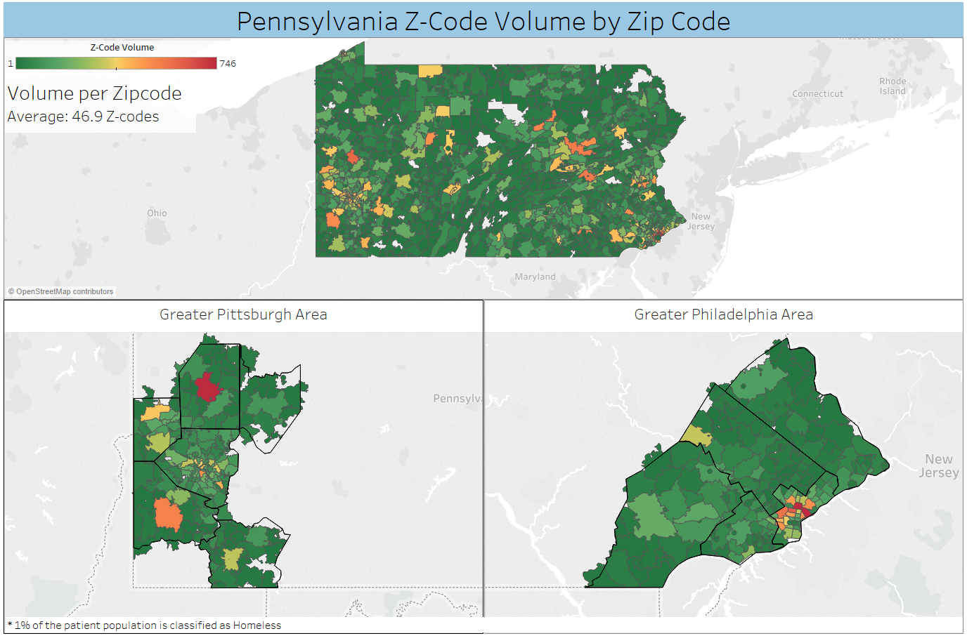

Slide 148
Networking
and
Refreshment Break

Slide 149
High Reliability Organizations
Lorri Gibbons, South Carolina Hospital Association

Slide 150
Sepsis
Patricia Atkinson, Alaska State Hospital and Nursing Home Association
Carol Wagner, American Hospital Association

Slide 151
Sepsis
Patricia Atkinson
Director of Quality and Performance Improvement Alaska State Hospital and Nursing Home Association
Carol Wagner
Senior Advisor President HRET
AHA Center for Innovation

Slide 152
Sepsis – Magnitude of the Issue
Sepsis is diagnosed in over one million patients each year in the United States.
$20.3 billion in health care costs
5.2 % of the total cost for all hospitalizations and was the most expensive condition treated
Mortality rate of 28 to 50 percent

Slide 153
Sepsis Core Measure
CMS National Core Measure for Sepsis, beginning October 2015, measures compliance with the 3-hour and 6-hour bundle interventions to reduce sepsis mortality.
National average: 49% (2017)

Slide 154
Sepsis
Sepsis is real and impacts our friends and family.
Photograph by Carol Wagner

Slide 155
Sepsis Mortality Reduction - Inpatient

Slide 156
How did they do it?
Part of 52-hospital Providence St. Joseph collaborative on sepsis mortality reduction
Use Hoag Hospital, Newport Beach CA, as model
Physician and nurse co-champions
Multidisciplinary steering committee
Strong administrative support

Slide 157
Multiple Interventions
PDSA cycles – analyzed from all angles
Gemba walks
CNA testing and education
Patient and family education
Bathroom education
Improving relationships – nurse/CNA
Improving communication – nurse/physician
Early risk recognition in the ED

Slide 158
Strategies That Make a Difference
Nurse initiated order sets
Sepsis nurses – smoother transitions
Reluctant docs listen to sepsis nurses
Hardwiring treatment bundles – high reliability

Slide 159
What’s working in your state?
Share best practices and tools
Share your challenges!

Slide 160
Administrative Wrap Up
Dinner: 6:00 p.m., Oxford Theater
Check-in with team in the back
Haunted Historical Walk: departs 7:00 p.m. from Oxford Theater
Tomorrow start:
Breakfast 7:30-8:00 a.m.
Welcome 8:00 a.m.

Slide 161
Welcome – Day 3
Housekeeping
CHA gold name tags
John Savage Cell: 720.295.7187
Invoices expected this quarter
Todays topics
A2Q
SC’s Transformation
Behavioral Health & Substance Issues

Slide 162
Brainstorming the Future of A2Q
Beth Dibbert, Wisconsin Hospital Association

Slide 163
A2Q – Structure and Leadership
Beth Dibbert
Chief Quality Officer
Wisconsin Hospital Association

Slide 164
Framing – We Own A2Q
Spring Meeting – Chicago (AHA and Joint Commission updates)
Fall Meeting – various locations, agendas, etc.
Monthly calls – updates from AHA
Departure and arrival of members of this group are not formally announced
Leadership for event and agenda planning is “presumed”
History of the group is not documented formally
Generally not organized

Slide 165
Are we okay?
What are the benefits/risks of the status quo?
If we want a more formalized leadership structure, what would it look like?
How do we balance benefit/burden of a more formalized leadership structure?

Slide 166
A2IRNET model
Planning committee volunteers for the next year’s events
Meets regularly via conference call and pitches in to help out
In addition to the planning committee there are two leaders elected every year – the chair and the host
The chair is responsible for “content”
The host is responsible for logistics and “fun stuff”
Elected two years ahead of when they will serve (apprenticeship and fallback in case of a committee member departure)

Slide 167
Jim’s Suggestion
A2Q “council”
Small group that stays in touch
Makes sure A2Q is “on track” for the next year(s)
Could be made up of past 2 fall hosts and next 2 year fall hosts
Additional duties (added by me)?
Keep a history?
Onboard and orient new members?

Slide 168
Discussion and Choices…..

Slide 169
Save the Date
2019 A2Q Fall Meeting
October 27-29
Boston Loews Hotel
Boston, MA
www.loewshotels.com/boston-hotel
For questions, contact:
pnoga@mhalink.org
Registration details and agenda will be available soon.
Hosted by

Slide 170
Association Transformation
Lorri Gibbons, South Carolina Hospital Association

Slide 171
“Transformation”
Transforming what?????
Lorri Gibbons, RN, MSHL, CPHQ
Vice President, Development, SCHREF

Slide 172
Needs, Wants, Desires
Focus on things that the hospitals care about
Provide more focus and a succinct approach on visits, less individual visits
Want more data
Self select areas of concern/improvement – SCHA’s urgent needs are not necessarily the hospital’s urgent need!
Priorities areas were identified and set by our members:
community health
reliability
workforce
Notes:
Thornton was hearing feedback from the hospitals of “project overload, too many visits, not enough relevant data, SCHA’s urgency was not necessarily their urgency! Initially met with 6 CEOs, CMOs and CNOs to talk about SCHA’s current approach to support them. They emphatically did not want us to become “consultants” but wanted more autonomy in selecting supportive resources based on data.
The visits were very open and candid! Areas of concern are wide open – do not need to be clinical!

Slide 173
Outcome
The strategic plan for SCHA was created focusing on the three identified areas – community health, reliability and workforce.
Tasked with building an approach that offers customized support based on the facility’s data.
Overarching goals is to improve the health status of South Carolina!
Notes:
SCHA pushes out the data and hospitals self-select the areas of concern and needed improvement. Hospitals then pull from SCHA the needed resources and support. We need dialogue to dissect the data, identify areas of concern, address approach through elements of high reliability – 5 behaviors plus Just Culture, Robust process improvement, leadership engagement and established pt/family engagement

Slide 174
Our Aha Moment……………
Transformation at SCHA!
Notes:
We told every hospital that it was our transformation! How SCHA will work with our hospitals to affect change - again using the principles of high reliability.
5 behaviors of highly reliable organizations – Preoccupation with failure, Reluctance to simplify, Sensitivity to operations, Commitment to resilience, Deference to expertise PLUS Just Culture, Robust Process Improvement, Leadership Engagement, Pt and Family Advisory Councils

Slide 175
Outline of Transformation Team hospital visit
Introduction and purpose of the meeting – We LISTENED to you!
Transformation of Quality, Safety and Population Health approach and support under community, reliability and workforce priorities
Start meaningful dialogue with c-suite. Decision making/identified priorities set by hospital and based on data (By the Numbers)
SCHA can provide support through all of our existing service lines and also research hospital suggestions/ideas for new SCHA innovation.
Self-select areas for support/improvement
Notes:
We visited all 67 acute care member hospitals – engaging the C-suite of each hospital. “Know” more through “Listening”. We initially presented By The Numbers 1.0

Slide 176
Notes:
We debriefed after each visit, collated all feedback and identified priorities from all hospitals. After trending the responses, we felt our initial report (By the Numbers 1.0) needed to be revised. The next iteration was created called “ By The Numbers 2.0” (data report) and it was our dialogue enhancer!

Slide 177
Notes:
Identified 4 areas of our state for benchmarking
Website for data measures, methodology, and high performers
Identified SCHA Navigator
Identified 3 priority areas, assigned focus areas (took inventory and categorized all SCHA services into focus area grouping) and high level measures for each focus area
Questions concerning By The Numbers (data report)

Slide 178
Notes:
Facility specific data – community Health – pop health
Brief explanation of facility specific report
Statewide and national benchmarking
Dialogue Driver: self selected identified areas for support

Slide 179
Notes:
Facility specific data – Reliability - clinical

Slide 180
Notes:
Workforce – still in construction. Wanted to hear more of what they want
Glossary

Slide 181
Notes:
Current hospital initiative participation
Need Hospital Point of Contact

Slide 182
Collective Impact
Aggregate all data points, benchmark to regional, statewide and national to identify statewide measures for improvement.
SCHA selects 5-7 measures that are effecting the health of our state
Present to SCHA Board for selection of 1-2 statewide measures to impact improvement (collective impact) by all member hospitals
Ultimate goal: improve the health status of South Carolina
Notes:
Ultimate goal: improve the health status of South Carolina!! Hospitals, individually and collectively, will focus on improvement areas employing elements of high reliability to accelerate change, improvement and sustained gains.

Slide 183
By The Numbers Plus
MEASURES
PRINT
SAVE AS .PDF
 | BY THE NUMBERS PLUS |  |  | HOME | SC CURRENT |  | Range | Count
 |  |  |  |  | QUINTILES | 16% | 16% - 25% | 11
 | Click a link below to navigate to a tab with more details about a specific measure for your hospital/county.
 | FOCUS | NUMBER | MEASURE NAME | TYPE
 | COMMUNITY HEALTH | 1 | Physical Inactivity | County
 |  | 2 | Food Environment Index | County
 |  | 3 | Fair or Poor Health | County
 |  | 4 | Obesity | County
 |  | 5 | High School Graduation Rate | County
 |  | 6 | Uninsured Rate | County
 |  | 7 | Preventable Hospitalizations | County
 |  | 8 | Infant Mortality | County
 |  | 9 | Percentage of Low Birthweight Births | County
 |  | 10 | Low Birthweight Births Racial Disparity Gap | County
 |  | 11 | Poor Mental Health Days | County
 |  | 12 | Naloxone Administration by EMS | County
 |  | 13 | Transitional Care Management Revenue Opportunity | Hospital
 |  | 14 | Hospital Economic Impact | Hospital
 | RELIABILITY | 15 | Patient-Doctor Communication Satisfaction | Hospital
 |  | 16 | Patient-Nurse Communication Satisfaction | Hospital
 |  | 17 | Annual Routine Care | County
 |  | 18 | STAR Rating | Hospital
 |  | 19 | Harm | Hospital
 |  | 20 | Heart Failure Mortality (Medicare) | Hospital
 |  | 21 | Emergency and Inpatient Behavioral Health Diagnoses | Hospital
 |  | 22 | Emergency and Inpatient Opioid Overdoses | Hospital
 |  | 23 | Readmission Rate | Hospital
 |  | 24 | Readmission Rate Racial Disparity Gap | Hospital
 |  | 25 | Value Based Purchasing Impact (Medicare) | Hospital
 |  | 26 | Hospital-Acquired Conditions Impact (Medicare) | Hospital
 |  | 27 | Medicare Spending Per Beneficiary Score | Hospital
 |  | 28 | Readmission Rate Penalty (Medicare) | Hospital
 | WORKFORCE | 29 | Hospital-wide Turnover Rate | Hospital
 |  | 30 | Supplemental Staff Placed | Hospital
 |  | 31 | Supplemental Staff Assignment Length | Hospital
 |  | 32 | FTEs per Adjusted Average Daily Census | Hospital
 |  | 33 | Physician Concentration | County
Notes:
Interactive data tool to provide accelerated and in-depth details for all measures – not for the average C-Suite!

Slide 184
High Reliability comes in many forms. Our high reliability journey has evolved from collaborating with the Joint Commission’s Center for Transforming Healthcare exploring hospital centric HR fundamentals to adoption of the ACHE Blueprint. But no matter what platform you choose, there are proven elements that transcend all platforms.
It is with a new approach to working with our member hospitals that we hope to accelerate improvement, innovation and reliability in all areas of community, health and health care delivery and work force.

Slide 185
Behavioral Health
Jenny Schoenecker, Minnesota Hospital Association

Slide 186
Mental and Behavioral Health
Jenny Schoenecker, Senior Director, Quality and Patient Safety

Slide 187
Agenda
MBH committee
PAD Study
SIA
Asset Mapping

Slide 188
Approach
Action
Awareness
Advocacy
Notes:
Addressing mental and behavioral health is a priority for MHA and our members.
MHA’s MBH efforts are encompassed in our multipronged approach through
Advocating for public policies that support access to care and services:
Raising the public’s awareness of mental and behavioral health needs
Taking action to help our members deliver better care to patients by:
Improving access;
Encouraging collaboration
parity

Slide 189
MBH Committee
Priority Topic | Detail
1) MN Mental Health Access Website | Enhance the mental health access website to improve collection and retrieval of access data in order to serve patients better across the state and increase participation.
2) Partnership with CCBHCs | Develop a statewide care transition and communication approach for CCBHC patients. Collaboration between with the CCBHCs and hospitals and health systems to determine, develop and disseminate methods and tools to enhance continuity of care.
3) Mental and behavioral health education | Coordinate and disseminate mental and behavioral health educational opportunities:

Slide 190
Mental and Behavioral Health Committee subgroup
Mental and Behavioral Health Committee
1) Expand to include Intensive Residential Treatment Services (IRTS), crisis, detox and partial hospitalization
Mental Health Access Website Subgroup
3) Increase the information that is available on the services
2) Increase communication of the available website resources
4) Annual user survey/review

Slide 191
MN MH Access Website

Slide 192
MN MH Access Website
Service Drop Down Options:
-Acute Care Hosp.
-Intensive Residential Treatment
-Assertive Community Treatment
-Crisis Beds
-Crisis Teams
-Detox
-Partial Hospitalization
-Day Treatment
Service For Drop Down Options:
-Child <12
-Adolescent 12-18
-Adult 18+
-Geriatric

Slide 193
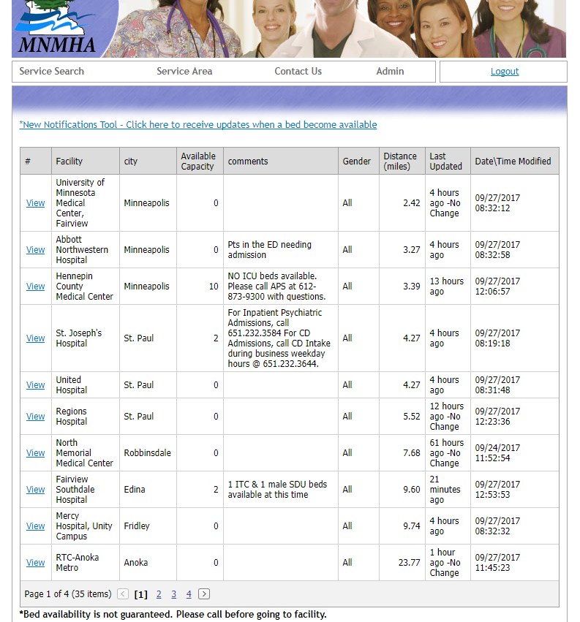
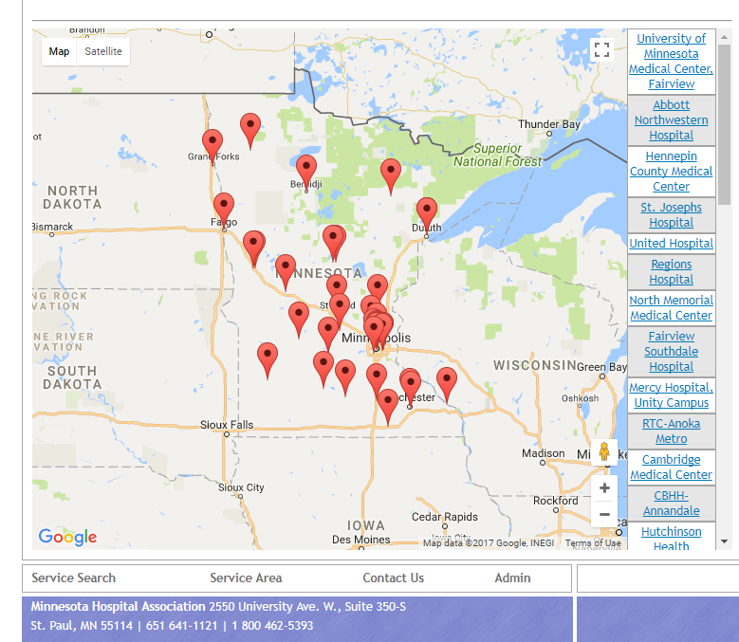
MN MH Access Website

Slide 195
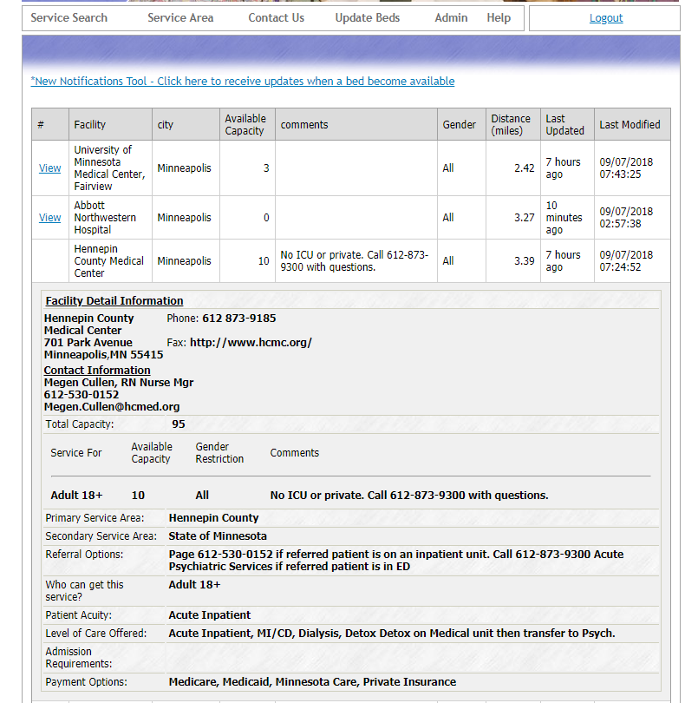

Slide 196
Mental and Behavioral Health Committee subgroup
Mental and Behavioral Health Committee
Certified Community Behavioral Health Clinic (CCBHC) Subgroup
2) Develop a card for patients to carry
3) Care coordination from ED to discharge with warm hand offs
1) Develop a tip sheet for staff to refer to on communication methods for CCBHC patients.
4) Identify and share care coordination best practices

Slide 197
Partnership with CCBHCs

Slide 198
Mental and Behavioral Health Committee subgroup
Mental and Behavioral Health Committee
Certified Community Behavioral Health Clinic (CCBHC) Subgroup
2) Develop a card for patients to carry
3) Care coordination from ED to discharge with warm hand offs
1) Develop a tip sheet for staff to refer to on communication methods for CCBHC patients.
4) Identify and share care coordination best practices

Slide 200
Mental and Behavioral Health Committee subgroup
Mental and Behavioral Health Committee
Certified Community Behavioral Health Clinic (CCBHC) Subgroup
2) Develop a card for patients to carry
3) Care coordination from ED to discharge with warm hand offs
1) Develop a tip sheet for staff to refer to on communication methods for CCBHC patients.
4) Identify and share care coordination best practices

Slide 202
Mental and Behavioral Health Committee subgroup
Mental and Behavioral Health Committee
Certified Community Behavioral Health Clinic (CCBHC) Subgroup
2) Develop a card for patients to carry
3) Care coordination from ED to discharge with warm hand offs
1) Develop a tip sheet for staff to refer to on communication methods for CCBHC patients.
4) Identify and share care coordination best practices

Slide 203
Best Practices

Slide 204
Potentially Avoidable Days

Slide 205
Potentially Avoidable Days Study
STATEWIDE
Of the 32,520 possible bed days in east metro hospitals
6,052 were potentially avoidable

Slide 206
Potentially Avoidable Days Study

Slide 207
PAD Study Participating Hospitals

Slide 208
Systems Improvement Agreement

Slide 209
Systems Improvement Agreement

Slide 210
Systems Improvement Agreement

Slide 211
Asset Mapping

Slide 212
Networking
and
Refreshment Break

Slide 213
Opioids Again!
Leslie Porth, Missouri Hospital Association

Slide 214
Marijuana and Hospitals
John Savage, Colorado Hospital Association

Slide 215
Legalizing Marijuana: Policy Considerations
John Savage, MBA, CMPE, PMP
Director, Quality Improvement and Patient Safety

Slide 216
MJ Dictionary
Cannabinoids: a class of diverse chemical compounds that acts on cannabinoid receptors in cells that alter neurotransmitter release in the brain
THC (tetrahydrocannabinol): The principal psychoactive constituent of cannabis, making the user feel “high”
CBD (cannabidiol): A non-psychoactive cannabinoid with analgesic, anti-inflammatory, and anti-anxiety properties
Cannabis Oil (aka CBD oil, resin): extraction from marijuana plant containing 80% THC; commonly used to treat severe epilepsy, anxiety, pain
Hemp: a “cousin” to marijuana that grows differently (size, space) and is low in CBD and THC; commonly used for fabrics and food products, but growth is still prohibited under federal law

Slide 217
Marijuana Legislation
Colorado was the first state to establish legal retail recreational marijuana sales in January 2014.
Sources: Third Way, April 2017; Business Insider, June 2018

Slide 218
Colorado Law: 21-year-olds
Consumption
Six plants
One ounce

Slide 219
Colorado Law: Recreational Basics
Purchasing Limits, Possession and Consumption
Purchasing limit is one ounce (28 grams) in a single transaction (1 gram/10mg THC is a typical “serving”)
Legal possession limited to one ounce
Public consumption (smoking, eating, etc.) is NOT permitted, nor is use on federal land
Use of edibles and vaping in public is prevalent, but not legal per se
State law prohibits liquor stores from also having a dispensary license
State law prohibits consumption at a dispensary
Denver Initiative 300 (2016): allows permit for for limited public consumption at private clubs and events
Packaging Rules
All packaging requires universal symbol
Child protection efforts
Must be child-resistant
Must say “Contains Marijuana. Keep out of the reach of children.”
May not say “candy” or “candies”

Slide 220
Colorado Law: Recreational Basics
Driving Under the Influence of Drugs (DUID) Laws
Legal limit is five nanograms THC per liter of blood
Actual impairment is highly variable: when MJ consumed, what kind, heaviness of use
Tests do not measure impairment, just presence of THC
“Seed to Sale” Tracking
Individual product tracked from grow facility to manufacturer to retailer to purchaser
Transport & Federal Law
MJ is subject to state “open container” laws while driving
It is illegal to transport MJ across state lines, including via mail
Possession and use are prohibited on federal lands

Slide 221
What has this meant to Colorado?
Sales & Tax Revenue
The Cannabist: Newspaper fully devoted to marijuana journalism
Influx in marijuana tourism
Dispensaries are prevalent
Think about zoning near schools, jails, etc.
Some cities or counties have banned retail sales or limited sale hours
Year | Sales | State Tax Revenue
2014 | $683.5 million | 67.6 million
2015 | $995.6 million | 130.4 million
2016 | $1.3 billion | 193.6 million
2017 | $1.5 billion | 247.4 million

Slide 222
Lessons Learned – Hospitals
Role as Employer: Review employment rules and policies
In CO, legalization does not protect individuals against employment actions
Will MJ be treated more like alcohol or more like illicit drug use? (In CO, more like alcohol)
Can hospitals test employees? (OK in CO)
Can employees be disciplined or terminated for legal “on my own time” use? (OK in CO)
Can employees possess but not use while at work? (OK in CO)
Role as Care Provider
When a patient is in possession or is using MJ medically or recreationally
How to track and whether patients will be tested for MJ (there is a code for that)
Whether to allow employees/contracted docs to prescribe
When a visitor is in possession
Consider partnership with poison control center
Role as Researcher
Challenging under federal law

Slide 223
Lessons Learned – Education
$7 million education campaign
Funded through tax revenue
Refined issues/messaging
Time from ingestion to “high”
Understanding standard dosage
Potency and effects vary across products
Accidental ingestions, especially children
Packaging matters
Dangers of illegal/unregulated production (e.g., hash oil)

Slide 224
Lessons Learned – Resource Materials
https://www.colorado.gov/pacific/marijuana/laws-about-marijuana-use
Denver Public Health -http://denverpublichealth.org/Portals/32/Public-Health-and-Wellness/Public-Health/Health-Information/Docs/DPH-Marijuana-Fact-Sheet-FINAL-9-2015.pdf?ver=2015-09-17-085655-937
Data - http://denverpublichealth.org/home/health-information-and-reports/reports-and-publications/marijuana-data
State Health Department: https://www.colorado.gov/pacific/cdphe/retail-marijuana

Slide 225
Adjourn
Spring 2019: Chicago
What do we need to do?
Who can help?
Fall 2019: Boston
Oct. 27-29
Travel Safe
Thank you

