Slide 1
Federal Regulatory Update
October 2018
Nancy Foster, Vice President, Quality Policy
Diane Jones, Director, Policy

Slide 2
Agenda
Washington Update
Burden Reduction rule
FY Final and CY Proposed Rule Recaps
Health IT
CAHPS
Accrediting Organizations
Behavioral Health
Opioids
Rural Hospitals
Looking Ahead

Slide 3
Individual Market Developments
Expanded access to association health plans
11 states and DC suing the Administration over this rule
Expanded availability of short-term, limited-duration health plans
Consumers will now be able to renew short-term coverage for up to three years
States retain authority to regulate (and even ban) these plans
Decreased funding for the navigator program for the second year
Texas lawsuit against the ACA continues
A coalition of state attorneys general are defending the law
Amicus brief filed by AHA and other national hospital associations
Notes:
The Administration expanded access to association health plans (group health plans that employer groups and associations can join together to offer; new rules allow members to join based on geography alone OR by business/professional interests)
11 states and DC are suing the Administration over this rule, as it allows flexibility in covering essential health benefits
Shared regulatory authority between states and federal government; exact state role under discussion with the Labor Department
Administration expanded availability of short-term, limited-duration health plans (extends maximum duration of short-term plans from 3 months to 12; plans to do not have to comply with ACA rules)
Consumers will now be able to renew short-term coverage for up to three years
States retain authority to regulate (and even ban) these plans
Administration decreased funding for the marketplace navigator program for the second year; the program was created by the ACA to provide outreach, education, and enrollment assistance for marketplace and Medicaid coverage
Justified reduction in funding because they say public awareness of health insurance options in marketplaces has grown
Will also require navigators to promote short-term plans during 2019 open enrollment
Texas lawsuit to end the ACA continues; state argues that ACA is no longer constitutional after Congress repealed the individual mandate.
A coalition of state attorneys general is defending the law, including the community rating and pre-existing condition protections; AHA and other national hospital associations filed an amicus brief in support of the ACA

Slide 4
Reducing Burden: Potential Progress
CMS RFI on Stark and HHS OIG RFI on Anti-Kickback Statute (AKS)
Stark RFI released June 25; comment period closed Aug. 24
AKS RFI released Aug. 24; comments due Oct. 26
CMS forthcoming guidance
Ligature risk
Co-location
EMTALA issues
Notes:
WE WILL DISCUSS CO-LOCATION AND EMTALA ISSUES IN A COUPLE OF SLIDES but they are referenced here
RFIs
Stark – physician self-referral law – AHA submitted comments
AKS – AHA will be submitting comments.
On September 17, 2018 CMS released a proposed rule intended to reform certain Medicare regulations that it identified as unnecessary, obsolete, or excessively burdensome on a subset of health care providers and suppliers. These are religious non-medical health care institutions, ambulatory surgical centers (ASCs), hospice, hospitals, transplant centers, home health agencies (HHAs), comprehensive outpatient rehabilitation facilities (CORFs), critical access hospitals (CAHs), community mental health centers, portable X-ray services, rural health clinics (RHCs) and federally qualified health centers (FQHCs). Also addressed are regulations involving emergency preparedness of providers and suppliers. The rule was published in the Federal Register on September 20th, and the deadline for public comment is November 19, 2018.

Slide 5
Calendar Year (CY) Proposed Rules
Burden Reduction
Outpatient/ASC
Home Health
Medicare Shared Savings Program
Fiscal Year (CY) Final Rules
Inpatient
Physician Fee Schedule (PFS)/MACRA Quality Payment Program
Inpatient Psychiatric Facility
Post-acute Care
Inpatient Psych
Long-term Care Hospitals
Skilled Nursing Facilities
Notes:
We’ll do a high-level overview of the issues in the calendar year proposed rules and fiscal year final rules, knowing that you’ve heard updates from us on these already. However, I want to start with the Burden Reduction rule.

Slide 6
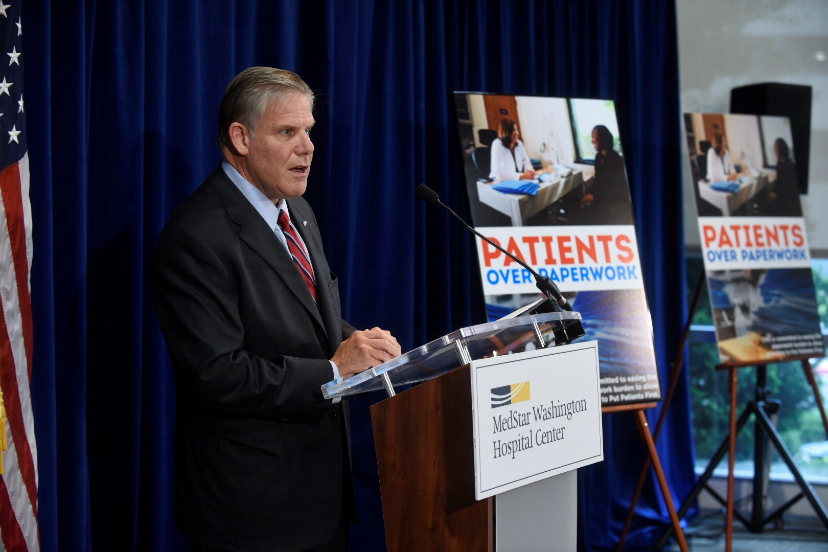
Reducing Burden: Proposals & Progress
Comments Due November 19
Omnibus CMS Proposed Rule Released September 17
Increase organs for transplantation
System approach to quality/ safety
Flexibility on emergency preparedness training & CAH review of policies
Greater flexibility on pre-op assessments
Eliminate ASC requirements to have agreements with hospitals in case something goes wrong
Notes:
TOSS TO NANCY FOR SLIDES 10-12, 13-18. DISCUSSION to occur on this slide (10) 8:56 mark
On September 17, CMS released its Omnibus Burden Reduction Rule.
The proposed rule affects hospitals, critical access hospitals, psychiatric hospitals, ambulatory care clinics, ambulatory surgical centers, hospice providers and more.
CMS estimated the savings at $1/1 billion per year and asked AHA to join in a press event that both released the proposed rule and celebrated efforts to date to reduce burden. Rick Pollack joined CMS administrator, Seems Verma, for the event. (IN REGION 3, note that the event was at the Washington Hospital Center and the other person pictured is Dr. Greg Argyros (R-ger ROSS), President and CEO of WHC and formerly in charge of Walter Reed Medical Center.)
Key proposed provisions include:
Changing the way CMS uses metrics to assess transplant centers and determine if they will be re-certified to continue transplantation. (many had complained that the metrics of survival rates led the surgeons to not use some viable organs)
Allowing multihospital systems to take a unified approach to quality assessment and infection control
Providing greater flexibility in how hospitals conduct emergency preparedness training
Allowing CAHS to review their policies and procedures once every two years instead of annually
Allowing medical staffs to specify what types of pre-op/ pre-procedure assessments need to be done
Eliminating the requirement that ASCs have agreements with hospitals to treat patients when something goes wrong; no longer requiring ASC surgeons to maintain privileges at a hospital.
AHA is soliciting clinical and other input and will be submitting comments

Slide 7
CMS’s Meaningful Measures Initiative
Notes:
Moving on to the payment rules, much of the activity related to quality stemmed from CMS’s Meaningful Measures Initiative.

Slide 8
Progress on “Measures that Matter”
AHA influenced CMS’s “Meaningful Measures”
16 out of 19 CMS meaningful measure areas align with AHA measure priority list (other 3 reflect AHA cross-org priorities)
FY / CY 2019 CMS policies by the numbers:
29 percent reduction in inpatient hospital measures
28 percent reduction in inpatient psychiatric measures
55 percent reduction in outpatient hospital measures (proposed)
34 measures removed from MIPS (proposed)
10 measures removed from various post-acute care programs (final)
AHA-facilitated collaborative effort for public / private measure alignment underway
Notes:
We have made important progress on urging CMS to streamline and focus its quality measurement and value programs around “measures that matter.”
CMS calls its quality burden reduction framework “meaningful measures.” CMS’s measure priority topics align very closely with those the AHA developed with the input of councils and RPBs back in 2016. In fact, 16 out of 19 topics align with ours. And the remaining 3 (e.g., health equity, community engagement) reflect AHA cross-organizational priorities. CMS officials told us when Meaningful Measures launched that they made use of our analyses, and hoped we recognized our work in theirs.
Obviously, streamlining measures is a multi-year effort. But CMS has made some significant progress, as demonstrated by its most recent finalized and proposed policies [READ BULLETS ON SLIDE]
We also recognize that CMS programs are the biggest – but not only – driver of measurement burden. That is why we also have been working with the national hospital associations, AHIP and the Blues on a collaborative effort to align public and private measurement efforts. More to come on that in the coming months.

Slide 9
Updates to Measure Removal Factors
Factor 1: Measure performance among providers is so high and unvarying that meaningful distinctions in improvements in performance can no longer be made (measure is “topped out”).
Factor 2: Performance or improvement on a measure does not result in better patient outcomes.
Factor 3: The measure does not align with current clinical guidelines or practice.
Factor 4: A more broadly applicable measure (across settings, populations, or conditions) for the particular topic is available.
Factor 5: A measure that is more proximal in time to desired patient outcomes for the particular topic is available.
Factor 6: A measure that is more strongly associated with desired patient outcomes for the particular topic is available.
Factor 7: Collection or public reporting of a measure leads to negative unintended consequences other than patient harm.
NEW: Factor 8: the costs associated with a measure outweigh the benefit of its continued use in the program.
Notes:
Across the board, CMS proposed a unified set of measure removal factors that the agency uses to consider whether a measure, on a case by case basis, should be retained in a quality reporting program. Each of the QRPs– IP, OP, post-acute, etc.– had its own fairly similar list of removal factors. CMS proposed to use the first seven factors you see there in each of the programs, and to add a new 8th factor: the costs associated with a measure outweigh the benefit of its continued use in the program. When CMS says “Costs,” they mean both the costs to the provider associated with collecting and reporting the data as well as participating in various quality reporting and improvement activities and programs, but also the cost to the agency itself– costs to review and maintain measures and reporting interfaces.
One idea that occurred to use this year is that CMS might consider using a 9th factor when identifying measures that might be removed: loss or lack of NQF endorsement. As you know, NQF conducts regular measure reviews to ensure that specifications are up-to-date in terms of clinical guidelines, validity and reliability, so if NQF removes its endorsement then that’s an indication that the measure doesn’t work for its purpose any more. Of course, just as with any of these other factors, if a measure loses endorsement it wouldn’t automatically be removed from the program– for example, if the measure still addresses an important aspect of care that is otherwise not measured or if removing the measure would result in declines in quality of care.
CMS applies these measure removal factors to the various QRPs, and proposed the removal of several. Starting with the OQR:

Slide 10
OQR: Measures Proposed for Removal
Measure Number | Measure Title | Rationale for Removal
OP-27 | Influenza Vaccination Coverage among Healthcare Personnel | Costs to use NHSN outweigh benefits of measure
OP-5 | Median Time to ECG | Costs outweigh benefits; little variation; NQF endorsement removed
OP-9 | Mammography Follow-up Rates | Not in line with recently updated clinical practices
OP-11 | Thorax Computed Tomography (CT) Use of Contrast Material | Topped out
OP-12 | The Ability for Providers with HIT to Receive Laboratory Data Electronically Directly into Their Qualified/Certified EHR System as Discrete Searchable Data | Does not directly assess quality or patient outcomes; not NQF-endorsed
Notes:
NANCY WILL DO QUICK CLICKS THROUGH SLIDES 14-16
Won’t go into detail on all of these measures unless asked, but you can see that a common theme among these measures for removal is that several of them have lost or never received NQF endorsement. CMS acknowledges in their rationale that the measures are not endorsed, although they don’t directly state that they are removing the measure because of that reason.

Slide 11
Measures Proposed for Removal, cont.
Measure Number | Measure Title | Rationale for Removal
OP-14 | Simultaneous Use of Brain Computed Tomography (CT) and Sinus CT | Topped out
OP-17 | Tracking Clinical Results between Visits | Does not directly assess quality or patient outcomes; NQF endorsement removed
OP-29* | Endoscopy/Polyp Surveillance: Appropriate Follow-up Interval for Normal Colonoscopy in Average Risk Patients | Costs outweigh benefits; measure available in MIPS
OP-30* | Endoscopy/Polyp Surveillance: Colonoscopy Interval for Patients with a History of Adenomatous Polyps-Avoidance of Inappropriate Use | Costs outweigh benefits; measure available in MIPS
OP-31* | Cataracts: Improvement in Patient’s Visual Function within 90 Days Following Cataract Surgery | Costs outweigh benefits; low reporting rates
*Proposed for removal from ASCQR as well
Notes:
I’ll note that there are a few other OQR measures that do not have NQF endorsement but are not proposed for removal in this proposed rule. In our comments, we do suggest that CMS consider the removal of those measures as well.

Slide 12
ASCQR: Measures Proposed for Removal
Measure Number | Measure Title | Rationale for Removal
ASC-8 | Influenza Vaccination Coverage among Healthcare Personnel | Costs to use NHSN outweigh benefits of measure
ASC-1 | Patient Burn | Topped Out; NQF endorsement removed
ASC-2 | Patient Fall | Topped Out; NQF endorsement removed
ASC-3 | Wrong Site, Wrong Side, Wrong Patient, Wrong Procedure, Wrong Implant | Topped Out; NQF endorsement removed
ASC-4 | All-Cause Hospital Transfer/Admission | Topped Out; NQF endorsement removed
Notes:
Overall, CMS proposes to remove 10 measures from the OQR and 8 measures from the ASCQR. And like I said, there are several others that we think should be removed. However, if all of these measures were removed, both QRPs would have very few measures left. You’ll see here in the ASCQR that several safety-related measures are being removed. CMS does raise the question in their rules about future measure topics– if these measures aren’t the right ones, what measures are? One conversation this leads to is whether there are aspects of patient safety, perhaps even beyond HACs, that we should be considering.

Slide 13
HH Proposed Rule: Measures for Removal
Depression Assessment Conducted
Still required for risk adjustment
Diabetic Foot Care and Patient/Caregiver Education
Multifactor Fall Risk Assessment
Improvement of Surgical Wounds
Still required for risk adjustment
ED Use Without Readmission in First 30 Days
Rehospitalization in First 30 Days
Pneumococcal Polysaccharide Vaccine
Topped Out
More applicable measure available
Not in line with clinical guidelines
Notes:
CMS also proposed to remove 7 measures from the home health QRP. Happy to go into detail, but I think one of the takeaways here is from the removal of the ED Use and Rehospitalization measures– both are being removed because there are other measures in the HH QRP that capture the same data and more because they look at a longer time period (in first 60 days). We’re hoping CMS learns some lessons from this measure removal– maybe next time when they add a measure that will capture the same data as an existing measure, they’ll remove that from the outset.

Slide 14
HH VBP: New Composite Measures
Replace Improvement in Bathing, Bed Transferring, and Ambulation-Locomotion measures
Incorporates those OASIS items with 6 others to create two new measures:
Total Normalized Composite Change in Self-Care
Grooming, upper body/lower body dressing, bathing, toileting hygiene, eating
Total Normalized Composite Change in Mobility
Toilet transferring, bed transferring, ambulation/locomotion
Calculates absolute change for each OASIS item at episode level
Normalizes scores; sums normalized scores
Averages scores for all episodes
Risk-adjustment with national and HHA-specific predicted values
HHA Risk-Adjusted Score = HHA Observed + (National Predicted – HHA Predicted)
Notes:
Another interesting development from the HH space is in the VBP pilot. CMS is testing out measures in these limited-scope pilots so they can potentially implement them in larger scale programs later. For HHAs, this might mean measures that are more applicable to their patients. For example, a lot of outcomes measures evaluate how a patient is improving. However, many HH patients are chronically ill or otherwise not really expected to get better. Thus, if a HHA performs poorly on an outcome measure, it might not be due to a failure on the HHA’s part, but rather a reflection of patient characteristics.
Thus, CMS proposed to implement two new composite measures that evaluate stabilization, or lack of decline, rather than improvement. These measures combine several aspects of functional status– generally, self-care and mobility– and instead of measuring improvement over time, will compare absolute change over time. So if a patient starts out less functionally independent– that is, sicker– and doesn’t have high functional scores at the end of the episode, the HHA would not necessarily look like a poor performer.
Of course, these are new measures that haven’t been implemented yet– the rule isn’t final– so we’ll see how it pans out.

Slide 15
MSSP: ACOs – Pathways to Success Rule
Proposed redesign of Medicare Shared Savings Program
New tracks
Differentiated options by ACO characteristics
If finalized, would be harder for “high-revenue” ACOs to achieve savings
Other proposals include less time for upside-only risk, fewer shared savings, and refinements to benchmarking methodology
Notes:
DIANE PICKS UP WITH THIS SLIDE (slide 19) AND CONTINUE TO SLIDE 23 (HOSPITAL VBP)
In mid-August, CMS published a proposed rule to completely redesign the Medicare Shared Savings Programs (MSSP). Among the changes, CMS would discontinue the existing Tracks 1 and 2 and the CMMI Track 1+ model and instead offer a BASIC track and an ENHANCED track. The BASIC track would offer a glide path to risk consisting of 5 levels, two of which would be upside-only risk, but only certain ACOs would be permitted to enter the program at the start of the glide path. The ENHANCED track is designed to replace the existing Track 3.
CMS proposes to differentiate between ACOs based on several characteristics (e.g., previous experience in two-sided risk Medicare ACOs) and to restrict certain ACOs to certain participation options. We are most concerned about CMS’s proposal to differentiate between “high-” and “low-revenue” ACOs. To define low- and high-revenue ACOs, CMS proposes to assess the degree of control an ACO holds over the Medicare expenditures of its assigned beneficiaries. CMS proposes to gauge control by comparing the total Medicare Part A and Part B fee-for-services (FFS) revenue of an ACO’s participants with the total Medicare Part A and Part B FFS expenditures of its assigned beneficiaries. If an ACO’s Medicare Part A and B FFS revenue is 25 percent or more of the Medicare Part A and B FFS expenditures for its assigned beneficiaries, CMS would consider that ACO “high-revenue.” CMS expects that ACOs with hospital participation would fall into the “high-revenue” category. CMS’s proposed participation options for high revenue ACOs will require those ACOs to take on more risk at a faster pace, making it more difficult for them to achieve shared savings.
Other proposed changes include:
Reducing the amount of time ACOs can spend in upside-only risk from a maximum of 6 years to a maximum of 2
Greatly cutting the amount of shared savings that ACOs can achieve
Refining various aspects of the benchmarking methodology.
**Please inform members that we’d love to hear from them if they have thoughts on this rule as comments are not due until Oct. 16.

Slide 16
Where are we on MACRA Quality Payment Program?
2016
2017
2018
2019
1st round of rulemaking
1st Performance Period
2nd Performance Period
Payment Adjustment (based on 2017 data)
2nd round of rulemaking
Submit 2017 data (Mar 31)
Submit 2018 data + 2018 feedback reports
2017 feedback report
Additional rulemaking
Additional rulemaking

Slide 17
2019 QPP Proposals – Key Takeaways
Gradual implementation of MIPS continues
Low-volume threshold still excludes large number of clinicians (590,000)
MIPS opt-in available
Carry over of most 2018 quality reporting requirements
Expansion to new clinician types (PT, OT, social work, psychologists)
Impact of MIPS cost measurement grows
Increased category weight to 15 percent, and new episode-based measures
MIPS Advancing Care Information (ACI) category renamed and revamped
Now “Promoting Interoperability”, with greater alignment with hospital program
CMS staying the course on MIPS facility-based measurement
Available in 2019, with minor proposed expansions
Changes to advanced APM track are quite minor
Excluded clinicians have more time to prepare…but stakes are rising!
Notes:
CHECK THE NOTES CONTENT AS THEY REFERENCE CY2018 PERFORMANCE YEAR AND A “RELEASED RULE ON NOV 2”
On Nov. 2, CMS released the final rule for the CY 2018 performance year of the MACRA’s (so it will affect payment in 2020). We continue to work our way through the details of the 1,600+ page rule now, and released a Special Bulletin on Fri. 11/3. We also have a webinar and full Regulatory Advisory planned. But we do want to highlight a few things:
CMS is continuing a gradual, flexible implementation approach. This is especially evident in two policies:
The increase in the MIPS “low volume threshold”, the amount of Medicare charges and patients below which clinicians don’t have to participate in the QPP. CMS estimates that over 540,000 clinicians will not have to participate in 2018.
Relief from meaningful use. Clinicians would still have a 90-day reporting period in 2018 and 2019, and don’t have to upgrade to the 2015 edition of certified EHRs.
We got a welcome win with a new facility-based measurement option in the MIPS. This will allow for hospital-based clinicians to use their hospital’s VBP performance in the MIPS without having to report separate data. We’ve urged the agency to adopt something like this for a long time. CMS did delay implementation until 2019 to give itself more time to prepare, but still, glad to see it.
CMS’s final policies do give the field more time to prepare. But, the stakes of performance on the MIPS are continuing to rise. As you may recall, the potential upside and downside of the MIPS started at 4 percent in 2019, and rises to a maximum of 9 percent in 2022 and beyond. So by the time more clinicians are added into the program, the stakes will be significantly higher.
That’s why we continue to educate the field about MACRA. Back in September we released a MACRA Decision Guide, and will refresh it once we’ve had the chance to more fully digest the rule. And there’s plenty more on our website – www.aha.org/MACRA

Slide 18
IPPS: Impact of CMS Meaningful Measure Policies
 | IQR | VBP | HAC | HRRP
Number of measures in FY 2019 Program | 62 | 18 | 6 | 6
Number of Measures Removed, FY 2019 – FY 2023 | 39 | 4 | 0 | 0
Number of Measures in FY 2023 | 23 | 14 | 6 | 6
IQR:
18 measures removed from ALL CMS hospital quality reporting and value programs because they are topped out, don’t lead to better quality, or have costs outweighing their benefit
21 measures “de-duplicated” (that is, removed from IQR, but retained for only one CMS hospital program)
VBP
4 measures removed to “de-duplicate” with IQR
CMS did NOT finalize proposal to remove 6 safety measures from VBP
Notes:
THIS IS THE DETAIL FROM THE PRIOR REFERENCES TO MEANINGFUL MEASURES SLIDES 11-12

Slide 19
Hospital VBP
Funded by reducing base inpatient PPS operating payments by 2.0 percent to create incentive pool -- $1.9 billion for FY 2019
Budget neutral – all funds must go back to hospitals (not a lever for Medicare savings)
“De-Duplication” of four measures
Remove PC-01 (Early Elective Deliveries)
PC-01 retained in IQR
Remove 3 condition-specific payment measures from VBP (retained in IQR)
CMS retains safety measures (PSI and infection measures), and will not change domain weights
AHA remains concerned by use of these measures in both VBP and HAC Reduction programs (i.e., potential for double penalties and misaligned performance incentives)
Notes:
4 measures to be de-duplicated
VBP measure weights to be revised based on measure removals:
Safety domain removed
Clinical outcomes domain now 50%
Other domains unchanged

Slide 20
Hospital Readmissions Reduction Program
Hospital Readmissions Reduction Program
Program began in FY 2013 (Oct. 1, 2012)
Hospitals with “excess” readmissions have their base inpatient Medicare payments reduced by:
1 percent in FY 2013
2 percent in FY 2014
3 percent in FY 2015 and beyond
Uses 30-day readmissions measures for a total of six conditions:
FY 2013: AMI, HF, PN
FY 2015: Elective hip/knee, COPD
FY 2017: CABG
Notes:
NANCY COVERS READMISSIONS SLIDES 24-26

Slide 21
Hospital Readmissions Reduction Program
FY 2019 Performance Period
Jul. 1, 2014 – Jun. 30, 2017
Socioeconomic adjustment will start with FY 2019 penalties
Mandated by 21st Century Cures Act of 2016
Statutory Requirements:
“Transitional adjustment” (FYs 2019 and 2020) in which hospitals assessed relative to other hospitals with similar proportions of dual eligible patients
CMS may implement different approach in future
Budget neutral (that is, aggregate penalties must be same as non-SES adjusted approach)

Slide 22
Readmissions Socioeconomic Adjustment
Calculate measure performance (i.e., excess readmission ratios) for all hospitals
Place hospitals into five peer groups (quintiles) based on proportion of dual eligible patients
Includes dual-eligible Medicare FFS & Medicare Advantage
Calculate median excess readmission ratio for each measure in each quintile
Calculate each hospital’s performance versus the quintile median and apply budget neutrality modifier

Slide 23
HAC Reduction Program
Beginning in FY 2015, 1-percent reduction to total inpatient PPS payments for hospitals in worst-performing quartile of HAC rates
HAC Measures:
Patient Safety Indicator 90 (claims-based)
Healthcare-Associated Infections (HAIs)
CAUTI
CLABSI
Surgical Site Infection
MRSA
C Difficile
Notes:
BACK TO DIANE FOR HACs SLIDES 27-30
No proposed measure removals or additions
HAC scoring methodology changes:
Measure domains eliminated
Equal weighting to all six performance measures
Remainder unchanged

Slide 24
HACs: Current Scoring Approach
A hospital’s Total HAC Score determines its performance…
1. Score each individual HAC measure (Winsorized z-score)
2. Calculate domain scores (85% HAI measures, 15% PSI)
3. Calculate the Total HAC Score
…hospitals with Total HAC Scores in highest (i.e., worst performing) quartile receive penalty

Slide 25
HACs: New Scoring Approach (Starting FY 2020)
A hospital’s Total HAC Score determines its performance…
1. Score each individual HAC measure (Winsorized z-score)
2. Sum individual measure scores (all weighted equally) to create Total HAC Score
…hospitals with Total HAC Scores in highest (i.e., worst performing) quartile receive penalty
© American Hospital Association
25

Slide 26
Inpatient Psych Quality Reporting Program: FY2020
Removal Finalized
Not Removed
Influenza Vaccination Coverage Among Healthcare Personnel
Requires registration with NHSN, not used for any other purpose by IPFs
Alcohol Use Screening (SUB-1)
Routinely high performance; moving away from chart-abstracted measures
Tobacco Use Screening (TOB-1)
Topped out
Use of an Electronic Health Record
Structural measure; not tied to improved patient outcomes
Static performance over past 2 program years
Assessment of Patient Experience of Care
Structural measure; not tied to improved patient outcomes
Originally intended as information gathering tool for future measures
Tobacco Use Treatment Provided or Offered at Discharge/Tobacco Use Treatment at Discharge (TOB-3/3a)
Hours of Physical Restraint Use (HBIPS-2)
Hours of Seclusion Use (HBIPS-3)
Notes:
NANCY TO COVER SLIDES 30-31
Onto inpatient psych- CMS proposed to remove 8 measures from the quality reporting program, but citing overwhelming public concern declined to remove three of those 8. Those three were related to use of controversial and often unsafe patient interventions, restraint and seclusion, and tobacco use treatment.
The argument behind removing the restrain and seclusion measures was that CMS already monitors the use of these interventions through the survey process, and measure results are showing that rates are very low across the board. However, several stakeholders commented that they fear the use of these techniques increasing if they’re not measured– that seeing the data in CMS’s QRP is an incentive to monitor their use. Other stakeholders commented that the rates reported are aggregate and thus it’s impossible to see population-specific rates, like for adolescents or elderly or by diagnostic group, and internal data collection shows that rates of restraint and seclusion use are often higher than the median values reported (in other words, the measure isn’t as “topped out” as it seems).
As for tobacco use treatment provided, some inpatient psychiatric practitioners argue that their job is really short-term, acute care, and they literally do not have time in the day to offer counseling for ongoing, chronic issues like tobacco and substance use. Others argue that the purpose of psychiatric care is to attend to the whole person, including other health behaviors that are common in the psychiatric patient population (like smoking and substance use). So, again, citing overwhelming public response to keep this measure, CMS will.

Slide 27
IPFQR: Developing New Measures
Only 3 measures in program developed specifically for psych (HBIPS)
August meeting with SAMHSA, CMS, APA, NABH, NAMI on developing new measures for IPFQR
IPF Discharges by Diagnostic Group
Notes:
Removing the 5 measures from the program means that the IPFQR only has 13 measures left, and only 3 of those– the HBIPS measures (restraint, seclusion, and patients released on multiple antispychotics)– were specifically developed for the inpatient psychiatric setting. Thus, CMS invited AHA and a few other provider and patient groups to SAMHSA for a discussion on priorities for developing new measures for the program.
During the discussion (which Caitlin attended, fyi) CMS mentioned that it didn’t think condition-specific outcomes measures were appropriate because they have limited relevance to a wide swath of patients. However, they also shared the data you see here– where you can see that over half of IPF discharges are for patients with mood disorders (depression, anxiety, etc.), and nearly a quarter are for psychotic disorders. So if we have cardiac-specific measures in the inpatient space, even though not all patients are cardio, why is that inappropriate in the IPF setting? In fact, CMS also touts these measures as being key in helping patients and families make decisions as to where to receive care, so ostensibly it would make sense to have more specific measures for this very specific type of setting.
Other ideas for measure topics are welcomed.

Slide 28
IQR eCQM Reporting Changes for FY 2021
Report on at least 4 of the eCQMs available in the CY 2019 reporting year
Report one, self-selected quarter from 2019
Hospital required to use the 2015 edition of certified EHR technology
Changes aligned with eCQM policies in the “Promoting Interoperability” program (formerly known as the Medicare EHR Incentive Program)
Looking Ahead:
Seven eCQMs removed from IQR for CY 2020 reporting year
CMS received feedback on future development and use of eCQMs and hybrid measures
Notes:
DIANE TO COVER HEALTH IT SLIDES 32-33

Slide 29
Promoting Interoperability Programs (aka Meaningful Use)
Greater flexibility in requirements
Better alignment across hospitals and physicians
Emphasis on sharing health information with patients and other providers
2015 Edition Certified EHR
Enabling use of “apps”
RFI on Conditions of Participation
Forthcoming ONC actions on a Trusted Exchange Framework and from ONC and CMS on information exchange
Image
Notes:
BREAK AFTER THIS SLIDE FOR 15 MINUTES
Both the IPPS Rule and the PFS Rule included an update to the “meaningful use” requirements, under the new name of the Promoting Interoperability Programs. There was good news in these rules:
Much greater flexibility in requirements
90-day reporting period
Many items removed
Use a “scoring” approach that retains the “all-or-nothing” but provides opportunity for points for reporting - this is something we advocated for, so that providers who put in the effort but fell just short of the benchmark would still get credit for their work. A minimum score of 50 points means hospitals pass the scoring round of meaningful use
Better alignment of those requirements across hospitals and physicians.
The proposals in the PFS are close to what was finalized in IPPS. Variation with Medicaid continues
This administration has also made it clear that they are serious about interoperability and sharing of information with patients and other providers. Therefore, the rules:
Require use of 2015 Edition Certified EHR Technology
Require providers to enable an application programming interface (API) that will connect “the app of the patient’s choice”. We are concerned that this requirement will be challenging to meet. CMS acknowledged but did not address the security concerns raised by the AHA, stating that steps could be taken to vet apps and hospitals could block apps that pose a security risk. CMS states their expectation that EHs, CAHs and their technology vendors will take reasonable steps to protect the privacy and security of their patients’ information.
CMS inquired in the IPPS, PFS and OPPS proposed rules whether interoperability and information sharing should be a condition of participation in Medicare. We stated support for the creation of an efficient and effective infrastructure for health information exchange. This is central to the efforts of hospitals and health systems to provide high-quality coordinated care, support new models of care and engage patients in their health. We objected strongly to that CoP proposal.
CoPs are requirements to ensure safe health care delivery, and care can be delivered safely without the interoperability of electronic health records. EHRs have potential to enable such a complete set of information in a manner that can easily be searched by the recipient so that vital facts can quickly be identified and used. However, we still lack a fully implemented exchange framework, adoption of common standards, and incentives for EHR and other IT vendors to adhere to standards.
Modification of the CoPs/CfCs require clear and unambiguous evidence that compliance could be readily seen by a survey team charged with assessing the facility’s compliance. What would surveyors rate as full compliance with the requirement? If the hospital or other provider can transmit the information, but the intended recipient cannot receive it or use it, has interoperability been achieved?
the commitment of health care providers is not sufficient by itself to create interoperability. Our survey data indicates challenges persist:
• the information sent is not useful to recipients;
• the workflow required to enter and send information from their EHR is cumbersome;
• identifying the correct patient between systems is difficult because there is no single patient identifier; and
• exchanging information across different vendor platforms is difficult.
CMS has other mechanisms to promote interoperability – the current information exchange attestation:
• did not “knowingly and willfully take action to limit or restrict the compatibility or interoperability” of their certified EHR;
• have implemented the technology to support “secure and trusted bidirectional exchange” of health information; and
• have “responded in good faith and in a timely manner” to requests for exchange information from others.
Work is needed on the vendor side
The efficient exchange and all parties to exchange must be using compatible technology in consistent ways to allow the free flow of information to others who have a legitimate reason to have the information while protecting the information from hackers and others with nefarious intent.
Elsewhere in HHS, the Office of the National Coordinator for Health IT is moving forward with rules to create better infrastructure for information sharing, including common “rules of the road” to connect across networks.
The ONC proposed rulemaking to define what is not information blocking, to aid in enforcement of rules against information blocking was submitted to OMB on Sept 18.
On Sept 24, a proposed CMS rule on health IT interoperability was submitted for OMB review. CMS has prioritized greater patient access to data under the My Health eData initiative. It will be interesting to understand how the ONC and CMS proposals fit together regarding hospital requirements to increase the exchange of health information.

Slide 30
IQR HCAHPS Pain Questions
CMS previously replaced pain management questions in HCAHPS with “Communication about Pain” questions
Stakeholders continue to voice concerns regarding inadvertent pressure to prescribe opioids for pain
CMS proposes to remove questions beginning with Jan. 2022 discharges
Can’t do it earlier: agency needs time to make “necessary updates”
Still wants to collect data on impact of questions to inform future program changes
Notes:
NANCY TO COVER SLIDES 34 AND 35

Slide 31
CAHPS Survey Developments
CAHPS Survey Family
Used in CMS Programs
Hospital CAHPS
CG CAHPS
MIPS
ACOs
Home Health CAHPS
CAHPS for Health Plans
Medicare Advantage
Part D Drug Plans
Medicaid
ICH CAHPS (ESRD)
Outpatient and ASC CAHPS (indefinitely suspended)
Other CAHPS Surveys
Surgical CAHPS
Dental CAHPS
Nursing Home CAHPS
ED CAHPS (under development)
Wide range of surveys available, some used in CMS program
Limited survey administration modes permitted in CMS programs (mail, phone)
CAHPS Consortium exploring ways to enhance response rates and refine surveys
Web and app-based survey modes
Survey length

Slide 32
AOs: Proposed Requirements (HH P Rule)
Honoring term of accreditation
AOs would have to provide written agreement to sustain accreditation for facilities that voluntarily withdraw from program until original end of accreditation or date of facility’s choosing
Surveyor training requirements
Would require all surveyors to take CMS program-specific training
AOs would have to provide documentation that all surveyors completed training
Notes:
NANCY TO COVER Aos AND TJC STUDY ON PATIENT SUICIDE SLIDES 36-37

Slide 33
TJC Study on Patient Suicide
First data-driven estimate of number of suicides in US hospitals
Based on CDC National Violent Death Reporting System (NCDRS) and TJC Sentinel Event Database
Major Findings:
49-65 hospital inpatient suicides per year (less than often cited 1,500)
75-80% among psychiatric inpatients
3.2 per 100,000 psychiatric inpatient admissions (0.03 per 100,000 non-psychiatric inpatients)
Method, location, fixture use
70% by hanging
~50% in bathroom (~33% in bedroom)
54% used door, door handle, or door hinge
Notes:
NANCY TO COVER
Study in the Joint Commission Journal on Quality and Patient Safety published September 3

Slide 34
Mismatch of Prevalence and Access
Source: Substance Abuse and Mental Health Services Administration (SAMHSA). (2017).
Notes:
NANCY TO COVER BH SLIDES 38-44
Behavioral health disorders, including mental health disorders like depression and anxiety, schizophrenia, and bipolar as well as substance use disorders, affect nearly one in five Americans. However, fewer than half of the 44.7 million adults with any behavioral health disorder received treatment in 2016.
Source: Substance Abuse and Mental Health Services Administration (SAMHSA). (2017). Key substance use and mental health indicators in the United States: Results from the 2016 National Survey on Drug Use and Health (HHS Publication No. SMA 17-5044, NSDUH Series H-52).

Slide 35
Multiple Barriers to Access
Reasons for Not Receiving Mental Health Services, Among Adults Reporting Unmet Need
Notes:
According to the Kaiser Family Foundation, the main reason that adults have unmet needs is due to cost, including out of pocket expenditures and lack of sufficient insurance coverage. However, there are several other issues not related to payment that are precluding adults from getting help.
These issues stem from the inaccessibility of services to concerns about how the care is perceived. Obviously, these barriers to access are intertwined; ideally, we would be able to take a holistic approach to behavioral health care. However, due to the nature of politics and policy, it’s often easier to break “access” up into discrete policy issues.

Slide 36
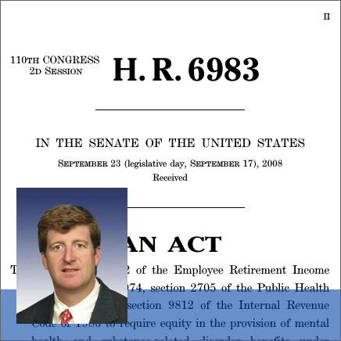
Reimbursement & Parity Enforcement
MHPAEA Enforcement
IMD Exclusion
190-day Lifetime Limit
Lack of bundled payment options
Non-compliant plans, benefit design restrictions
Short term/association plans
Narrow networks, high deductibles
“Medical necessity” reviews
Notes:
We understand that payment—both on the patient side regarding out of pocket expenditures and insurance coverage as well as on the provider side relating to reimbursement rates and funding streams– is a major issue for behavioral health. We have outlined what we believe are the major policy considerations; each council will be discussing payment and coverage for behavioral health services specifically at their respective meetings.

Slide 37
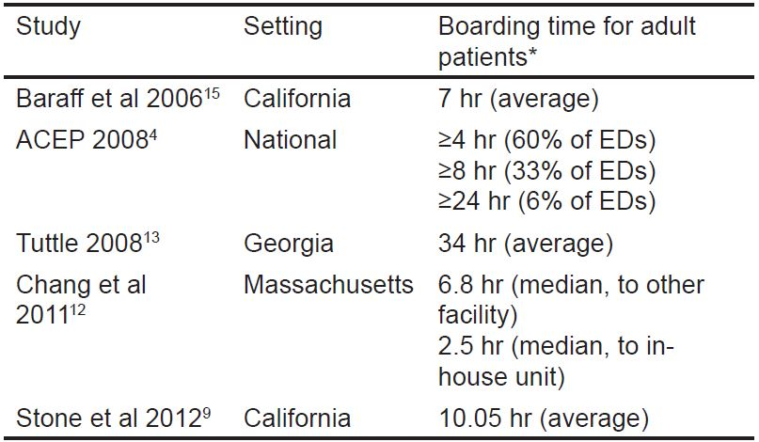
Resource Shortages
Decreasing number of state psychiatric beds
Workforce shortages
ED Boarding
Notes:
Another “category” of policy issues relevant to behavioral health is resource shortages. These include the decreasing number of state psychiatric beds, as well as the significant shortage of mental health professionals in the US. According to HRSA, the US is only fulfilling about 44 percent of the total need for mental healthcare professionals; these include psychiatrists, psychologists, family and marriage counselors, and social workers. The workforce is aging and tends to hold more specialization in education.
These shortages are a major facet of emergency department boarding, wherein a patient– not necessarily but more often than not a psychiatric patient– is held in the emergency department while awaiting a professional consultation or available bed for inpatient admission. Resource shortages are not the only cause of boarding– delays can be caused by pre-certification processes by insurance carriers, for example. However, the American College of Emergency Physicians survey found that only 16.9 percent of respondents reported having a psychiatrist to call to respond to psychiatric emergencies in the ED.

Slide 38
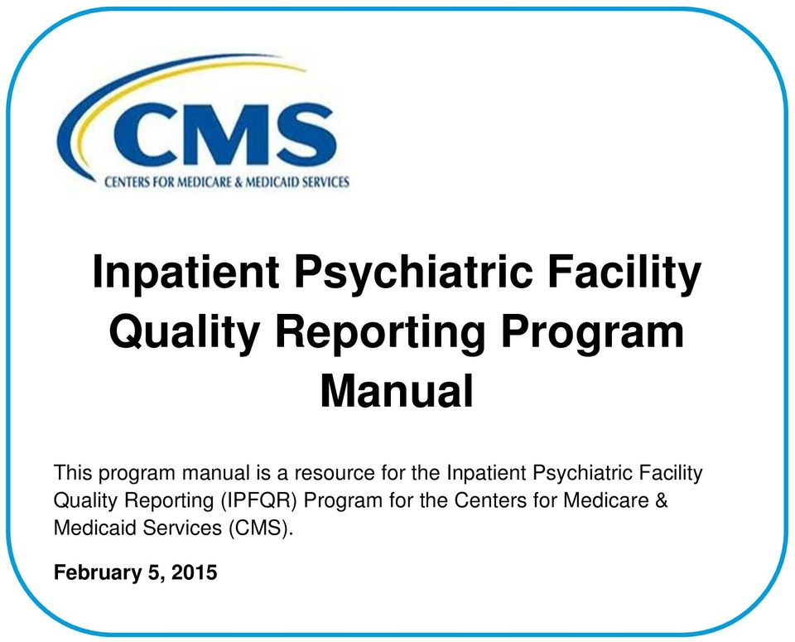
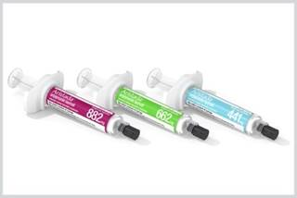
Treatment & Quality
Assisted Outpatient Treatment (AOT)
Long-acting Injectable (LAI) Antipsychotics
Restraint & Seclusion
Inpatient Psychiatric Facility Quality Reporting Program (IPFQR)
Ligature Risk
Notes:
Another area of policy that is sometimes overlooked is the actual regulations and requirements around treatment and quality of care. While this category covers many topics, there are a few that are generally top-of-mind. These include:
Assisted OP Treatment: court-ordered care for patients with SMI; 21st Century Cures Act allows states to implement AOT with flexibility and provides financial support and technical assistance. While this strategy has shown promising results in certain states, some patient advocates argue that it infringes upon autonomy and civil rights.
Similarly, Long-acting injectable antipsychotics have been used to improve adherence to medication, as they are not required to be taken with the same frequency as many oral medications. The FDA has approved six of these drugs for use in the US, a few very recently. Despite scientific evidence of effectiveness, LAIs are underused; some experts report that this is due to general discomfort with injectable medications, both on the part of patients and providers.
Restraint and Seclusion have been used for centuries, probably millennia, as interventions to respond to patients in crisis. Due to the negative consequences of their use– including trauma to both patients and providers– there have been international efforts to reduce or eliminate these interventions if possible. Still, SAMHSA reports that there are 50-150 deaths due to restraint and seclusion each year.
The IPFQR is a pay-for-reporting program, rather than pay for performance– this means that providers are evaluated on WHETHER they submit data, not how good their performance on the measures is. The program began with 6 measures originally developed and tested specifically for the psych setting by The Joint Commission; since then, measures addressing more generic aspects of care including transmission of information and flu vaccine. SAMHSA and CMS are currently working with external stakeholders including AHA to develop new measures for this setting.
(If asked): IPFQR Measures for FY2020 and beyond include:
Hours of physical restraint use (HBIPS-2)
Hours of seclusion use (HBIPS-3)
Patients Discharged on Multiple Antipsychotic Medications with Appropriate Justification (HBIPS-5)
Transition Record with Specified Elements Received by Discharged Patients
Timely Transmission of Transition Record
Screening for Metabolic Disorders
Alcohol Use Brief Intervention Provided or Offered and the subset, Alcohol Use Brief Intervention
Alcohol and Other Drug Use Disorder Treatment Provided or Offered at Discharge and the subset, Alcohol and Other Drug Use Disorder Treatment at Discharge
Tobacco Use Treatment Provided or Offered and the subset, Tobacco Use Treatment (during the hospital stay)
Tobacco Use Treatment Provided or Offered at Discharge and the subset, Tobacco Use Treatment at Discharge
Influenza Immunization
Follow-Up After Hospitalization for Mental Illness
30-Day All-Cause Unplanned Readmission Following Psychiatric Hospitalization in an Inpatient Psychiatric Facility (IPF)

Slide 39
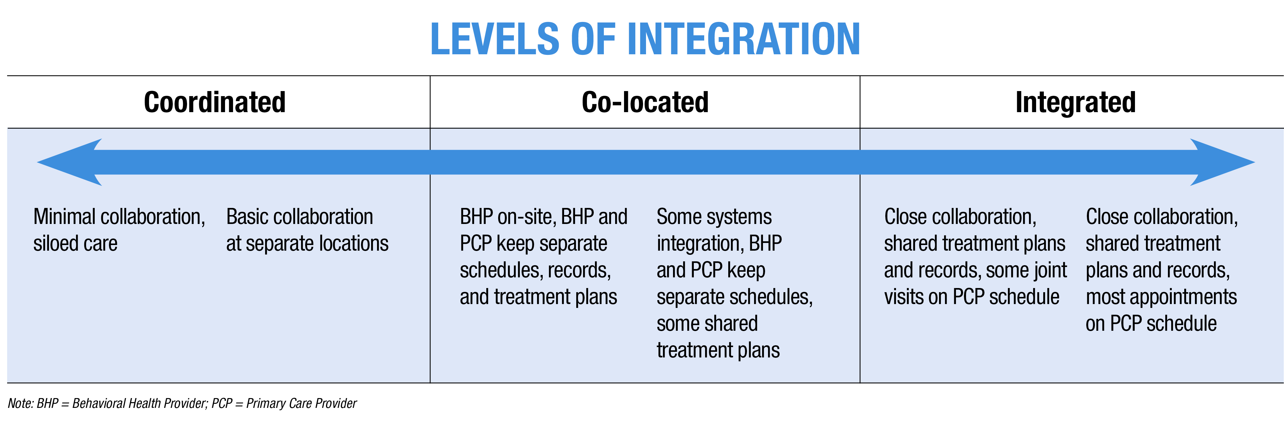
Overarching Issues
Stigma
Integration of Behavioral Health with Physical Health
Notes:
Finally, there are a few overarching issues that are key to addressing behavioral health, but have unclear ties to policy and regulation. We talk a lot about the stigma associated with mental illness that prevents patients from seeking help because they fear judgment by their peers, providers, or employers. In addition to the societal notions related to mental illness, there are other drivers that lead us to treat these patients differently than physical health patients. For example, behavioral health services are paid using a different system since traditional fee-for-service payments are based on finite episodes rather than the time-based nature of behavioral health services. Many policies, like the 190-day lifetime limit or medical necessity reviews, separately evaluate psychiatric needs.
Thus, treating mental health differently from physical health is both a cause and effect of stigma. We have scientific evidence that proves the interrelatedness of physical and mental health– improvements in one spur improvements in the other, and vice versa. However, integrating behavioral health with physical health faces logistical barriers, like physical space– where are you going to put a psychologist in your already crowded outpatient clinic?

Slide 40
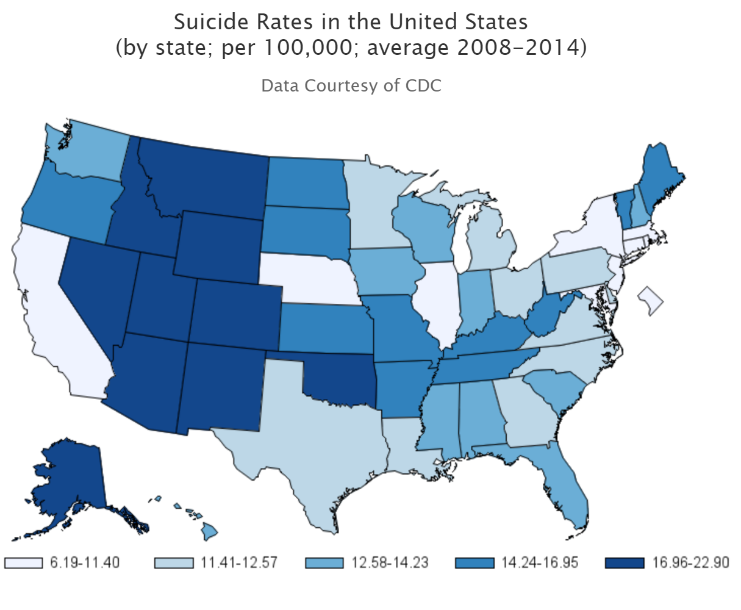
Extra-hospital Issues
Suicide Prevention
Community-based Services
Notes:
Similar to these overarching challenges are those that I’ll call “extra-hospital issues,” by which I mean those that are definitely related to facility-based care, but span beyond clinical walls. For example, the Zero Suicide campaign seeks to eliminate suicides within health care, but what about people with suicidal ideation who are no longer within our care or who were never patients? How far should the reach of hospitals and other providers extend before it becomes unsustainable or is perceived as infringing upon autonomy, as has been suggested for AOT?
Community-based services are key in maintaining long-term behavioral health, through non-clinical care models as well as other services that enable patients with mental illness to live day-to-day– like housing, transportation, and vocational training. In these policy boards, we have discussed the concept of the hospital being responsible for not only clinical care, but population health overall; are there policy levers we can pull to make this wide-ranging responsibility operationable?

Slide 41
Opioid Action in Congress
H.R. 6, the SUPPORT for Patients and Communities Act of 2018
Increases funding and flexibility for existing SAMHSA grants to states
Gives other federal agencies (CDC, FDA, NIH) more authority to address crisis
Demo to promote follow-up to ED care of overdose patients
Targets Medicare, Medicaid and CHIP programs’ ability to address crisis
The House and Senate passed the bill and it is going to the President for signature
AHA Priorities:
IMD included in Conference Package
Notes:
DIANE TO COVER OPIOIDS 45-48
House bill incorporates 50+ bills that went through four committees. The bill passed the House in June 261-155
The Senate passed opioid legislation on Sept 17 by a vote of 99-1.
Conference Agreement: Senate passage 98-1 (Sen. Mike Lee UT opposed)
The final language includes an AHA-supported provision that partially repeals the longstanding Institutions for Mental Diseases (IMD) exclusion by giving state Medicaid programs the option to cover up to 30 days per year of services for substance use disorder treatment in an IMD for patients 21-64 years old. The states will be allowed to receive federal Medicaid matching funds The bill also expands treatment coverage to individuals suffering from cocaine use disorder.
addresses health insurance for former foster youth;
maternal and infant health; includes new programs for family members of addiction victims and babies born with opioid dependence
medication-assisted treatment: expands access to medication-assisted treatment, known as the gold standard of addiction care, and will allow Medicare to reimburse for some of these services
access to telehealth: includes a pilot program to test incentives for adoption of EHR technology in behavioral health incentives through CMMI. The Behavioral Health IT Coalition believes such adoption will enable e-prescribing of medication-assisted treatment.
The law also strengthens prescription drug monitoring programs by enabling increased data-sharing among the programs and by encouraging mandates that prescribers check the databases.
parity in mental health and substance use disorder benefits;
alternatives to opioids and abuse deterrence and prevention;
patient experience survey questions relating to pain management;
care coordination for drug overdose patients; and the prescription drug monitoring program.
In the appropriations bill, Congress approved abouty $4 billion toward treatment programs as well as law enforcement. HR. 6 will direct where much of that money goes.
.
The requirements for electronic prescribing of controlled substances and the Promoting Interoperability Program requirements for PDMP query prior to prescribing controlled substances and query of an opioid treatment plan point to greater demand for EHR use and health information exchange.
IMD provision allows states to receive federal matching funds for up to 30 days per year for services provided to adult Medicaid beneficiaries with a substance use disorder in an Institution for Mental Disease – available FY 2019-2023
AHA statement upon Senate passage of conference report: We are deeply disappointed that the agreement excludes a critical provision passed overwhelmingly by the House to allow the responsible sharing of patients’ substance use disorder treatment information in accordance with Health Insurance Portability and Accountability Act regulations. Current law (42 CFR Part 2) undermines the ability of providers to effectively coordinate care for patients with SUDs. We remain committed to the passage of legislation that eliminates the statutory barriers to optimal care for our patients.
The House language would have aligned 42 CFR Part 2 regulations with the Health Insurance Portability and Accountability Act to allow health care providers to responsibly share substance use disorder treatment information.

Slide 42
42 CFR Part 2 Reform
H.R. 6082, the Overdose Prevention and Patient Safety Act
Delayed Action in Energy and Commerce
Passed House 357-57
S. 1850, the Protecting Jessica Grubb’s Legacy Act
Cosponsors: Manchin (WV), Capito (WV), Feinstein (CA), King (ME), Harris (CA), Klobuchar (MN), Rounds (SD), Tillis (NC), Donnelly (IN), Whitehouse (RI), Collins (ME)
Jessie’s Law (Manchin)
Notes:
Urged the Senate to vote separately on the Overdose Prevention and Patient Safety Act, H.R. 6082.

Slide 43
More Federal Efforts on Opioids
CMS Roadmap: Prevention, Treatment, Data
FDA MAT: approving generic versions, new dosages of Suboxone
DEA Production Quotas: FY19 quotas
National Academy of Medicine Action Collaborative
Notes:
CMS Roadmap: three pillars, have held various workgroups with stakeholders including AHA throughout summer with plan to inform future rulemaking
Prevention
Gathering best practices around prescribing by condition, working with specialty groups
Promoting non-opioid pain treatment; example, unpackaging non-opioid pain treatment (On-Q continuous infusion pump, ice machine, etc.) for surgical procedures to incentivize use
Treatment
Enhance access/coverage for opioid use disorder treatments
Data
Gathering prescriber, pharmacy data to track opioid use patterns across different populations
Promote data sharing across continuum of care
FDA approving new and adjusted options for MAT to increase use
DEA FY19 proposed aggregate production quotas for schedule I and II controlled substances: third straight year of reductions that affect both oral and injectable opioid medications; exacerbates shortages for IP drugs, which are less prone to diversion, lead to burdensome workarounds
NAM Action Collaborative: NAM-facilitated standing body that brings together stakeholders nationally to advance progress through collaboration, coordination, communication, and shared learning activities. Through various meetings, will develop tools and knowledge hub regarding education and training, prescribing guidelines and evidence standards, treatment and care models, communication, culture and stigma, engaging the private sector, and data.

Slide 44
Addiction Recovery Medical Home APM
Announced publicly Sept. 7
Five Elements to ARMH:
Payment in 3 phases: pre-recovery and stabilization (<30 days), recovery initiation and active treatment (0-12 months), and community-based recovery management (0-5 years)
Quality metrics developed by National Committee for Quality Assurance
Integrated treatment and recovery network
Care recovery team
Treatment and recovery plan
Looking for additional organizations to pilot model
Partners from Facing Addiction with National Council on Alcoholism and Drug Dependence have offered to provide live webinars with our members, interested providers
Notes:
As we mentioned in our section on challenges to behavioral health generally, there is a lack of alternative payment models that specifically address behavioral health issues. With that in mind, the AHA joined with several other organizations to develop an addiction recovery medical home model, which was publicly announced on September 7th after about a year of work. The model provides for bundled payments for three different phases of recovery: the immediate stabilization, shorter term recovery and treatment, and long-term community-based recovery management. This model is unique in that it recognizes that recovery takes longer than the oft-cited 28 days, and also requires the input of a team of clinical and non-clinical caregivers.
Our next steps are to pilot the model so we can gather some real data. We have a few organizations who have committed to piloting the model, including Anthem and Intermountain, but if you think there are organizations, especially systems, in your states who might have interest, let us know. More info, including a detailed paper on the various aspects of the model, is available at incentivizerecovery.org.
The next two hidden slides provide more info on the model if there is interest.

Slide 45
Cornerstones of Rural Communities
National reach:
20% of Americans live in rural areas
Key access points:
Local, timely access to health care
Economic anchors:
Employment opportunities
Transactions, attraction for business investment
Contributions local taxes, public services
Image
Notes:
NANCY TO COVER THE RURAL HEALTH SLIDES 51-56
Purpose of slide: why rural hospitals matter
To set the stage, almost 20% of Americans live in rural areas, dispersed throughout the country as you can see from the green areas on the map.
Rural communities rely on more than 1800 rural hospitals as key access points to health care, including emergency medical services
Having these hospitals in the community is crucial to prevent patients from having to travel long distances for care, or even forgoing care in some cases
In addition to their direct impact on health, rural hospitals are also economic anchors in their communities. They are often the largest employer in their area, and also have indirect impact on local economy through transactions with other businesses, attracting local business expansion or new business investments, in addition to contributing to a healthy tax base which helps to sustain public services like transportation, education, and public safety.
If asked, some additional factoids:
Nearly half of rural hospitals are part of larger health systems (2016 AHA hospital survey; includes CAHs)
1825 rural hospitals according to 2016 AHA survey (includes CAHs) – this is more than a third of US community hospitals
In one rural example, a community hospital in Virginia has led to 177 direct jobs and nearly 10. 5 million dollars in payroll within the community (in this case, the county)

Slide 46
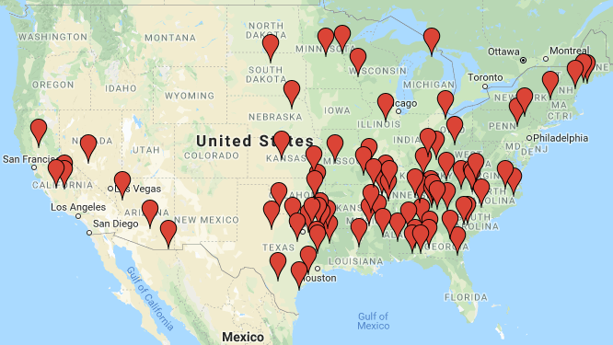
Facing Difficult Decisions
Closures since 2010
More than 40% of rural hospitals have negative operating margins
Hospital responses:
Conversion: service reduction
Merger: 380 between 2005 - 2016
Closure: 88 rural hospitals closed since 2010
Source: http://www.shepscenter.unc.edu
Service reductions + closures = access barriers
Notes:
Purpose of slide: rural hospitals are financially vulnerable, many face tough decisions/closure which have real ramifications for patients
In spite of their importance and community benefit, many rural hospitals are financially vulnerable – demonstrated by the more than 40% of rural hospitals (incl CAHs) that have negative operating margins
There are a few ways rural providers have been responding to their financial struggles
reduce the services they offer, or otherwise convert from a full service acute care hospital to a facility with more limited services
merge with another entity, typically a larger health system – and we are seeing this happen with some frequency. Roughly 380 rural hospitals mergers have occurred between 2005-2016 , according to UNC sheps center , with some rural facilities merging more than once
fully close its inpatient care and/or other services – since 2010, 88 rural hospitals have closed, and you can see from the map closures happen across the country, but have been mostly concentrated in the south east
While some responses to financial troubles can work to sustain access – e.g., preserving some outpatient care even if they eliminate inpatient, in general service reductions and closures lead to access barriers for rural patients who may have to travel long distances to receive care they had been accessing locally.
(If needed) According to recent research, a substantial portion of rural patients must travel over 25 miles to access care after their local provider closes – and for individuals who are older, have worse health, or lack transport, this is especially problematic
Factoids:
Two thirds of rural hospitals (incl CAHs) have negative margins for Medicare (same for Medicaid)
Hospital closures have been on the rise from 2010-2016, with a slide decrease last year but expected to continue
UNC defines closure (where the 88 number comes from) as eliminating inpatient services
Roughly 80% of rural hospital closures since 2014 have been in states that have not expanded Medicaid

Slide 47
What are the challenges?
Emergent
Opioid epidemic
Violence in communities
Medical surge capacity
Cyber threats
Care delivery shifts
Behavioral health
High cost of drugs
Regulatory burden
Recent
Economic & demographic shifts
Low patient volume
Payer mix
Patient mix
Geographic isolation
Workforce shortage
Aging infrastructure
Persistent
Notes:
Purpose of slide: Rural hospitals & communities always face unique circumstances and challenges - some have persisted for many years, while others are more recent. Issues of today may hinder rural providers’ preparedness for the challenges of tomorrow (tackling the bottom of the pyramid can strain rural hospitals; persistent and recent issues can make it impossible to address challenges that are higher up in the pyramid)
What factors underlie these financial pressures that rural hospitals are facing, leading to difficult decision? What are the unique challenges in providing rural health care?
This chart identifies several obstacles that rural providers face overall, although each hospital has its own mix of challenges to be addressed
Looking at the pyramid from bottom to top, we show numerous challenges that have persisted in rural areas for long periods, such as low patient volume and reliance on Medicare and Medicaid, with others that have developed more recently, like shifts from IP to OP care, and then several that emerge with little warning, but requiring shifts in attention and/or resources, such as the opioid crisis
[ if there is time and interest, presenter could pick out a few examples and describe – some stats are noted below if desired – more so in the rural report attachment].
These challenges compound each other, making it more and more difficult for providers to ensure access to care. Tackling persistent and recent issues can strain hospitals, and prevent them from having capacity to take on emergent challenges
Some Factoids
Payer mix:
46 percent of rural hospital revenue was from Medicare, and 17 percent was from Medicaid (AHA Annual Survey of Hospitals, 2016)
hospitals receive 87 cents for every dollar spent caring for Medicare patients, 88 cents for every dollar for Medicaid patients. (AHA survey 2016)
Medicare margin is -7.4%. (MedPAC March 2018)
Patient mix: rural areas are older, sicker, poorer than average
less than 14 percent of the nation’s population is over age 65, but 65+ make up 18 percent of residents in rural areas
Workforce
While almost 20 percent of the U.S. population live in rural areas, less than 10 percent of U.S. physicians practice in these communities
Changes in HC delivery
Since 2006, outpatient visits have risen 33 percent, while inpatient discharges have dropped 17 percent. (AHRQ data analysis, 2017)
In 2016, outpatient services represented nearly two-thirds of rural hospitals’ total gross revenue. ^{(AHA} survey)
Behavioral health
Suicide rates have long been higher in rural areas, but the gap between rural and other areas is widening since mid 2000s
more than 60% of mental health provider shortage areas are rural or partially rural
Economic, social, population shift
between 2010 and 2014, a majority of rural counties lost businesses across multiple industries, including farming, manufacturing, coal, timber, and fishing
from 2010-2016, the population in rural areas declined, due to the combination of migration (including younger workers seeking employment in urban areas) and natural changes (births minus deaths)
Reg burden
Hospitals , health systems, and PAC providers nationwide spend 39 billion per year on non clinical regulatory activities (2017 aha analysis)
While rural hospitals are subject to the same regulations as other hospitals, lower patient volumes mean that, on a per-discharge basis, their cost of compliance is often higher than for larger facilities
Opioid crisis
in 2017, the Centers for Disease Control announced that the rates of deaths from drug overdoses in rural areas were rising to surpass rates in urban areas

Slide 48
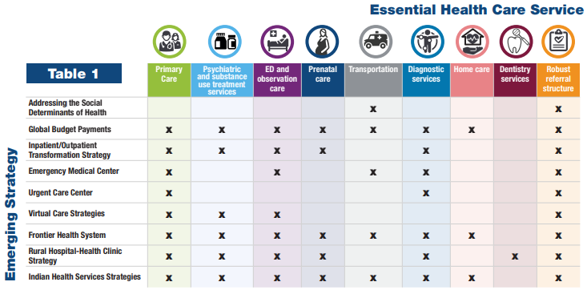
AHA Leadership and Member Engagement
Flexibility needed across rural areas
Task Force
Identified essential services that should be available in all communities
Outlined strategy options for rural communities to protect local access
Notes:
Purpose of slide: AHA has been working on access and rural issues for awhile; task force outlines options for providers since rural areas require flexibility; no one-size-fits-all
AHA has a recognized these challenges and has a long history of working on issues that affect access to care in rural communities
Because the mix of challenges varies from place to place, we know that flexibility is needed in order for rural areas to implement new strategies successfully
Taking that into account AHA put together a Task Force on ensuring access in vulnerable communities in 2015.
The Task Force identified a set of essential services that should be available in all communities [presenter note: they are listed below if you want to name them] and
Identified various strategy options that rural communities may explore in order to ensure local access to high quality, affordable care
Notably, these should be considered a menu to select from, rather than directives – the strategies are not mutually exclusive – some providers and decision makers may find that a combination of the strategies may ultimately provide the most benefit for their communities
there is no one-size-fits-all approach to ensuring access to care in rural areas
If needed:
Task force essential services
Primary care
Psych and substance use treatment
Emergency and observation services
Prenatal care
Transportation
Diagnostic services
Home care
Dentistry
Robust referral structure
Task force strategies
Addressing SDOH
Screening & information
Navigation
Alignment
Global budget payments
Inpatient/outpatient transformation strategy: Reduce IP; boost OP and primary care; continue providing ED services
Emergency Medical Center: Freestanding ED with transport; optional OP services; elimination of IP
Urgent care center
Facility to address Non life threatening conditions but needs to be addressed within 24 hours
Eliminate IP services; no appointments needed; evening and weekend hours; x ray services, some procedures available
Virtual care strategies
Frontier health system
Medical home for all pts in service area
Similar to ACOs with strong transportation component
local, integrated health care organizations for very small, isolated frontier communities
Rural hospital- health clinic strategy
Coordination with FQHC and other clinics
Contractual collaboration (referrals), corporate merger, agreements for data sharing
Indian health service strategies: Assessment of available services + collab/coordination to bridge gaps and connect to services

Slide 49
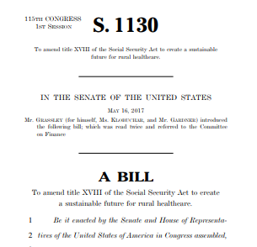
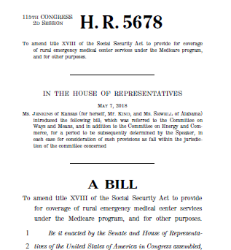
Increasing Visibility of Rural Issues
Rural Voters Played A Big Part In Helping Trump Defeat Clinton –NPR
Small hospital closures mean loss of access to care
Rural hospitals are in dire need of regulatory relief
Death by a Thousand Cuts: The Flickering Lights of the U.S. Rural Hospital
Rural hospitals need flexible policies to survive, report says
Rethinking Rural Health Solutions to Save Patients and Communities
Notes:
Purpose of slide: describe how there has been uptick in media attention on rural America, both the challenges they face and their political power; we are seeing an increased focus on rural issues from legislators and regulators
NPR https://www.npr.org/2016/11/14/501737150/rural-voters-played-a-big-part-in-helping-trump-defeat-Clinton
There has been increasing visibility of rural areas in the media, and more attention to these communities from legislators and regulators
These stakeholders are taking notice of not only rural challenges, but also the power and voice of these communities
On the legislative front, several bills have been introduced on both the senate and house sides that support the rural Emergency Medical Center model that was outlined by the AHA task force
[presenter note: you can remind them of the model; key points are that the model allows CAHs and some smaller rural hospitals to convert to a new Medicare EMC designation; inpatient care is eliminated; 24/7 ED with optional outpatient services depending on community need; SNF allowable although no swing beds; must have transport to full service hospital]
This model was also recommended recently by MedPAC in their June 2018 report to Congress
Also on the regulatory front, CMS recently released their Rural Health Strategy, which outlines a set of objectives to promote their work on rural health (included below if needed)
With this rise in visibility and attention to rural communities, the time is right for action that bolsters rural communities and ensures access to care
If needed, CMS rural health strategy objectives:
Apply rural lens to CMS programs and policies
Improve access to care through provider engagement
Advance telehealth and telemedicine
Empower patients in rural communities to make decisions about their health care
Leverage partnerships to achieve the goals of the Strategy

Slide 50
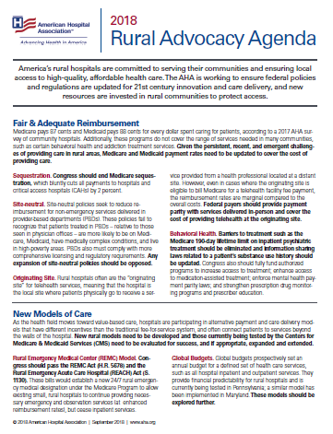
Federal Advocacy
Fair and adequate reimbursement
New models of care
Regulatory relief
Health information technology
Workforce
Prescription drug prices
Share the Hospital Story
This calamity did not arrive on us in 15 minutes,
we’re not going to solve it in 15 minutes.
Sen Ron Wyden (D-OR), Ranking Member, Senate Finance Committee
Notes:
Purpose of slide: Overview of key AHA advocacy areas and calls for action (legislative and regulatory); NEW investments and UPDATED policies are needed; acknowledgment that this is a marathon, not a sprint in light of the complex, multifaceted environment for rural health care; we are continuing to work to tell the rural hospital story and we ask members to do the same
The AHA is working to motivate federal action on rural health and communities across a number of focus areas
These include…
Fair and adequate reimbursement
New models of care
Regulatory relief
Health information technology
Workforce
Prescription drug prices
….which are described further in the advocacy agenda attachment
Overall, these areas requires NEW federal investments and UPDATED policies in order to support rural providers and the patients they serve
Because of the complex, multi-faceted environment for rural health care, policy activities – as well as our advocacy - will be a marathon and not sprint – as noted by Sen Wyden’s quote
Lastly, while we work to tell the rural hospital story, we ask our members to do so as well. This will help decision makers to have a real understanding of both the burdens and opportunities rural communities have, and to shape policies that are effective in protecting access to life saving health care in rural America

Slide 51
AHA’s Quality TrendWatch
Highlights progress in quality improvement
Explains various QI programs, infrastructure needed
Outlines quality and value-based purchasing programs
Details challenges to quality improvement:
Lack of meaningful measurement
Unintended consequences of measurement programs
Lack of useful, accurate comparisons
Challenges with eCQMs
Outdated, unclear CoPs, standards
Recommendations
Notes:
NANCY TO COVER QUALITY TRENDWATCH AND LOOKING AHEAD

Slide 52
LOOKING AHEAD
Measures that Matter
Hospital Pay-for-Performance programs
MedPAC’s HVIP
Including rural hospitals in quality reporting programs
More work on CoPs; right-sizing regulation
20th Anniversary of To Err is Human: Telling the story of quality improvement
Innovative care/payment models
Advanced Payment Model for Advanced Illness Management
Progress (or not?) on the opioid epidemic
How will efforts affect patients with other disorders?
Interoperability
Progress on eCQM?
Notes:
NOW THAT YOU HAVE HEARD OUR FEDERAL UPDATE, AS YOU THINK ABOUT THESE TOPICS AND THE TOPICS YOU DISCUSS WITH YOUR COLLEAGES BACK HOME AND THE ISSUES RAISED BY MEMBER HOSPITALS,, WHAT ARE THE FIVE BIG TOPICS THAT WE SHOULD THINK ABOUT FOR 2019.
JUST AS A RECAP, OUR FEDERAL UPDATE COVERED:
Burden Reduction
Fiscal Year final and Calendar Year proposed rules
Health IT
CAHPS
Accrediting Organizations
Behavioral Health
Opioid Legislation
Rural Hospital Issues / Concerns

