Slide 1
Sepsis 101
Colorado Hospital Association
©2019 CHA

Slide 2
Objectives
The learner will:
Verbalize understanding of the criteria for severe sepsis and septic shock
Explain the most common sources of infection for sepsis
Explain and demonstrate treatment of severe sepsis and septic shock using the three- and six-hour bundles

Slide 3
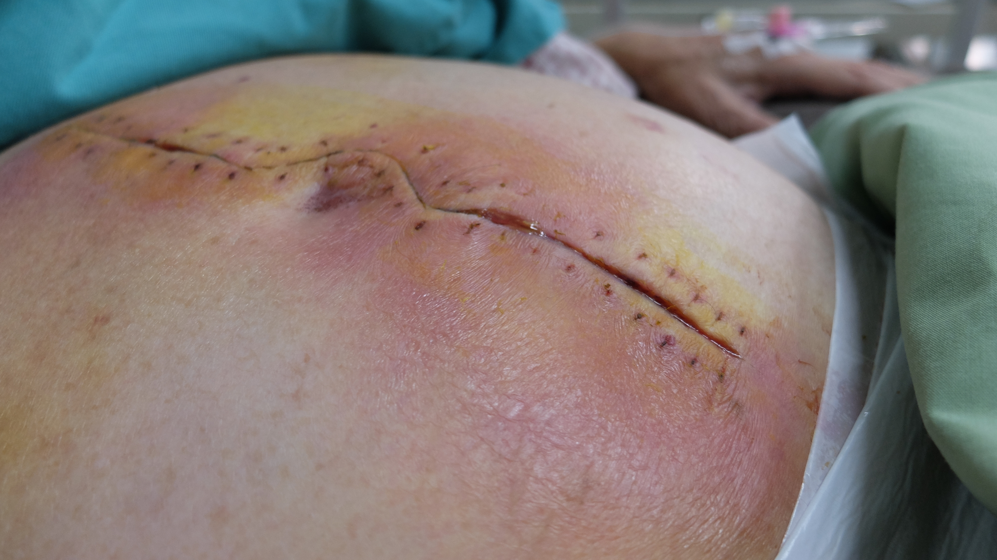
What is Sepsis?
In a NORMAL response to an infection, the inflammatory and coagulation response is localized to the infection site as the immune system attacks the pathogen, eliminating it from the body.
©2019 CHA
Notes:
Normally, an infection remains localized and you see swelling and redness at the site. The person may or may not have a fever with a localized infection. It does not normally become systemic.
When an infection becomes systemic, it can become sepsis. The accepted definition of sepsis is the body’s overwhelming response to an infection. It is characterized by coagulopathy issues such as micro emboli and the release of inflammatory mediators.
Photo: CHA purchased from Shutterstock

Slide 4
A Worldwide Problem
Sepsis is a major, world-wide health care problem
Affecting an estimated 30 million adults and children each year resulting in potentially six million deaths annually
Accounts for ~20 percent of U.S. hospital admissions but is a factor in over 50 percent of U.S. hospital deaths
Is the leading cause of U.S. hospital readmissions (20 percent)
Although mortality has decreased in the last decade, it remains over 25 percent → 1 in 4
©2019 CHA

Slide 5
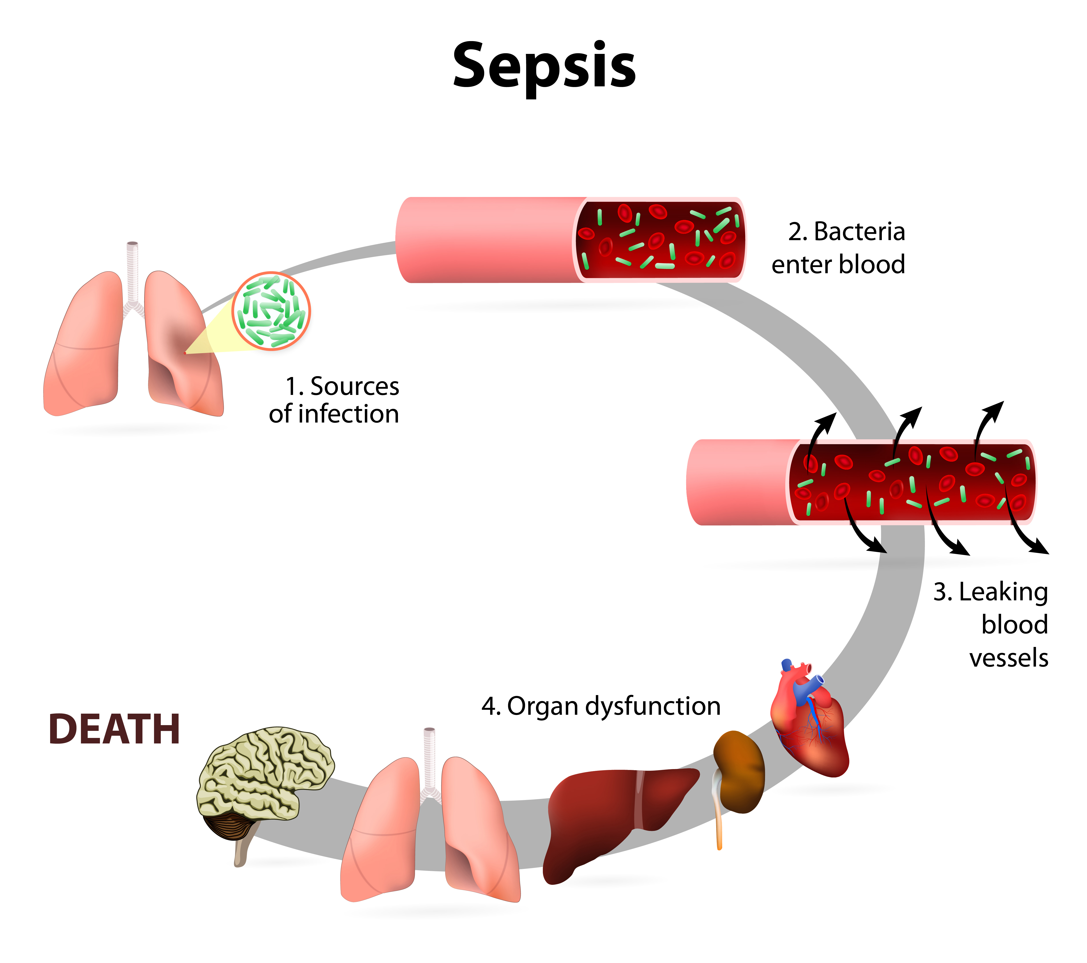
In Sepsis . . .
The inflammatory and coagulation response is rapid and widespread, causing a dysregulated response
The body’s reaction to the pathogen may overwhelm all of the body’s systems
Immune systems that are too strong or too weak are unable to respond effectively to pathogen invasion
©2019 CHA
Notes:
In sepsis, the same response to a localized insult occurs throughout the body, overwhelming the host defenses, that without intervention, results in death. Severe sepsis is a medical emergency!
Photo: CHA purchased from Shutterstock

Slide 6
Causes of Sepsis
Bacterial infections are the most common
Fungal, parasitic or viral infections can also cause sepsis
The infection can originate from anywhere in the body and can cause organ damage to any system of the body
Unknown (1/3 of all sepsis cases)
©2019 CHA
Notes:
The most common organisms seen are Staph aureus, E. coli and strep infections. (cdc.gov)
For viral infections, think flu

Slide 7
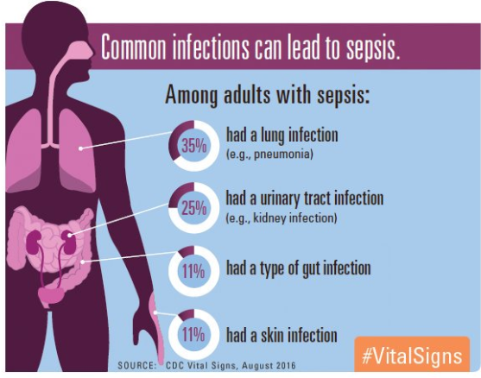
Most Common Infection Sources
https://www.cdc.gov/vitalsigns/sepsis/index.html
©2019 CHA
Notes:
The most common sources for infection in sepsis patients are
Pneumonia
Urinary tract infection
Gut & bowel infection
Skin & wound infections
IV drug abuse injection sites
Surgical site infections
Pneumonia and UTI top the list of sepsis sources followed by abdominal sources, device related and skin infections.

Slide 8
Who is at Risk to Develop Sepsis?
Host Factors
Age, gender, genetics, comorbidities
Elderly account for 60-85 percent of all cases of severe sepsis
Immunosuppression
Disease related, medications related
Exposure risk
Community acquired: pneumonia, urinary, wounds, trauma
Health care acquired: invasive devices, secondary infections and skin breakdown
©2019 CHA
Notes:
Additionally, clinicians should be particularly vigilant with geriatric patients since they are 13 times more likely to get sepsis—and have a mortality rate over 40 percent.

Slide 9
Progression of Sepsis
Early identification and treatment
It is crucial to identify septic patients and initiate treatment as early along the continuum as possible and treat them to avoid developing organ damage or shock.
SIRS
Severe Sepsis
Septic Shock
Sepsis
MODS
Goal:
early identification here
Death can result
Severe Sepsis + Refractory (unresponsive) hypotension
Sepsis + End Organ Damage
SIRS + Infection
Temp. > 38 °C or < 36 °C, HR > 90, RR > 20 or PaCO₂ < 32, WBCs > 12,000 or < 4,000 or > 10% bands
©2019 CHA
Notes:
SIRS is the nonspecific inflammatory response to an insult – the person has two or more of the criteria and it may or may not be sepsis. Assess if these are due to known conditions or a response to treatments.
Sepsis is two or more SIRS criteria AND a known or suspected infection.
Severe sepsis is sepsis with signs of organ dysfunction – the most common are altered mentation or an elevated lactate (> 2).
Septic shock is when the person has severe sepsis with persistent hypotension after adequate fluid resuscitation (30 mL/kg crystalloid fluid bolus) OR a lactate ≥ 4.0.
Multi-Organ Dysfunction Syndrome (MODS) can be the end result of septic shock. The more organs involved (failing), the higher the mortality rate.
The further along the sepsis continuum a patient gets, the higher their mortality rate goes. Early identification and rapid treatment saves lives.

Slide 10
SIRS Systemic Inflammatory Response Syndrome
SIRS is a nonspecific inflammatory response to an insult that results in activation of the immune system. This inflammatory response is the body’s way of attempting to maintain homeostasis.
SIRS is defined as two or more of the following variables:
Body temperature < 36ºC or > 38ºC
Heart rate > 90 beats per minute
WBC > 12,000/mm³ or < 4,000/mm³ or > 10% bands
Respiratory rate > 20 breaths per minute or PaCO2 < 32mmHg
SIRS + infection = sepsis
©2019 CHA
Notes:
SIRS is seen in many different insults (trauma, burns, pancreatitis, surgery, etc.), so it is sensitive to inflammation, but not specific to sepsis.
SIRS markers need to be new to the patient and not caused by treatment or medications.

Slide 11
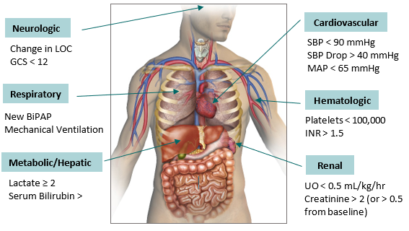
Severe Sepsis
Sepsis + new organ dysfunction = severe sepsis
Organ dysfunction is defined as a condition in which an organ does not function as expected.
Acute Organ Dysfunction Related to Sepsis
©2019 CHA
Notes:
When screening a patient for sepsis, it is important to distinguish acute organ dysfunction from chronic dysfunction.
Organ dysfunction needs to be new to the patient and presenting within the last 24-48 hours.

Slide 12
Septic Shock
Severe sepsis + refractory hypotension OR lactate ≥ 4 mmol/L = septic shock
Septic shock is a distributive shock
Cytokine release leads to a large-scale inflammatory response
Massive vasodilation
Increased capillary permeability
Decreased systemic vascular resistance
Blood clots form in the microvasculature
Hypotension reduces tissue perfusion causing tissue hypoxia
©2019 CHA
Notes:
Decreased tissue perfusion results in end organ dysfunction. This is the pathophysiologic response that requires the fluid resuscitation.
Even patients with heart failure or renal failure have this same response so they need fluids too.

Slide 13
Multiple Organ Dysfunction Syndrome (MODS)
MODS is altered organ function in an acutely ill patient requiring medical intervention to achieve homeostasis. Can be the end result of septic shock.
Sepsis-related organ dysfunction → No organ system is immune
Respiratory failure
Liver failure
Kidney failure
Heart failure
Gut permeability
DIC (disseminated intravascular coagulation)
Altered mental status
Brain death
©2019 CHA

Slide 14
Treatment Bundle
Lactate
Blood cultures x2 before antibiotics
Give antibiotics
Give fluids at 30 mL/kg if: initial hypotension, lactate ≥ 4, or septic shock
Reperfusion assessment
©2019 CHA
Notes:
The SEP-1 core measure treatment bundle is based on recommendations from the 2012 Surviving Sepsis Guidelines.
Once a sepsis patient is identified, the goal is to get antibiotics started as quickly as possible. The lactate and blood cultures need to be done prior to starting the antibiotic (in particular, the blood cultures).
If the patient has initial hypotension, defined as a SBP < 90 or a MAP < 65, a lactate ≥ 4 or septic shock, a 30mL/kg fluid bolus is required. If there is persistent hypotension (hypotension after the initial fluid bolus as evidenced by two BP readings within the hour after the bolus is completed), a vasopressor should be started; norepinephrine (Levophed) is the preferred vasopressor.
For any patient with persistent hypotension, an initial lactate ≥ 4 or septic shock, a tissue reperfusion assessment must be performed by the provider.
Any time the initial lactate is > 2, a repeat lactate must be done to reassess tissue perfusion (regardless of fluid resuscitation).

Slide 15
Blood Cultures
Source control: identify and stop the infection
Why two sets of blood cultures?
Corroboration of matching sets confirms treatment of a true pathogen versus a contaminate
The goal is to prevent culture negative severe sepsis (CNSS) and septic shock
Of 6.8 million severe sepsis admissions, 47 percent were culture negative
CNSS was seen as a statistically significant independent predictor of death
©2019 CHA
Notes:
Source control is the key to stopping the inflammatory response and systemic dysregulation.
Appropriate antibiotics are essential, but until the organism is identified, broad spectrum treatment is necessary to cover most likely sources.
Surgical removal of infection may be the most appropriate solution.

Slide 16
Antibiotics
Antibiotics are the life-saving treatment for an infection
Every hour antibiotic initiation is delayed increases the risk for mortality by four to eight percent.
Antibiotics should be given as soon as possible after blood cultures are drawn.
Preferably after the second set of cultures; however, if the second set is going to be delayed more than 30 minutes, antibiotics should be started after the first set.
If more than one antibiotic is ordered, give the broadest-spectrum antibiotic first. Infuse multiple antibiotics concurrently, if appropriate.
©2019 CHA
Notes:
Antibiotics are the single most effective treatment we have for sepsis. The goal is to stop the infection. Source control is important – if it is something that needs surgery – don’t delay.
The longer treatment is delayed, the higher the patient’s risk for mortality rises (four to eight percent for every hour of delay).
Always give the antibiotic with the shortest run time first. Give antibiotics with 30-minute infusion times first, then give the vancomycin that is infused over one to two hours.

Slide 17
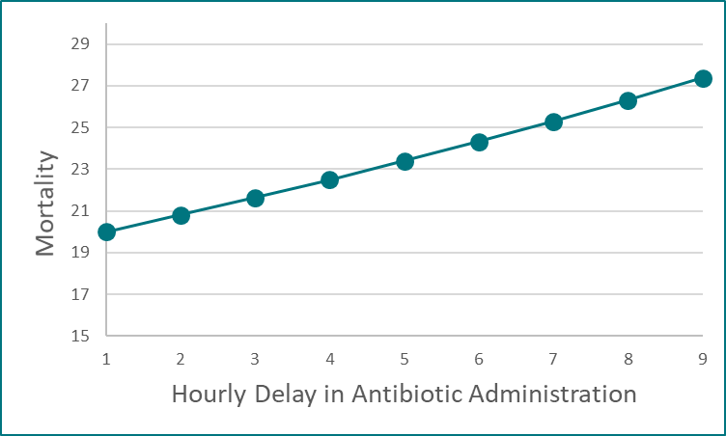
Antibiotics
The MOST important thing you can do for your septic patient
For every hour delay in antibiotic administration, mortality increases 4-8%
©2019 CHA
Notes:
The only definitive treatment for sepsis is antibiotics. All other interventions guide treatment or are supportive care.
There is a linear correlation between mortality and time to antibiotics. The longer it takes to get antibiotics to a patient with sepsis, the higher their risk for mortality (and morbidity).
The risk for mortality for someone who progresses to septic shock is upwards of 50 percent. Remember, mortality risk goes up four to eight percent for each antibiotics are delayed.

Slide 18
Crystalloid Fluids
The Society of Critical Care Medicine suggests isotonic saline (normal saline) or balanced salt solutions (lactated Ringers) for initial fluid resuscitation.
Sepsis and severe sepsis without hypotension:
For most patients, the provider will likely order a fluid bolus based on their assessment, but there is no specific requirement
Severe sepsis with hypotension or lactate ≥ 4 mmol/L:
30 mL/kg of actual body weight for patients with a BMI < 30
30 mL/kg of ideal body weight for patients with a BMI > 30
Provider must document that they are using ideal body weight if BMI over 30 and document what the BMI is or state “obese”
©2019 CHA

Slide 19
Lactate
With sepsis, lactate is viewed as a marker of global tissue perfusion.
Lactate has some predictive use:
Sustained > 6 hours, an elevated lactate foreshadows increased mortality
Mortality increases as lactate levels increase
Lactate Level | Mortality
0-2.5 mmol/L | 4.9 percent mortality
2.5-4.0 mmol/L | 9.0 percent mortality
> 4.0 mmol/L | 28.4 percent mortality
(Nguyen, et al., 2004; Shapiro, et al., 2005)
©2019 CHA
Notes:
The pathophysiology behind this is that as the body goes further down the sepsis continuum and the hypoperfusion of end organs increases (due to hypovolemia and coagulopathic responses), there is more anaerobic metabolism and the byproduct is the production of lactate.
The higher the lactate, the higher the risk for mortality.

Slide 20
Centers for Medicare and Medicaid Services
SEP-1 Bundle
Time zero (or time of presentation) is defined as:
The earliest chart documentation consistent with all elements of severe sepsis or septic shock identified through chart review
Elements for time zero (last qualifying element within 6-hour window):
Provider documentation of infection or suspected infection
Two SIRS criteria (last of the two)
Organ dysfunction
S
©2019 CHA
Notes:
See Identifying Time Zero.

Slide 21
Severe Sepsis
Sepsis + new organ dysfunction = Severe Sepsis
To be completed within three hours:
Draw lactate
Draw two blood cultures prior to antibiotic administration
Administer broad-spectrum antibiotic(s)
Fluid resuscitation of 30mL/kg crystalloid solution (NS or LR)
SBP <90mmHg or MAP <65 mmHg
Initial lactate > 4 mmol/L
If initial lactate > 2 mmol/L, repeat lactate within six hours
Within timeframe of six hours before or six hours after time zero
©2019 CHA
Notes:
Blood cultures
Two sets are preferred to ensure matching pathogens (as opposed to contaminants).

Slide 22
Septic Shock
Severe sepsis + refractory hypotension OR lactate ≥ 4 mmol/L = septic shock
To be completed within three hours:
Same as for severe sepsis
To be completed within six hours:
Repeat lactate if initial lactate was > 2.0
Start vasopressor if persistent hypotension after fluid bolus
norepinephrine is preferred
Perfusion assessment
©2019 CHA

Slide 23
SEP-1 Bundle
Documentation of Tissue Perfusion Reassessment
Provider documentation of 5 of 8 of the following:
Arterial oxygenation
Vital signs
Cardiopulmonary exam
Capillary refill exam
Peripheral pulse evaluation
Skin exam
Shock index
Urine output
Provider documentation of one of the following:
Central venous pressure measurement
Central venous oxygen measurement
Bedside cardiovascular ultrasound
Result of passive leg raise or fluid challenge
Provider documentation of completion of perfusion reassessment:
I have completed a full physical assessment
Sepsis reassessment completed
Sepsis tissue perfusion reassessment completed
OR
OR
©2019 CHA
Notes:
Provider can be a physician, nurse practitioner or a physician’s assistant.
The third box contains the easiest verbiage for the provider to document rather than remembering all the components of the other two.

Slide 24
Do We Really Have Three Hours?
Society of Critical Care Medicine published a retrospective cohort study:
5,072 patients with severe sepsis or septic shock
The majority of the patients had the four three-hour bundle recommendations initiated within three hours
In-hospital mortality was 27.8 percent
Time after which a delay increased the risk of death:
Lactate: 20 minutes
Blood cultures: 50 minutes
Antibiotics: 125 minutes
Crystalloids: 100 minutes
“The guideline recommendations showed that shorter delays indicate better outcomes. There was no evidence that three hours is safe; even very short delays adversely impact outcomes.”
(Pruinelli, et al., 2018)
©2019 CHA
Notes:
The times found were statistically significant.

Slide 25
Sepsis is a medical emergency . . .
minutes matter
Remember
Sepsis signs and symptoms
are highly variable due to an abnormal, dysregulated response
most common response to infection is fever, although not everyone has a fever
©2019 CHA

Slide 26
References
Centers for Medicare and Medicaid. (2018). Specifications Manual for National Hospital Inpatient Quality Measures.
Gupta, S., Sakhuja, A., Kumar, G., McGrath, E., Nanchal, R. S., & Kashani, K. B. (2016). Culture negative severe sepsis: nationwide trends and outcomes. Chest, 150(6), 1251-1259.
Kumar, A., Roberts, D., Wood, K. E., Light, B,. Parrillo, J.E., Sharma, S., …& Gurka, D. (2006). Duration of hypotension before initiation of effective antimicrobial therapy is the critical determinant of survival in human septic shock. Critical Care Medicine, 34(6), 1589-1596.
Levy, M. M., Evans, L. E., & Rhodes, A. (2018, June). The Surviving Sepsis Campaign bundle: 2018 update. Critical Care Medicine, 46(6), 997-1000.
Mayr, F. B., Talisa, V. B., Balakumar, V., Chang, C. C., Fine, M., & Yende, S. (2017). Proportion and cost of unplanned 30-day readmissions after sepsis compared to other medical conditions. Journal of the American Medical Association, 317(5), 530-531.
©2019 CHA

Slide 27
References
Nguyen, H. B., Rivers, E. P., Knoblich, B. P., Jacobsen, G., Muzzin, A., Ressler, J. A., & Tomlanovich, M. C. (2004). Early lactate clearance is associated with improved outcome in severe sepsis and septic shock. Critical Care Medicine, 32(8), 1637-1642.
Pruinelli, L., Westra, B. L., Yadav, P., Hoff, A., Steinback, M., Kumar, V., . . . Simon, G. (2018). Delay within the 3-hour Surviving Sepsis Campaign guideline on mortality for patients with severe sepsis and septic shock. Critical Care Medicine, 46(4), 500-505.
Shapiro, N. I., Howell, M. D., Talmor, D., Nathanson, L. A., Lisbon, A., Wolfe, R. E., & Weiss, J. W. (2005). Serum lactate as a predictor of mortality in emergency department patients with infections. Journal of Emergency Medicine, 45(5), 524-528.
World Health Organization. (2019, January 11). World Health Organization. Retrieved from Factsheets Detail Sepsis: https://www.who.int/news-room/fact-sheets/detail/sepsis
©2019 CHA

