Slide 1
Sepsis Table
Top Scenario
Colorado Hospital Association
Notes:
Explain what the process will be for the table top exercise. What are the goals of the exercise? A time to talk through what the team would do in the identified situation.
Supply the team with any documents available to them in a real situation – e.g., sepsis checklist, order sets, etc.
Today we will work through case scenarios.

Slide 2
Clinical Scenario – Jim Garland
Jim Garland is a 43-year-old male nursing home patient
History of CVA with right-sided weakness
ESRD with HD on MWF
Diabetes
Hypertension
Peripheral Venous Occlusive Disease
Chronic pain
Patient was at dialysis today and became hypotensive
Unable to complete treatment and sent to an outside hospital for stabilization

Slide 3
Clinical Scenario – Jim Garland
Patient arrived at outside hospital at 1000
  Vital signs revealed sinus tachycardia, SpO2 94% on 2L NC, BP 77/40
  Chest x-ray showed patchy consolidation of the right lung base, concerning for pneumonia
  Treatment at outside hospital
    No IV fluids
    Started on Levophed through a peripheral IV at 1100
Diagnosis was septic shock secondary to HCAP and was transferred to the ICU
Patient became obtunded, with decreased respiratory effort in ambulance and was orally intubated by EMS
Notes:
Should patient have received IV fluids? Why or why not?
Argument for: Patient is hypotensive and in septic shock; body needs fluids before starting pressors
Argument against: Patient has end-stage renal disease so we don’t want to fluid overload him
Which is right? The jury is still out to some extent but not giving fluids is probably not ok; judicious fluid resuscitation is warranted – give some, reassess, give more, reassess until BP improves or patient starts showing signs of fluid overload. Patient can be dialyzed, but if organs begin to die due to hypoperfusion, that’s hard to recover from.
Was it appropriate to start Levophed? No. Need fluids before considering vasopressor.

Slide 4
Labs from outside hospital
Notes:
What are your initial thoughts about this patient?
Blood gas shows:
Compensated metabolic acidosis
pO₂ – ok (pt. breathing adequately)
Elevated WBCs – neutrophils are elevated
Potassium, BUN & creatinine elevated (renal failure)
Lactate is within normal range
INR normal

Slide 5
What will you do to prepare for this admission to ICU?
Notes:
Encourage participants to talk about what they would do to prepare for a direct admit from an outside hospital
Sepsis huddle on next slide

Slide 6
Clinical Scenario – Jim Garland
Preparing for this admission:
Sepsis huddle
  Get the right people in the room
  Review history and current status
  Discuss where patient is on sepsis continuum
  Review what interventions have been completed
  Identify priorities for when patient arrives
  Provide sepsis checklist
Prepare room
Notes:
Who are the right people? This will depend on your facility and the available resources; tailor the answer to your facility and resources.
Where is the patient on the sepsis continuum and what needs to be completed?
Patient has received no fluids, blood cultures or antibiotic – so pretty much everything
What do you need to have available when patient arrives?
Ventilator/RT
End tidal CO₂ and CXR to validate tube placement
Lines cart – central line and arterial line if that is your protocol
Plan to hook up the hemodynamic monitoring when placing invasive lines (CVP and/or dynamic monitoring)
Antibiotic (alert pharmacy)
Fluids

Slide 7
Abbreviated Med List
Fentanyl 75 mcg/hr patch: 1 patch, topical, q72h
Lantus (glargine) 100 unit/ml subcutaneous solution: 23 Unit, subq, BID
NovoLOG sliding scale: subq, AC, TID
Aspirin buffered 81 mg: 1 tab, PO, daily
Baclofen: 10 mg, PO, TID
Bumex (bumetanide) 2 mg: 1 tab, PO, daily
Depakote (divalproex sodium) 125 mg: 1 cap, PO, BID
Levothyroxine 0.075 mg: 1 Tab, PO, AC breakfast
Morphine: 30 mg, PO, q12h

Slide 8
Clinical Scenario – Jim Garland
Patient arrives in ICU at 1200
Vital Signs
  BP 72/40
  HR 120
  SpO2 95%
  RR 10 (Vent settings: TV 450, Rate 8, PEEP 5, FiO2 60%)
  T 98.5°F
Levophed infusing at 20 mcg/min
Lungs: scattered rhonchi, no jugular vein distention or edema, cap refill < 3 seconds, skin cool and dry
Notes:
Review with participants (through next slide)

Slide 9
Physical Examination
General: intubated, diaphoretic
Weight/Height: 80kg, 5'2"
CNS/Neuro: obtunded, in minor distress
HEENT: neck grossly normal
Lungs: no wheezes, rhonchi noted bilaterally
Heart: sinus tachycardia, no murmur/gallop/heave, 2+ DP pulses bilaterally
Abd: obese, +BS, soft, non-tender, non-distended
Musculoskeletal: moving all four extremities, decreased strength and movement RUE/RLE
Skin: no rashes or lesions, stage 2 ulcer on right lateral sacral area
Other: no joint effusion, no muscle tenderness, no LE edema

Slide 10
What are your first impressions of what is happening with this patient?
Notes:
Answers on next slide

Slide 11
Clinical Scenario – Jim Garland
First impressions
Does Jim have severe sepsis or septic shock?
Altered mental status
Respiratory failure from pneumonia
Notes:
X-ray from sending facility indicated lung process
Meets criteria for severe sepsis
SIRS – HR, WBC
Infection – pneumonia per chest x-ray
Organ dysfunction – SBP < 90

Slide 12
What is time zero?
Notes:
If doing what is best for the patient – time zero for severe sepsis would be 1000 when pt. presented to the outside hospital – tachycardic, elevated WBC, SBP less than 90mmHg, and lung source for infection.

Slide 13
What are the first interventions?

Slide 14
Clinical Scenario – Jim Garland
1215
Needs three-hour bundle
  Draw lactate and blood cultures, start antibiotics
  Repeat CBC, BMP, Coags
  Fluid bolus of 2400 mL (80 kg wt.)
Invasive lines
  Central line
  Arterial line
Any additional labs?

Slide 15
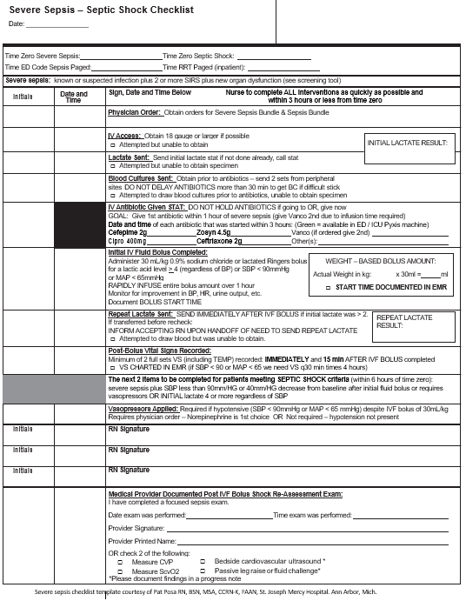
Severe Sepsis/ Septic Shock Checklist
What can we complete on the checklist?
Notes:
Where are we on the checklist?
We have IV access - 1215
Cultures have been sent - 1215
Antibiotic given - 1215
Fluids given/infusing - 1215

Slide 16
Repeat Lab Results (resulted at 1300)
Notes:
Do these labs tell us if pt. is improving and our interventions have been effective?
Lactate is normal
WBS and potassium are improved

Slide 17
1315 - After fluids and antibiotics
Clinical Scenario – Jim Garland
Vital Signs
  BP 80/44
  HR 116
  SpO2 96% on vent (FiO2 60%)
  RR 8
  CVP 4
Initial
Hemodynamic Monitoring
SV 40
CI 2.5
CO 4.6
SVV 30
SVI 22
Notes:
What other information do we need to determine if pt. is fluid responsive or needs more vasopressors?

Slide 18
Clinical Scenario – Jim Garland
Impression and interventions
Patient in septic shock
Passive leg raise or fluid bolus
Notes:
Ask participants to do a passive leg raise (PLR) (See Optimizing Fluid Management in Sepsis Patients)
What do you expect to see in the hemodynamics?

Slide 19
Clinical Scenario – Jim Garland
Vital Signs
  BP 96/40
  HR 125
  SpO2 95%
  RR 24
  CVP 8
Repeat Hemodynamic Monitoring after PLR
SV 42
CI 2.8
CO 5.2
SVV 31
SVI 24
Notes:
Does the patient need more fluid or an increase in vasopressor? Is the patient volume responsive?
Pt. is not fluids responsive; he needs additional vasopressor.
SVV only increased one point, not > 10 percent.

Slide 20
Severe Sepsis/ Septic Shock Checklist
What can we complete on the checklist?
Notes:
Have we completed the bundle?
Lactate and blood cultures drawn
Fluids and antibiotics given
Repeat lactate drawn
Vasopressors given
Documented reassessment of tissue perfusion

