Slide 1
Sepsis Table Top Scenario
Colorado Hospital Association
Notes:
Explain what the process will be for the table top exercise. For example:
What are the goals of the exercise?
Purpose is to walk through a case scenario
Supply the team with any documents that would be available to them in a real situation – e.g., sepsis checklist, order sets, etc.

Slide 2
Clinical Scenario – Rosie Jetson
Rosie Jetson is a 60-year-old female admitted two weeks ago for abdominal pain.
PMH:
History of metastatic ovarian cancer, status-post abdominal hysterectomy and bilateral salpingo-oophorectomy three years ago.
Subsequent exploratory laparotomy, lysis of adhesions, recto-sigmoid resection with primary anastomosis and removal of pelvic mass for recurrence.
Pt. developed an anastomotic stricture with progressive colonic obstruction requiring an endoscopic stent two weeks ago. Discharged to home following stent placement.
Pt. was readmitted for recurrent symptoms and underwent an exploratory laparotomy and loop colostomy yesterday. Admitted to med-surg unit.
Notes:
Labs drawn at 0700

Slide 3
Morning Labs (resulted at 0700)
Drawn on med-surg at 0600
CBC with differential |  | Reference Range
 |  | Male | Female
WBC | 2.3 | 4,500-10,111 K/uL
RBC | 2.32 | 4.5-5.5 M/uL | 4.0-4.9 M/uL
Hemoglobin | 7.1 | 13.5-16.5 g/dL | 12.0-15.0 g/dL
Hematocrit | 21.9 | 36.48%
Platelet | 220 | 140-450 K/mcL
MCV | 94 | 80-100 fL
MCHC | 32.4 | 32-36%
Neutrophil, absolute | 1.4 | 1.7-7.6 K/mcL
Lymphocyte, absolute | 0.5 | 0.8-5 K/mcL
Eosinophil, absolute | 0.0 | 0.0-0.7 K/mcL
Bands, absolute | 0.4 | 0.0-0.5 K/mcL
Basic Metabolic Panel |  | Reference Range
Sodium | 134 | 135-147 mmol/L
Potassium | 4.1 | 3.5-5.2 mmol/L
Chloride | 110 | 95-107 mmol/L
CO2 | 17 | 22-30 mmol/L
BUN | 13 | 7-20 mg/dL
Creatinine | 1.18 | 0.5-1.2 mg/dL
Glucose | 102 | 60-110 mg/dL
Calcium, total | 8.8 | 8.5-10.1 mg/dL
Notes:
Does anything stand out to you?
WBCs are low
Is there anything in her history that might be causing the low WBCs?
HGB and HCT are a little low
At what point would this patient need a transfusion?
What type of fluids should be used based on sodium level?
At this point the recommended fluid would be normal saline

Slide 4
Clinical Scenario – Rosie Jetson
0845
Vitals: BP 65/40, HR 93, RR 20, T 101.8°F
Labs: WBC 2.3
Pt. has developed hypotension
She is complaining of an urge to have a BM even though a colostomy is in place
Abdomen is distended and RN from med-surg unit reports increased firmness since the beginning of the shift
Urine output has only been 40 mL for the past eight hours
She has a peripheral IV with D5 NS with 20 meq KCL at 100 mL/hr
Weight is 62 kg
What is your assessment?
Notes:
You are part of the rapid response team (RRT) (or facility equivalent) that is called. This is your initial report.
Does the patient meet SIRS criteria?
Yes – patient has elevated HR, low WBC, temp
Does the patient have a suspected or confirmed infection?
Yes – surgical abdomen is distended and temp is elevated (presumed that something is going on in the abdomen post-surgery)
Does the patient meet severe sepsis criteria?
Yes – SIRS + suspected infection + organ dysfunction (SBP < 90 and decreased urine output)

Slide 5
Clinical Scenario – Rosie Jetson
0900 – 15 minutes later
A 1L bolus of NS was started
Blood was sent for cultures x2 and lactate
How long should it take for the liter bolus to infuse?
Notes:
The recommendation for the initial bolus is to infuse over 15-20 minutes (very quickly).
What is the most efficient way to make this happen? Use a pressure bag.

Slide 6
Clinical Scenario – Rosie Jetson
Current Medication List
Docusate 100 mg po BID – last given at 2100 yesterday
Heparin 5000 SQ q 8 hours – last given at 0600 this morning
IV: D5 NS with 20 meq KCL at 100 mL/hr
PRN
Zofran 4 mg given on med surg six hours ago
Toradol 15 mg IVP q 6 hours prn x 5 days (active); last given four hours ago
Notes:
Additional report while waiting for the bolus to infuse.

Slide 7
Clinical Scenario – Rosie Jetson
0920 – 20 minutes later
1L bolus has infused
Repeat vitals
BP 76/46
HR 90
RR 20
Lactate: 3.1
What are the next steps?
Notes:
Move to ICU (patient is still hypotensive).
Begin remaining fluids at 30 mL/kg.

Slide 8
What needs to be done in ICU to prepare for this admission?
Notes:
Talk through what team is thinking. Some suggestions for a sepsis huddle are on the next slide.
Encourage participants to describe what they would do.

Slide 9
Clinical Scenario – Rosie Jetson
Preparing for this admission:
Conduct a Sepsis Huddle
Get the right people in the room
Review history and current status
Discuss where patient is on sepsis continuum
Review what interventions have been completed
Identify priorities for when patient arrives
Provide sepsis checklist
Prepare the room
What does this look like?
Notes:
Who are the right people?
This will depend on your facility and the available resources; tailor the answer to your facility and resources.
What is the timeframe? How far into the three hours are we?
30-40 minutes into the three hour time frame
When is time zero for severe sepsis?
Time zero is 0845 (WBC, HR, temp, SBP < 90, suspected SSI)
Patient has received 1L NS and had blood cultures and lactate drawn.

Slide 10
Clinical Scenario – Rosie Jetson
0930 arrives in ICU
Vital signs
BP 65/40
HR 116
RR 20
SpO2 97% on 2L
How is the patient doing now?

Slide 11
What are the first interventions?
Notes:
Give targeted antibiotic
Ensure fluids are completed
Does the patient need central line access? Likely to need vasopressors, so yes.
What can we do to evaluate if she needs more fluid?
passive leg raise, fluid challenge

Slide 12
Clinical Scenario – Rosie Jetson
Patient is still hypotensive and tachycardic
Give 860 mL NS (to complete the 30 mL/kg fluid bolus)
Labs: consider complete metabolic panel, repeat CBC
Obtain order and give the antibiotic
VBG |  | Reference Range
pH | 7.3 | 7.30 – 7.40
CO2 | 38 | 42 – 48
PO2 | 176 | 35 – 45
HCO3 | 18 | 24 – 30
O2 Sat | 99.2
Notes:
We’ve called severe sepsis
The sepsis three-hour treatment bundle requires an initial lactate, blood cultures before antibiotics and a repeat lactate after the initial fluid bolus to re-evaluate tissue perfusion. Other labs may be warranted depending on patient condition, local protocols and time since previous labs.
In this case, they did a venous blood gas – what does it tell us?
Metabolic acidosis (would we expect this?) – patient has an elevated lactate, so yes.
Why would the PO2 and O2 Sat be so high on a venous blood gas – What happens to blood as it circulates through the body?
It picks up oxygen in the pulmonary system and drops it off at the tissue level. If it isn’t dropping the oxygen off and it returns to the right side essentially unchanged, do you think that is an issue?

Slide 13
Clinical Scenario – Rosie Jetson
1000 - Repeat vital signs
BP 80/42
HR 110
RR 16
SpO2 98% on 2L
Is the patient in septic shock?
What is time zero for septic shock?
Notes:
Have we fixed her? No, patient still has persistent or refractory hypotension after initial fluid bolus so Rosie is now in septic shock.
Classic definition of septic shock is severe sepsis (2 SIRS + organ dysfunction + an infection) with refractory hypotension after initial fluid bolus.
Time Zero - 1000

Slide 14
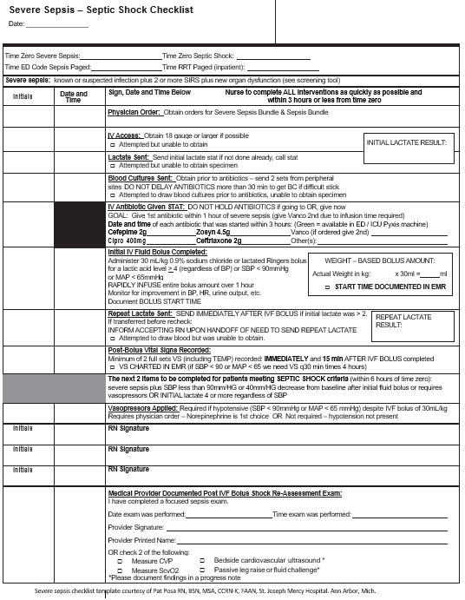
Severe Sepsis/ Septic Shock Checklist What can we complete on the checklist?
Notes:
The initial lactate was sent
Blood cultures have been drawn
Initial fluid bolus is complete
Gave antibiotic
Need to repeat lactate and start on vasopressors

Slide 15
Clinical Scenario – Rosie Jetson
What are your next steps?
Call physician to obtain orders for:
another liter of fluid
Levophed
Set up for an arterial line
Set up for a central line
Notes:
See also Optimizing Fluid Management in Sepsis Patients

Slide 16
Clinical Scenario – Rosie Jetson
It’s now 1100
BP 88/46 (arterial line inserted)
HR 96
RR 18
SpO2 sat 98% on 2L
Levophed started at 5 mcg/min
CVP 6 mmHg (central line inserted)
Notes:
What does a CVP of 6 tell you about the patient?
This is within the normal range of 4-8
What has your physical assessment told you?
Does the pt. still look dry?

Slide 17
Clinical Scenario – Rosie Jetson
Next Steps:
Need to determine if the patient needs more fluid or more vasopressor
Initial hemodynamic results:
CO 3.0, CI 2.8, SV 42, SVI 21, SVV 18
Does the patient need fluid or an increase in vasopressors? What information do you need?
Notes:
Assuming hemodynamic monitor is available . . .

Slide 18
Clinical Scenario – Rosie Jetson
Assess for fluid responsiveness
Fluid challenge OR
Passive leg raise (PLR)
What are the advantages of PLR (over a fluid bolus)?
Notes:
See also Optimizing Fluid Management in Sepsis Patients (for instructions on passive leg raise)
Advantages of a passive leg raise are that it mimics an actual fluid bolus without infusing additional fluids
But back to our dynamic measurements – next slide…

Slide 19
Clinical Scenario – Rosie Jetson
PRE – PLR results
POST – PLR results
CO 3.0
CI 2.8
SV 42
SVI 21
SVV 18
CO 3.4
CI 3.0
SV 60
SVI 27
SVV 16
Is this patient volume responsive?
©2019 CHA
Notes:
The goal for stroke volume is to see a 10 percent increase after the fluid challenge, this patient is fluid responsive.
So would give more fluids rather than increasing the vasopressors.

Slide 20
Severe Sepsis/ Septic Shock Checklist What can we complete on the checklist?
Notes:
Have we completed the bundle?

