Slide 1
Pediatric Sepsis Table Top Scenario
Colorado Hospital Association
Notes:
Explain what the process will be for the table top exercise. What are the goals of the exercise? A time to talk through what the team would do in the identified situation.
Supply the team with any documents available to them in a real situation – ie., sepsis checklist, order sets, transfer forms, etc.

Slide 2
Pediatric Sepsis Overview
Why is recognition of pediatric sepsis a challenge?
Needle in haystack effect: Many children have fever and tachycardia
SIRS criteria + suspected infection is not sensitive enough
Children present in compensated shock for a prolonged period
Why is recognition of pediatric sepsis critical?
Sepsis time-based bundle of care has shown improved outcomes in multiple studies
Care bundles start with first step of recognition
Notes:
Common signs and symptoms found in infant/children with sepsis include suspected infection plus fever or low temperature. A high level of suspicion should be maintained; once a patient develops organ dysfunction they now have severe sepsis. The goal is to treat aggressively early on to help prevent progression to organ dysfunction.
Pediatric patients can only increase their heart rate to maintain an adequate cardiac output; they have a lack of compensatory reserve.
Hypotension is not required in infants and children to be termed septic shock. The main presentation in pediatric septic shock is hypotension; remember most pediatrics patients compensate with tachycardia. Once they develop hypotension this is a late finding and you need to act rapidly to treat it.

Slide 3
Pediatric Sepsis Overview
Age Dependent SIRS Criteria

Slide 4
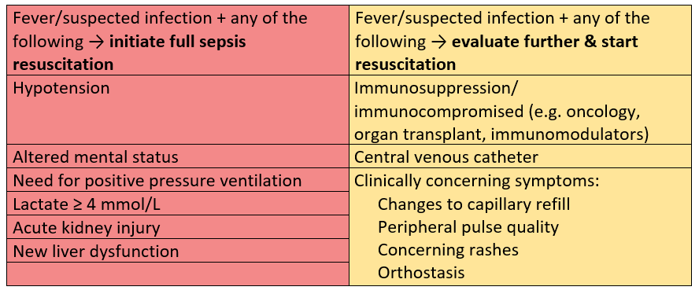
Pediatric Sepsis Recognition
Fever/hypothermia/suspected infection:
Always ask your team: “Is this sepsis?”
Notes:
On the left in red: patient has organ dysfunction and needs an immediate full resuscitation (next slide)
On the right in yellow: patient “may” have sepsis; evaluate and target resuscitation. Should immediately move to full sepsis resuscitation if any of signs or symptoms on the red side develop.

Slide 5
Pediatric Sepsis Care Bundle American Collage of Critical Care Medicine Pediatric Sepsis Guidelines
Bundle Element | Goal of Care
Recognition | ASAP and at latest within 5 minutes of organ dysfunction onset
Vascular access | Within 5 minutes of recognition
Fluid resuscitation | Begins within 10 minutes of recognition
Broad-spectrum IV antibiotics | Administered within 60 minutes of recognition
Do not tolerate hypotension | Resolution of hypotension within 60 minutes of recognition
Notes:
The importance of recognition is highlighted in that the rest of the bundle of care can not take place without recognition. Also start to determine disposition immediately when recognition is made.
IV access can be very difficult in pediatric sepsis patients. Consider alternative access options early.
Fluid resuscitation should begin as soon as possible. Normal saline or lactated ringers (LR) are both appropriate choices. Push-pull or pressure bag boluses are appropriate for (compensated) shock. For suspicion of sepsis without shock pump fluids can be considered. There is some evidence that LR is beneficial, but note it cannot be administered in the same line at the same time as ceftriaxone in children.
Broad-spectrum antibiotics delivered within 1 hour of recognition is key. Ensure antibiotics are broad; they can be narrowed later. Usually ceftriaxone and vancomycin are the preferred combination. Cefepime in patients with central lines or risk for pseudomonal infections. Consider addition of Flagyl if intra-abdominal or anaerobic source is suspected. Consider addition of clindamycin if toxic shock syndrome is suspected. Do not delay antibiotics (not for imaging, lumbar puncture, transport, etc.). Occasionally it is exceedingly difficult to obtain vascular access in pediatric patients; in this case consider IM cephalosporin if you are approaching the 60-minute mark.
Previous pediatric advanced life support (PALS) recommendations were 60 ml/kg prior to consideration of vasopressors. Now evidence shows that the “right” amount of fluid is unknown and the major principle to improve outcomes is non-tolerance of hypotension. If hypotension persists despite aggressive fluid resuscitation then start a vasopressor agent early, even before 60 ml/kg.
Davis AL, Carcillo JA, Aneja RK, Deymann AJ, Lin JC, Nguyen TC, et al. American College of Critical Care Medicine Clinical Practice Parameters for Hemodynamic Support of Pediatric and Neonatal Septic Shock. Critical care medicine. 2017;45(6):1061-1093.

Slide 6
Pediatric Sepsis Pearls
Maintain a high level of vigilance: Suspect and evaluate sepsis in patients who seem sicker than average
Provide aggressive time-based resuscitation according to the pediatric sepsis care bundle
Do not delay broad-spectrum antibiotics
Do not tolerate hypotension, treat aggressively
Look for organ dysfunction in all organ systems
Determine disposition early

Slide 7
Clinical Scenario

Slide 8
Clinical Scenario
Three-year-old male arrived in the ED having been sent from his pediatrician’s office with viral bronchiolitis due to human meta-pneumovirus diagnosed 4 days ago by nasal wash.
Patient transferred due to severe increased work of breathing, tachycardia, desaturations (down to 60%, requiring a non-rebreather mask) and high-grade fevers.

Slide 9
Clinical Scenario
Within hours of admission to the pediatric unit, the patient began experiencing worsening episodes of desaturation.
03:29: BP 122/71, HR 186, RR 32, SpO2 90% RA, T 40.1°C
04:00: BP 119/70, HR 205, RR 31, SpO2 98% 15 L HFNC
The patient was switched from heated high flow oxygen to CPAP.
What do you need to do?
Notes:
Do we have 2 SIRS criteria? Yes. High temperature; HR and RR elevated for age
Do we have a known or suspected infection? Yes, confirmed human meta-pneumovirus
So is sepsis present? Yes. 2 SIRS and known infection.
Do we have organ dysfunction? Yes, new CPAP requirements. Therefore he is now in severe sepsis.
What do you need to do?
Notify MD immediately if not already at bedside and call pediatric sepsis alert if in place at your facility
Record the time severe sepsis was identified as time zero, so all providers are working on the same clock
What elements of the bundle need to be completed first?
Assess airway and need for advanced airway
Establish 2 peripheral IVs (PIV)
Draw blood cultures and labs (from PIV insertion if possible)
Initiate abx therapy? Discuss with MD if antibiotics are indicated in this case since there is a known viral etiology. However anticipate a broad-spectrum antibiotic being ordered due to the risk of a secondary bacterial infection.

Slide 10
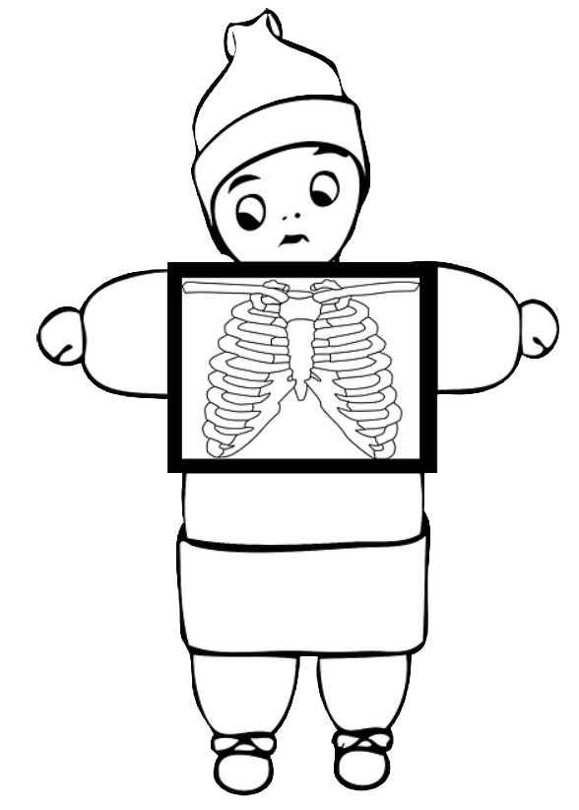
Imaging
Radiology
Moderate right pleural effusion. Diffuse hazy infiltrates throughout both lungs with suggestion of more social opacity at the right lung base. Possible pneumonia.
Notes:
Second identification of an infection source

Slide 11
Labs
Drawn in ED
CBC with differential |  | Reference Range
WBC | 1.8 | 4,500-10,111 K/uL
Hemoglobin | 12 | 13.5-16.5 g/dL
Hematocrit | 34.4 | 36.48%
Platelets | 100 | 250,000-450,00 uL
Bands, absolute | 0.4 | 0.0-0.5 K/mcL
Basic Metabolic Panel |  | Reference Range
Glucose | 62 | 60-110 mg/dL
Potassium | 4.1 | 3.5-5.2 mmol/L
Creatinine | 0.5 | 0.5-1.2 mg/dL
BUN | 26 | 7-20 mg/dL
Lactate | 2.2 | 0-1 mmol/L
Procalcitonin | >200 | 0-0.15 ng/mL
CRP | 17.3 | 0-1 mg/L
pH | 7.08 | 7.35-7.45
CO2 | 62 | 22-30 mmol/L
02 | 21 | 7-20 mg/dL
Notes:
Does anything stand out to you?
High procalcitonin indicating a possible bacterial infection.
C-Reactive Protein is a biomarker indicating general inflammation, especially in neonates. This can be an early indicator of stress in an undeveloped immune system.
Low WBCs, signal decline of the bone marrow’s ability to mount a immunological defense.
Other signs of organ dysfunction?
Lactate > 2 indicates tissue hypo-perfusion
Elevated BUN signals compromised kidney function

Slide 12
Clinical Scenario
The patient continued to decompensate and was soon intubated.
04:25: BP 123/78, HR 203, RR 52, SpO2 94% CPAP
05:00: BP 116/75, HR 184, RR 54, SpO2 94% CPAP
05:30: BP 115/84, HR 188, RR 54, SpO2 85%
Intubation, 100% FiO2, T 38.0°C
Weight: 15 kg
What interventions do you anticipate now?
Notes:
Children compensate with high cardiac output (ie HR) for prolonged periods until they can’t anymore and then they have no further compensatory systems to use, so act early to prevent systemic collapse.
What do you need to do NOW?
Initiate fluids bolus, if not already started. Although this patient is not hypotensive by definition yet, their vitals signs have been trending down, so initiate fluid resuscitation preventatively
Trend vitals every 5 minutes to monitor for rapid changes of condition
Notify PICU or nearest pediatric hospital of likely admission, due to need for critical care management

Slide 13
Clinical Scenario
Further assessment found that the patient’s neurological status had changed and he was no longer responsive to painful stimuli. He also began to have peaked T-waves on EKG.
06:30: BP 92/60, HR 103, RR 36, SpO2 92% Vent 100% FiO2
06:45: BP 70/34, HR 117, RR 28, SpO2 91% Vent 100% FiO2
07:00: BP 89/74, HR 183, RR 30, SpO2 90% Vent 100% FiO2
07:15: BP 71/28, HR 159, RR 27, SpO2 88%, T 35.1°C
Notes:
The recommendation for bolus infusions is 20 ml/kg over 15-20 minutes (very quickly). If there is persistent hypotension repeat 20 ml/kg over 15-20 minutes
What is the most efficient way to administer these fluids?
Use a 3-way stop cock using the pull-push method and a 60 ml syringe (or the largest available syringe)
!!! Start vasopressor early for fluid refractory hypotension

Slide 14
What needs to be done to prepare for this ICU admission or transfer to a higher level of care?
Notes:
Suggestions for a sepsis huddle are on the next slide. Encourage participants to describe what they would do.

Slide 15
Preparing for Admission or Transfer
Conduct a sepsis huddle
Get the right people in the room
Review history and current status
Discuss where patient is on sepsis continuum
Review what interventions have been completed (review the checklist for completion)
Identify priorities for when patient arrives
Notes:
Who are the ‘right’ people? This will depend on your facility and the available resources; tailor the answer to your facility and resources
Where is the patient on the sepsis continuum and what needs to be completed?
Patient has received 1 liter NS (> 40 ml/kg, adequate as 20 ml/kg x2), blood cultures and a lactic acid drawn
What are the priorities?
Initiate vasopressors (place central line if needed), complete antibiotics, respiratory support
When is time zero? What is our timeframe? How far into the hours are we?
Time zero is 0425 with identification of organ dysfunction in the presence of sepsis. We are 2 hours and 50 minutes into the resuscitation.

Slide 16
Pediatric “Treat Before Transfer” Checklist
Initiate immediately on recognition or suspicion of sepsis | Start time
Administer oxygen, secure airway, intubate if necessary
Vital signs and reassessment of patient every 5 minutes
Establish IV/IO access, 2 large bore, if possible
Ensure collection of blood cultures and lactate level (do NOT delay antibiotics >30 minutes if unable to obtain cultures) Labs to consider: UA/urine cx, procalcitonin, CRP, CBC auto, CMP
Administer broad spectrum antibiotics STAT (based on probable source) * Always give primary agent first. Do not delay transfer for secondary agent infusion; give in route if possible
If hypo-perfusion present, administer rapid 20ml/kg NS or LR bolus Repeat x1 if hypo-perfusion is persistent Signs of hypo-perfusion include: low SBP (see age-based ranges on back), tachycardia, pale skin, delayed capillary refill, mottling
*** Notify accepting facility and transferring service ASAP ***
What can be completed on the checklist?
Notes:
If the patient needs a higher level of care, alert the transfer or access center to arrange transport and notification of the accepting facility STAT. Then prepare the patient for transfer by completing checklist elements. Communication of completed bundle elements is essential for proper continuation of sepsis care.

Slide 17
Clinical Scenario
07:30 - Code blue
Outcome:
Despite multiple interventions to stabilize him and aggressive resuscitation, the patient passed away.
Post-mortem pathologic exam revealed Group A Strep in his cerebrospinal fluid. That, coupled with the patient’s respiratory compromise suggest overwhelming sepsis related to both a viral and bacterial process.
The patient’s final diagnosis was sepsis with septic shock and bacterial meningitis.

Slide 18
Questions and Discussion

Slide 19
References
ACLS-Algorithms (2018). Pediatric Advanced Life Support Review Septic Shock [website]. Retrieved from https://acls-algorithms.com/pediatric-advanced-life-support/pediatric-shock-overview-part-1/septic-shock/
Biban, P., Gaffuri, M., Spaggiari, S., Zaglia, F., Serra, A., & Santuz, P. (2012). Early recognition and management of septic shock in children. Pediatric reports, 4(1), e13. doi:10.4081/pr.2012.e13
Cardiovascular Physiology and Shock. (2018). In Waldhausen, J., Powell, D., & Hirschl, R. (Eds.), Pediatric Surgery NaT. Available from https://www.pedsurglibrary.com/apsa/view/Pediatric-Surgery-NaT/829023/all/Cardiovascular_Physiology_and_Shock
Chiarello P1, M. M. (2016, DEC). US National Library of Medicine. Retrieved from Pubmed.org: https://www.ncbi.nlm.nih.gov/pubmed/22075805
Davis AL, Carcillo JA, Aneja RK, Deymann AJ, Lin JC, Nguyen TC, et al. American College of Critical Care Medicine Clinical Practice Parameters for Hemodynamic Support of Pediatric and Neonatal Septic Shock. Critical care medicine. 2017;45(6):1061-1093
Giuliano Jr, J (Interviewer), Polikoff, L and Weiss, S (Interviewees). (2017). Management of Sepsis in the PICU: Biomarker-Based Approaches [Interview video]. Retrieved from Medscape website: http://www.Medscape.org/viewarticle/876833

Slide 20
References
Guzman-Cottrill, J., Cheesebrough, B., Nadel, S., Goldstein, B. The Systemic Inflammatory Response syndrome (SIRS), Sepsis, and Septic Shock. Retrieved on August 31, 2018 from https://www.macpeds.com/documents/13LongChap11-septicshock.pdf
Hirasawa, H., Oda, S., & Nakamura, M. (2009). Blood glucose control in patients with severe sepsis and septic shock. World journal of gastroenterology, 15(33), 4132–4136. doi:10.3748/wjg.15.4132
Hackethal, Veronica, MD. (July 2018). Sepsis Survival Higher in Kids with Quick Bundle Completion. Medscape. Retrieved from www.Medscape.com/viewarticle/899743
Jat, K. R., Jhamb, U., & Gupta, V. K. (2011). Serum lactate levels as the predictor of outcome in pediatric septic shock. Indian journal of critical care medicine : peer-reviewed, official publication of Indian Society of Critical Care Medicine, 15(2), 102–107. doi:10.4103/0972-5229.83017
Stoney Brook. (2006, OCT 20). Site Collection Documents. Retrieved from Surviving Sepsis: http://www.survivingsepsis.org/SiteCollectionDocuments/Protocols-Pediatric-ICU-Screening-Tool.pdf From Stoney Brook
University of California San Francisco Benioff Children's Hospital. (2011, February 10). Tests. Retrieved from C-Reactive Protein: https://www.ucsfbenioffchildrens.org/tests/003356.html

