Slide 1
Chapter 4 Regulations Explained
Spring 2022
Presentation prepared by Colorado Hospital Association
(approved for rebranding by member hospitals and health systems)

Slide 2
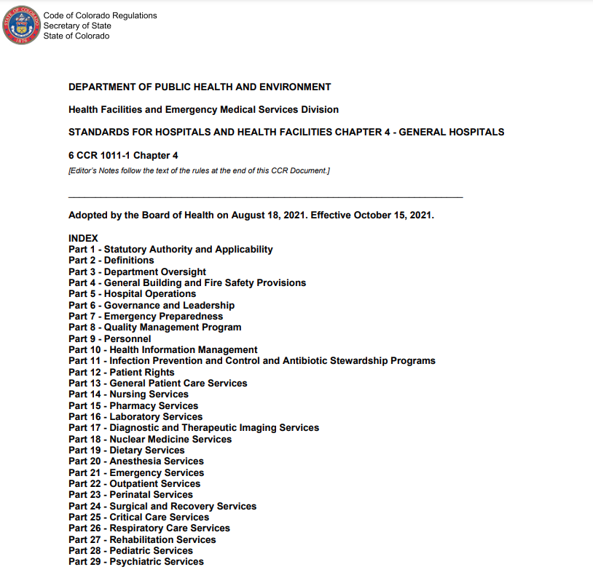
What Are Chapter 4 Regulations?
Vast set of regulatory standards specific to hospitals
Includes 29 sections, covering everything from building and fire safety provisions to patient rights
Overseen by a state government agency

Slide 3
State Regulatory Oversight in Health Care
Colorado Department of Public Health and Environment (CDPHE)
State government agency
Health Facilities and Emergency Medical Services Division (HFEMSD)
CDPHE division
Standards for Hospitals and Health Facilities
Regulatory standards overseen by HFEMSD
Chapter 4
Section that focuses on “General Hospitals”
(i.e., acute care hospitals)

Slide 4
Recent Revisions to Chapter 4 Regulations
Recent revisions to Chapter 4 regulations focused on Nursing Services section
Goal of revisions:
Address workforce challenges while ensuring continued quality in patient care
Resulted in significant changes that:
Set a standard for nurse staffing
Ensure the ability of frontline nurses to contribute to decision making through shared governance
Provide flexibility for hospitals to meet unique needs

Slide 5
Intention of Recent Chapter 4 Revisions
Empower nurses
Set standards
Increase oversight

Slide 6
Chapter 4 Empowers Nurses
Creates new rules requiring hospitals to develop and implement a master nurse staffing plan using a staffing committee model with at least 50 percent of the members being frontline nurses
Requires nurse leaders to share unit-based master nurse staffing plans with each nursing employee annually
Provides an avenue for nursing staff to raise concerns through an anonymous report to CDPHE if they feel that their work environment is unsafe or impacting quality of care

Slide 7
Chapter 4 Sets Standards
Increases the minimum staffing requirement to one nurse and one auxiliary staff on duty in each open inpatient care unit and adds the Emergency Department to the regulation for the first time
Note: Critical Access Hospitals (CAHs) are exempt from these staffing requirements, as CAHs are governed instead by federal staffing regulations (Chapter 4 regulations may still be used as “best practice” guidance for exempt facilities)
Adds a requirement that each open inpatient care unit within a hospital must have a 24-hour nurse staffing plan
Updates language to require that a master nurse staffing plan includes 24-hour continuous registered nurse coverage, distribution of nursing and auxiliary personnel, and forecasting future needs

Slide 8
Chapter 4 Increases Oversight
Requires that master nurse staffing plans and annual reports on staffing and patient outcomes are provided to CDPHE upon request
Requires that an annual report with patient and staff outcomes is made to the hospital governing body on the master nurse staffing plan
Details that hospitals found to be out of compliance with statute or regulations will be cited and must take corrective action; further noncompliance or subsequent deficiencies could result in actions against a hospital’s license

Slide 9
A Few More Details
Recent revisions are the result of a collaborative effort led by the Colorado Hospital Association, Colorado Nurses Association, Colorado Organization of Nurse Leaders, and CDPHE.
While the stakeholder process took place in 2020, the new rules didn’t go into effect until October 2021.
Learn more:
CDPHE website
Chapter 4 regulations

